Slide 1
Looking Forward
~ Looking Forward in Faith ~
Monday 30th January 2023
Brentwood Diocese Education Service

Slide 2
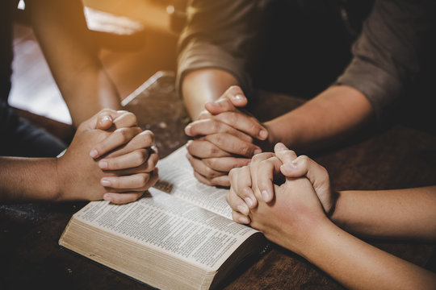
Looking Forward in Faith
Father God, open my eyes,
not to see the world more clearly,
but to see You.
Open my eyes to see you
working around me and in me.
Nothing happens by accident.
You orchestrate every day of my life.
Allow me to see your hand
in the ordinary and the amazing.
Help me to trust in what I cannot see,
and believe in Your invisible presence.
“For we live by faith not by sight.” (2 Corinthians 5 : 7)
BDES

Slide 3
In Sunday’s Gospel Reading
29th January 2023
In the Gospel of Matthew, Jesus tells us :
“Blessed are the peacemakers, for they will be called children of God.”
BDES

Slide 4
BDES

Slide 5
Preparing for World Youth Day 2023
“Youth is for taking risks,
good risks,
risks full of hope.”
- Pope Francis,
Convocation of the
Renewal in the Holy Spirit,
2014
BDES

Slide 6
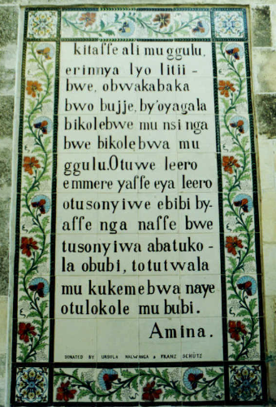
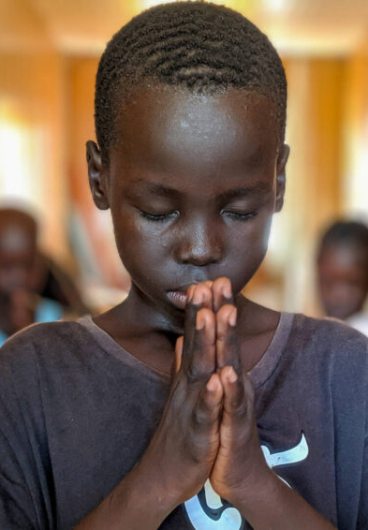
The Lord’s Prayer
As we look forward to World Youth Day in August this year, we remind ourselves of the things we share with our fellow Christians from all over the world. At this international event, Catholics will pray the prayer Jesus taught us in a huge number of languages. This week we have chosen the prayer in Luganda, a language from the African Great Lakes region with 21 million speakers.
BDES

Slide 7
Memorial of St. Blaise ~ 3rd February
In the General Calendar on 3rd February is the memorial of St Blaise : it is permitted to bless throats with unlit candles using the following prayer. “Through the intercession of St Blaise, Bishop and Martyr, may God free you from disease of the throat and from every other evil, in the name of the Father, and of the Son, and of the Holy Spirit, Amen.
xxx(from the Brentwood Diocesan Directory, 2023)
Blaise was a hard-working bishop dedicated to encouraging the spiritual and physical health of his people in Sebastea, Armenia. Although the Edict of Toleration which granted freedom of worship in the Roman empire had been signed five years previously, religious persecution still raged in the country. According to a legend, a mother came to him with her young son who had a fish bone lodged in his throat. At Bishop Blaise's command, xxxxxxxx the child coughed up the bone. In 316 he was beheaded for not sacrificing to the pagan gods.
BDES

Slide 8
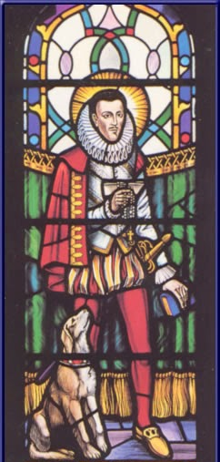
MARTYRS OF ENGLAND AND WALES
Philip was the earl of Arundel and Surrey and, although from a Catholic family, was largely indifferent to religion until his personal conversion, after which he became an enthusiastic Catholic in the midst of Elizabethan England. Arrested by authorities, he was placed in the Tower of London in 1585 and condemned to death in 1589. Although the sentence was never carried out, Philip suffered 10 years’ imprisonment in the Tower until he died of dysentery at the age of thirty eight. Beatified in 1929, he was included among the English martyrs canonized in 1970 by Pope Paul VI.
St Philip Howard (1557 – 1595)
BDES

Slide 9
Looking Forward
~ Looking Forward in Faith ~
Monday 30th January 2023
Brentwood Diocese Education Service

