Slide 1
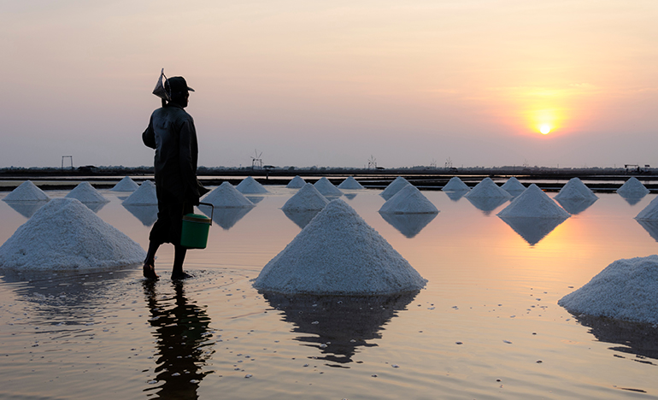
Looking Forward
~ Looking Forward in Faith~
Monday 6th February 2023
Brentwood Diocese Education Service

Slide 2
Looking Forward in Faith
Sunday 12th February is Racial Justice Sunday.
This year sees the 30th anniversary of the death of Stephen Lawrence, an event which still resonates today.
The Churches Together in Britain and Ireland ask us to Remember, Reflect and Respond.
The Franciscan Blessing on the next slide comes from the resources for Racial Justice Sunday.
BDES

Slide 3
Looking Forward in Faith
May God bless you with discomfort
At easy answers, half-truths and superficial relationships,
So that you may live deep within your heart.
May God bless you with anger
At injustice, oppression and exploitation of people,
So that you may work for justice, freedom and peace.
May God bless you with tears
To shed for those who suffer pain, rejection, hunger and war,
So that you may reach out your hand to comfort them
And turn their pain into joy.
And may God bless you with enough foolishness
To believe that you can make a difference in the world,
So that you can do what others claim cannot be done
To bring justice and kindness to all our children and the poor.
Amen
BDES

Slide 4
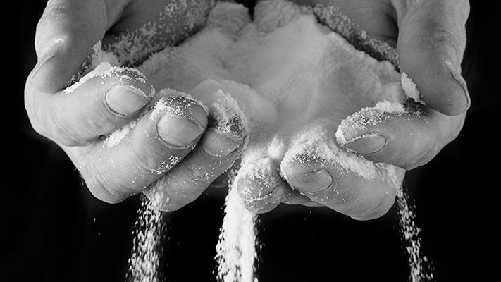
The Synoptic Problem
In Sunday’s Gospel Reading …
Sunday 5th February 2023 :
In the Gospel of Matthew, Jesus says :
“You are the salt of the earth.”
BDES

Slide 5
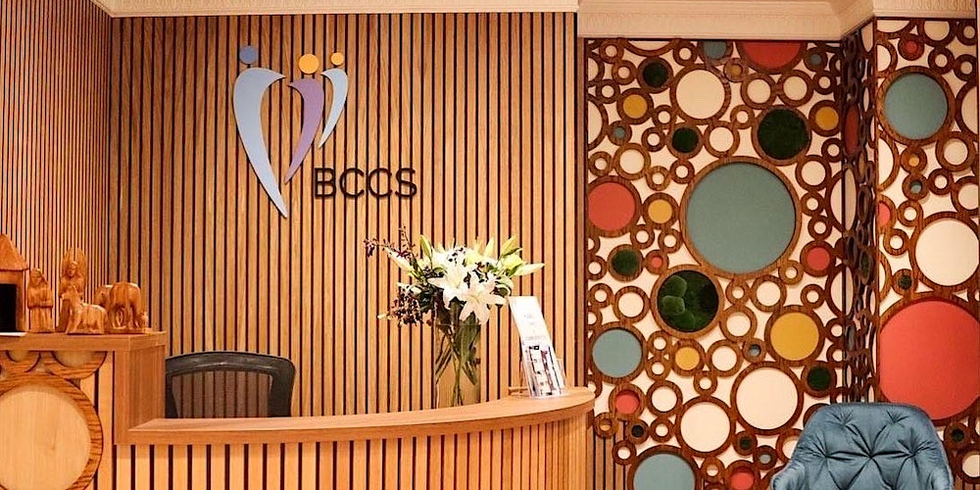
Children’s Mental Health Week
We pray for the Brentwood Catholic Children’s Society in their new building in Billericay.
May God continue to bless them for all the wonderful work they do in bringing light into the lives of young people and their families.
6th – 12th February 2023
BDES

Slide 6
Children’s Mental Health Week
God of Compassion,
Silence the voices that say we are not good enough,
Haven’t achieved enough, Haven’t enough to show for our lives, That we are not enough.
Help us to know that we are treasure.
We are prized.
We are cherished.
We are loved.
Infinitely.
By you.
6th – 12th February 2023
BDES

Slide 7
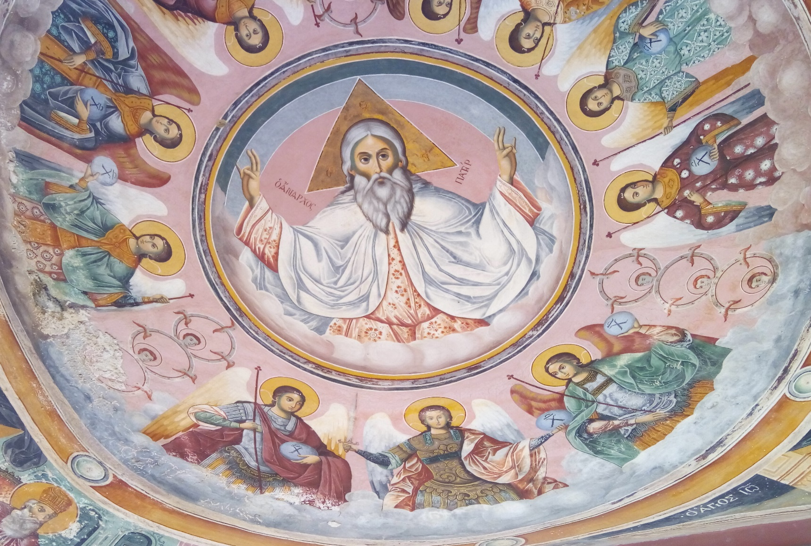
The Lord’s Prayer
Отче наш, Ти що єси на небесах, нехай святится ім'я Твоє, нехай прийде царство Твоє, нехай буде воля Твоя, як на небі, так і на землі. Хліб наш насущний, дай нам, днесь, і прости нам довги наші, як і ми прощаємо довжникам нашим і не введи нас у спокусу, а ізбави нас від лукавого. Бо Твоє є царство, і силa і слава, на віки. Амінь.
Отче наш, Иже еси на небесех! Да святится имя Твое, да приидет Царствие Твое, да будет воля Твоя, яко на небеси и на земли. Хлеб наш насущный даждь нам днесь; и остави нам долги наша, якоже и мы оставляем должником нашим; и не введи нас во искушение, но избави нас от лукаваго.
As we look forward to World Youth Day in August this year, we remind ourselves of the things we share with our fellow young people from all over the world. At this international event, Catholics will pray the prayer Jesus taught us in a huge number of languages. We will mark this with a weekly inclusion of the Lord’s Prayer in the languages spoken in our schools.
This week the Lord’s Prayer is in Ukrainian and Russian
BDES

Slide 8
Preparing for World Youth Day 2023
“Youth is meant to help others know the Lord.”
- Pope Francis, Convocation of the Renewal in the Holy Spirit, 2014
BDES

Slide 9
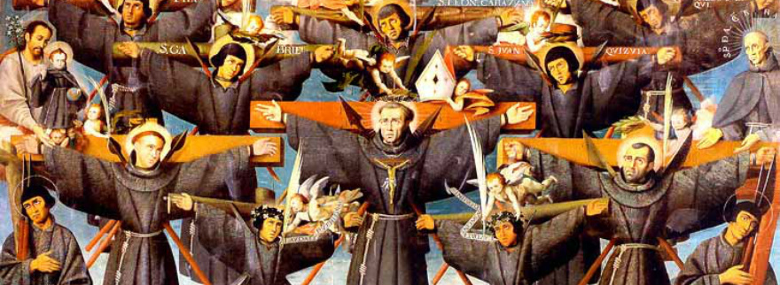
St Paul Miki & Companions:
6th February
Paul Miki was born into a wealthy Japanese family. He was educated by the Jesuits and joined them becoming a well known and successful preacher – gaining numerous converts to Catholicism. The ruler of Japan began persecuting Catholics for fear of the Jesuits' influence and intentions.
Miki was arrested and jailed with his fellow Catholics, who were later forced to march 966 kilometres (600 miles) from Kyoto to Nagasaki; all the while singing the Te Deum. He was crucified, preaching his last sermon from the cross, and it is maintained that he forgave his executioners. Crucified alongside him were Joan Soan (de Gotó) and Santiago Kisai, also of the Society of Jesus; along with twenty-three other clergy and laity, all of whom were canonized by Pope Pius IX in 1862. When missionaries returned to Japan in the 1860s, at first they found no trace of Christianity. But xx after establishing themselves they found that thousands of Christians lived around Nagasaki and that they xxxxxxxxxx had secretly preserved the faith.
BDES

Slide 10
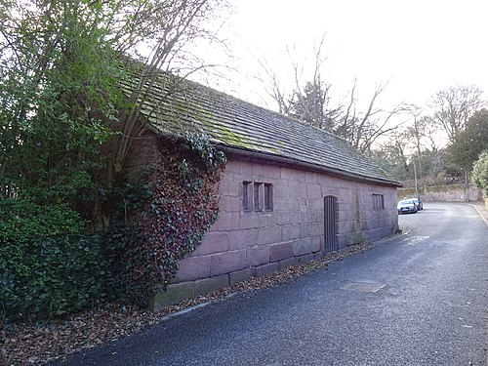
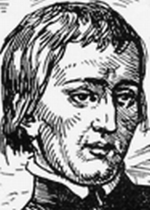
Martyrs of England and Wales : John Almond
John Almond was born 1577 in Allerton, Liverpool, and spent his childhood there and at Much Woolton, Lancashire (now Woolton, Liverpool) until at the age of eight. It is reputed that he was a student in the old school building which can be found in School Lane, Woolton, before he was taken to Ireland.
He went to the English College in Rome, at the age of twenty, where he was ordained as a priest, returning to England as a missionary in 1602.
He was arrested in 1608, and then again in 1612. In November 1612, seven priests escaped from prison.
Before his death, he prayed, distributed alms to the poor, and gave his final oration, concluding with these words: "To use this life well is the pathway through death to everlasting life". During his final speech on the scaffold he condemned regicide (killing a king), discussed the nature of grace and true repentance, and said that he conceded as much authority to King James as to any Christian prince.
John Almond was hanged, drawn, and quartered on 5 December 1612 at Tyburn, London.
BDES

Slide 11
Looking Forward
~ Looking Forward in Faith~
Monday 6th February 2023
Brentwood Diocese Education Service

