Slide 1
Looking Forward
~ Looking Forward in Charity ~
Monday 20th February 2023
Brentwood Diocese Education Service

Slide 2
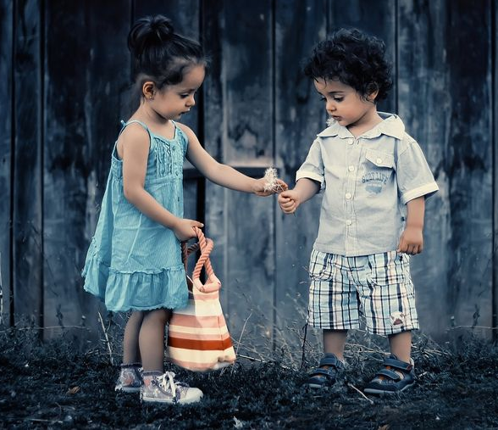
Looking Forward in Charity
Lord Jesus,
You came to teach us how to love one another
and how to be good stewards of Your many gifts.
You gave us new values
by which to measure our lives.
It is only by generously sharing ourselves
and our God-given gifts
that we find true joy and peace.
Help us to be a blessing for
all those we meet.
BDES

Slide 3
In Sunday’s Gospel Reading
19th February 2023
In the Gospel of Matthew, Jesus tells us :
“Love your enemies and pray for those who persecute you.”
BDES

Slide 4
Day of Prayer for the Unemployed
The Sunday before Lent has been kept by all the churches as a special Day of Prayer for the Unemployed in this country for over twenty years.
Heavenly Father,
we remember those who suffer
want and anxiety from lack of work.
Guide the people of this land
to use our public and private wealth
that all may find suitable and fulfilling employment,
and receive just payment for their labour.
Through Jesus Christ our Lord.
BDES

Slide 5
22nd February 2023
BDES

Slide 6
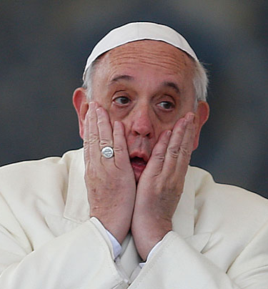
IDEAS FOR YOUR LENTEN FAST
Fast from hurting words, and say kind words.
Fast from sadness, and be filled with gratitude.
- attributed to Pope Francis

Slide 7
Preparing for World Youth Day 2023
“Don’t keep your youth to yourselves : get out there!”
Pope Francis,
Convocation of the
Renewal in the Holy Spirit,
2014
BDES

Slide 8
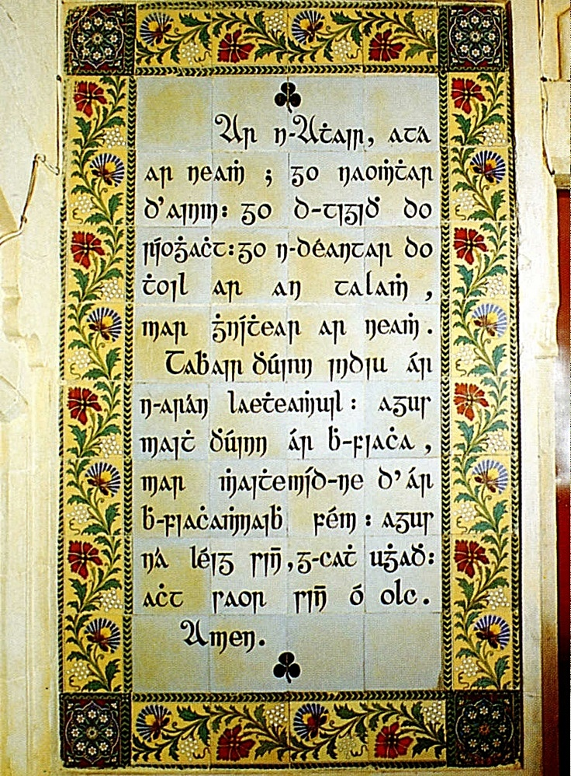
The Lord’s Prayer
As we look forward to World Youth Day in August this year, we remind ourselves of the things we share with our fellow Christians from all over the world. At this international event, Catholics will pray the prayer Jesus taught us in a huge number of languages. This week we have chosen the prayer in Irish.
Ár nAthair, atá ar neamh, Go naofar d’ainm, Go dtaga do ríocht, Go ndéantar do thoil ar an talamh, Mar a dhéantar ar neamh. Ár n-arán laethúil tabhair dúinn inniu; Agus maith dúinn ár bhfiacha, Mar a mhaithimidne dár bhféichiúna féin. Agus ná lig sinn i gcathú, Ach saor sinn ó olc. Áiméan.
BDES

Slide 9
St Peter Damian ~ 21st February
On Feb. 21, Catholics honour Saint Peter Damian, a Benedictine monk who strove to purify the Church during the early years of its second millennium.
Speaking about the saint in his general audience on 9th September 2009, Pope Benedict XVI described him as “one of the most significant figures of the 11th century ... a lover of solitude and at the same time a fearless man of the Church, committed personally to the task of reform.”
Peter was born in Ravenna in Italy in 1007. As a young man, he joined the Order of St Benedict in a community which lived mainly on bread and water and prayed all 150 Psalms every day. He became a skilled preacher and was invited to other monasteries to inspire their communities. He reluctantly agreed to being appointed a bishop xxxxx and supported popes through difficult times. He was allowed to resign and return to monastic life in 1067.
BDES

Slide 10
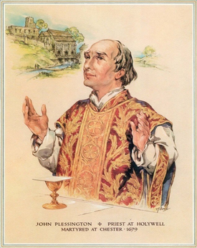
MARTYRS OF ENGLAND AND WALES
John was born into a Catholic family in Lancashire and went abroad to Spain and France to train as a priest. He then returned to England to minister to secret Catholics at Holywell and in Cheshire. For 16 years he lived undercover, under the name John Scarisbrick. In 1679 he was arrested during the Popish Plot scare caused by the infamous Titus Oates, sentenced to death for being a Catholic priest, and executed at Chester.
He was beatified by Pope Pius XI in 1929 and canonised as one of the Forty Martyrs of England and Wales by Pope Paul VI on 25th October 1970.
St John Plessington (1637 – 1679)
BDES

Slide 11
Looking Forward
~ Looking Forward in Charity ~
Monday 20th February 2023
Brentwood Diocese Education Service

