Slide 1
Looking Forward
~ Looking Forward in Charity~
Monday 27th February 2023
Brentwood Diocese Education Service

Slide 2
Looking Forward in Charity
This Sunday was the First Sunday of Lent
Following on from Ash Wednesday and the gospel of the temptations, have you spent some time thinking about your Lenten practices.
If you haven’t done so already, make a commitment for prayer, fasting, and almsgiving.
If your choices don’t seem challenging, consider changing them to something a little more difficult. Don’t set yourself up for failure though.
Your Lenten promises should be challenging, but not impossible.
BDES

Slide 3
Looking Forward in Charity
Lenten Thoughts
Fast from anger and be filled with patience.
Fast from pessimism and be filled with love
BDES

Slide 4
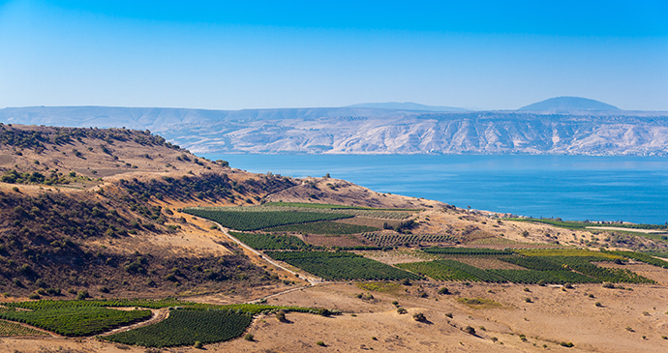
In Sunday’s Gospel Reading …
Sunday 26th February 2023 :
In the Gospel of Matthew, Jesus says :
“The Lord your God shall you worship and him alone shall you serve.”
BDES

Slide 5
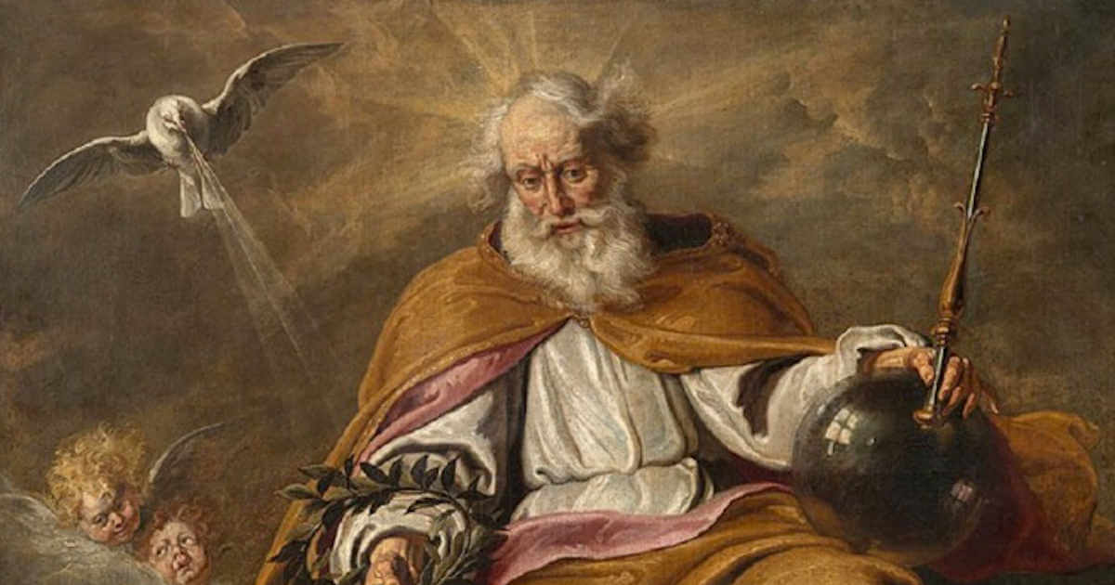
The Lord’s Prayer
Lạy Cha chúng con ở trên trời, chúng con nguyện danh Cha cả sáng, nước Cha trị đến, ý Cha thể hiện dưới đất cũng như trên trời. Xin Cha cho chúng con hôm nay lương thực hằng ngày và tha nợ chúng con như chúng con cũng tha kẻ có nợ chúng con. Xin chớ để chúng con sa chước cám dỗ, nhưng cứu chúng con cho khỏi sự dữ.
Amen
As we look forward to World Youth Day in August this year, we remind ourselves of the things we share with our fellow young people from all over the world. At this international event, Catholics will pray the prayer Jesus taught us in a huge number of languages. We will mark this with a weekly inclusion of the Lord’s Prayer in the languages spoken in our schools.
This week the Lord’s Prayer is in Vietnamese
BDES

Slide 6
Preparing for World Youth Day 2023
“Ask the Lord to give us the grace to be merciful to those who do us wrong.”
- Pope Francis, World Youth Day, 2016
BDES

Slide 7
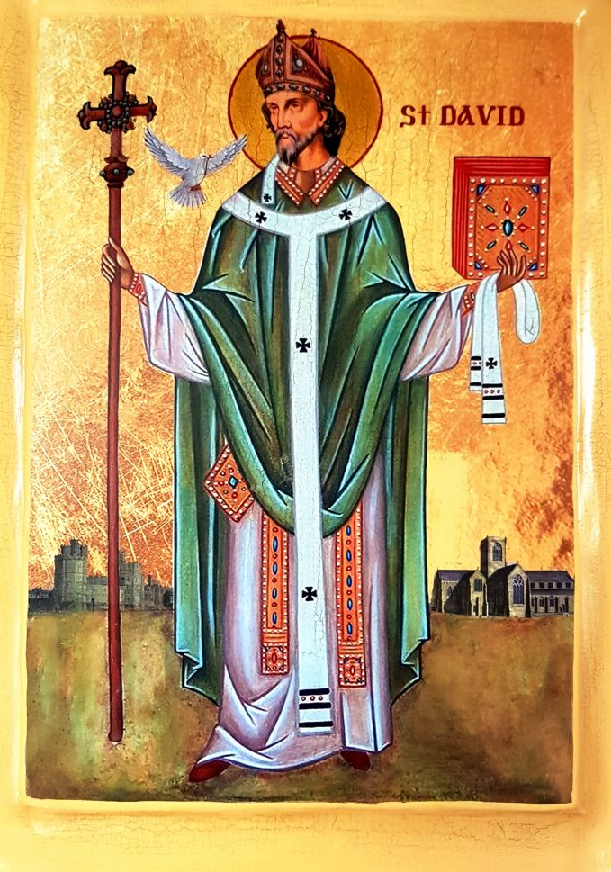
Saint
David
Feast day :
1st March
“Gwnewch y pethau bychain” - “Do the little things”.
These are supposed to have been St David’s final words of advice on his deathbed, advice to live your life by small acts of kindness which together would make a large difference.
He is the patron saint of Wales and was a bishop there in the 6th century. He was a teacher, a preacher, a founder of monasteries and churches, an inspirational man who lived a simple life, and a visionary.
BDES

Slide 8
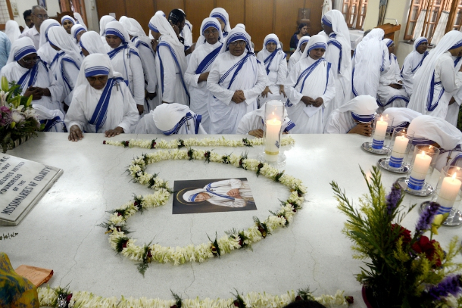
St Teresa of Calcutta and the Missionaries of Charity
Mother Teresa (St Teresa of Calcutta) was born in Skopje, Albania in 1910.
She became a nun and joined the Sisters of Loreto in Ireland in order to learn
English and become a missionary in India. In doing so she never saw her mother
or her sister again, her father having died when she was eight.
She took her vows in Calcutta and became a teacher but the extent of poverty troubled her.
In 1950 she received papal permission to establish the Missionaries of Charity who would care for "the hungry, the naked, the homeless, the crippled, the blind, the lepers, all those people who feel unwanted, unloved, uncared for throughout society, people that have become a burden to the society and are shunned by everyone“
The Congregation opened hospices, orphanages and leper houses throughout India.
Mother Teresa said, "By blood, I am Albanian. By citizenship, an Indian. By faith, I am a Catholic nun. As to my calling, I belong to the world. As to my heart, I belong entirely to the Heart of Jesus.” She was fluent in five languages – Bengali, Albanian, Serbian, English and Hindi – she made occasional trips outside India for humanitarian reasons. She received numerous awards including the Nobel Peace Prize in 1979.
She died in September 1997.
BDES

Slide 9
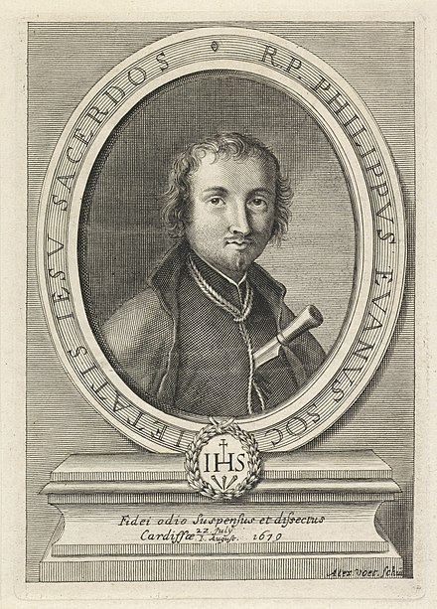
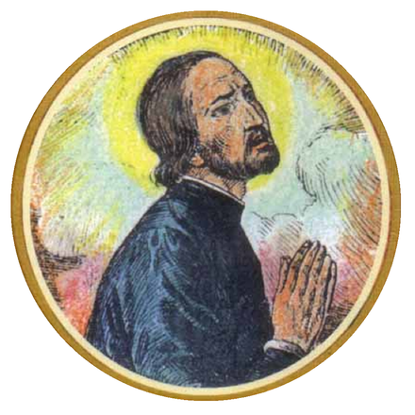
Martyrs of England and Wales : St Philip Evans and St John Lloyd
Philip Evans was born in Monmouth in 1645, and educated at Jesuit College of St. Omer. He joined the Society of Jesus in 1665, and was ordained at Liège (now in Belgium) and sent to South Wales as a missionary in 1675. He worked in Wales for four years, and despite the official anti-Catholic policy no action was taken against him. When the Titus Oates' scare swept the country both Lloyd and Evans were caught up in the aftermath.In November 1678 John Arnold, a justice of the peace and hunter of priests, offered a reward of £200 (equivalent to £30,000 in 2021) for his arrest. Despite the dangers Evans steadfastly refused to leave his flock. He was arrested at the home of Christopher Turberville at Sker, Glamorgan, on 4 December 1678. Ironically the posse which arrested him is said to have been led by Turberville's brother, the notorious priest hunter Edward Turberville.
John Lloyd, was a secular priest (a priest not associated with any religious order), he was a Breconshire man. He was educated in Ghent (now in Belgium), and from 1649 at the English College, Valladolid, Spain. He took the 'missionary oath' on 16 October 1649 to participate in the English Mission. Sent to Wales in 1654 to minister to covert Catholics, he lived his vocation while constantly on the run for 24 years. He was arrested at Turberville's house, on 20 November 1678, and imprisoned in Cardiff Gaol. There he was joined by the Jesuit, Philip Evans. These events xx events took place during the reign of Charles II.
The executions of the two priests took place on 22nd July 1679.
BDES

Slide 10
Looking Forward
~ Looking Forward in Charity~
Monday 27th February 2023
Brentwood Diocese Education Service

