Slide 1
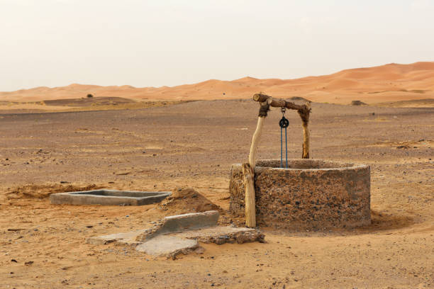
Looking Forward
~ Looking Forward in Charity~
Monday 13th March 2023
Brentwood Diocese Education Service

Slide 2
Looking Forward in Charity
The readings for this Sunday of Lent help us think about our true desires.
The first reading tells of how God satisfied the thirst of the Chosen People in the desert.
The psalm reminds us to let God open up our hearts and flow through them The second reading tells us again that God pours himself into our hearts.
The gospel is the story of the woman at the well, whom Jesus brings to new life through his mercy and compassion. It is worth noting Jesus chose to interact with a Samaritan woman (an outsider) .
Think about how you interact with others.
.
BDES

Slide 3
BDES

Slide 4
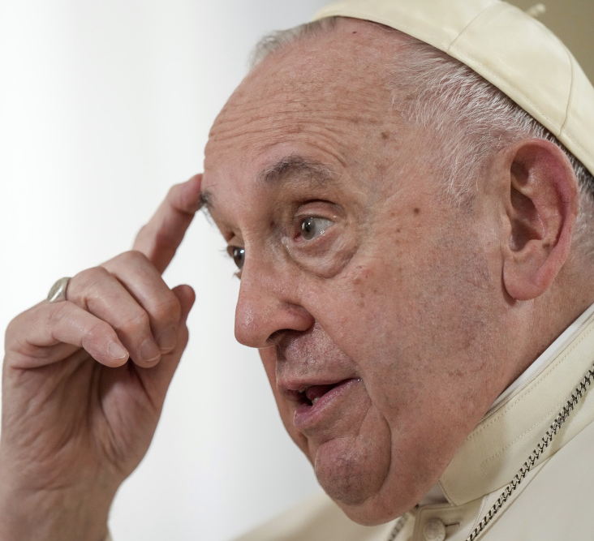
IDEAS FOR YOUR LENTEN FAST
Fast from pressure and be prayerful.
Fast from bitterness and fill your hearts with joy
- attributed to Pope Francis

Slide 5
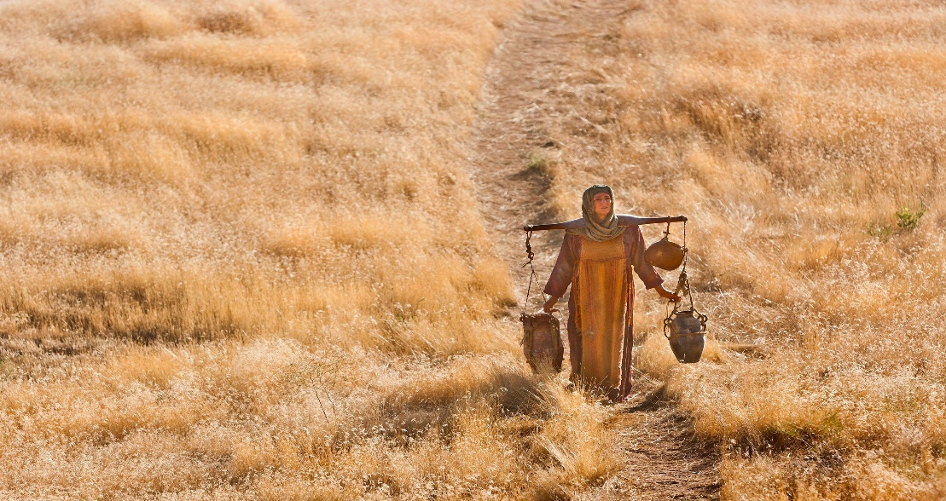
In Sunday’s Gospel Reading …
Sunday 12th March 2023 :
The Gospel of John:
“This is truly the saviour of the world.”
BDES

Slide 6
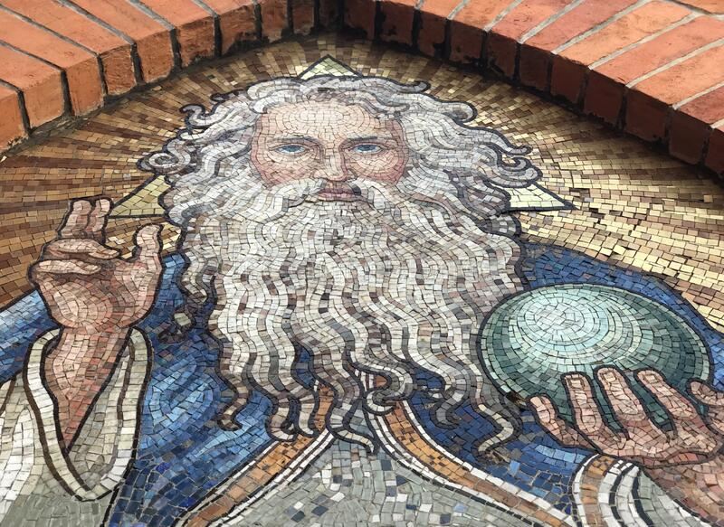
The Lord’s Prayer
Ojcze nasz, któryś jest w niebie, święć się Imię Twoje.
Przyjdź królestwo Twoje.
Bądź wola Twoja, jako w niebie tak i na ziemi.
Chleba naszego powszedniego daj nam dzisiaj.
I odpuść nam nasze winy, jako i my odpuszczamy naszym winowajcom.
I nie wódź nas na pokuszenie, ale nas zbaw ode złego.
Amen. Amen
As we look forward to World Youth Day in August this year, we remind ourselves of the things we share with our fellow young people from all over the world. At this international event, Catholics will pray the prayer Jesus taught us in a huge number of languages. We will mark this with a weekly inclusion of the Lord’s Prayer in the languages spoken in our schools.
This week the Lord’s Prayer is in Polish
BDES

Slide 7
Preparing for World Youth Day 2023
“Catholic Action without Jesus is pointless.”
- Pope Francis, To young people of Italian Catholic Action, 2013
BDES

Slide 8
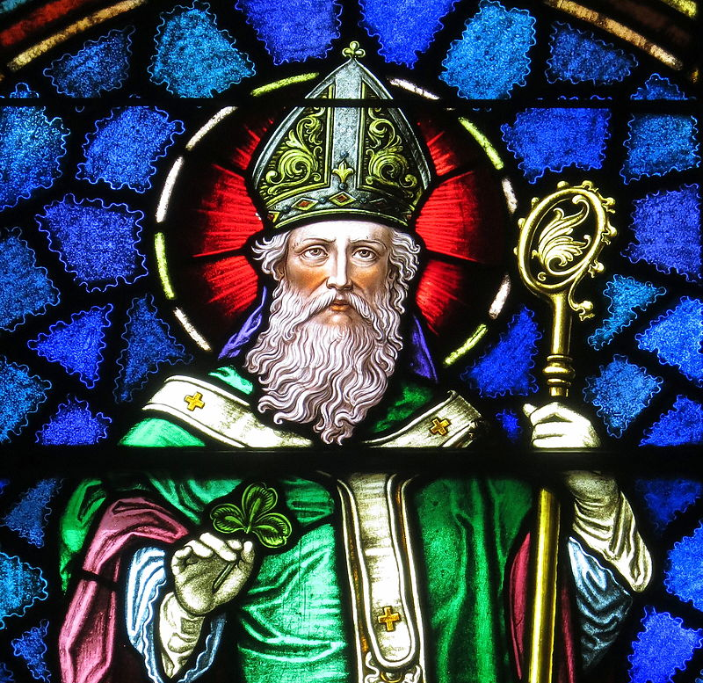
Solemnity of St Patrick
~ 17th March ~
Christ beside me, Christ before me, Christ behind me, King of my heart; Christ within me, Christ below me, Christ above me, never to part.
Christ on my right hand, Christ on my left hand, Christ all around me, shield in the strife; Christ in my sleeping, Christ in my sitting, Christ in my rising, light of my life.
- from St Patrick’s Breastplate
BDES

Slide 9
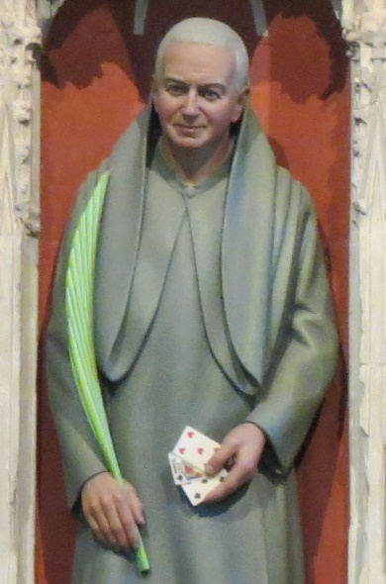
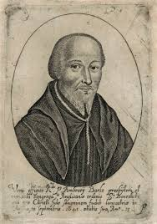
Martyrs of England and Wales : St Alban Roe and Ambrose Barlow
St Ambrose Barlow became a Benedictine monk in the year 1616. On 25 April 1641, he was arrested just after Easter Mass, and was later charged with the ‘crime’ of being a Catholic priest. He was hung, drawn and quartered on 10 September 1641 in Lancaster.
St Alban Roe (1642) was also a Benedictine who was martyred for being a priest. He was executed at Tyburn in London in 1642.
This was a period of great upheaval in England with the English Civil War beginning in 1642.
BDES

Slide 10
Looking Forward
~ Looking Forward in Charity~
Monday 13th March 2023
Brentwood Diocese Education Service

