Slide 1
Looking Forward
~ Looking Forward in Charity ~
Monday 20th March 2023
Brentwood Diocese Education Service

Slide 2
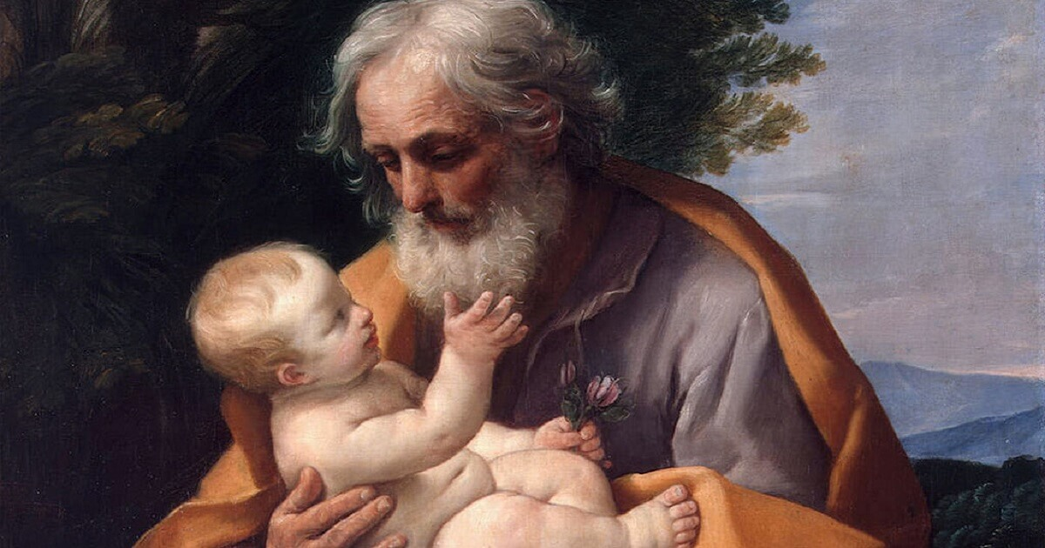
Solemnity of St Joseph, 20th March 2023
BDES
BDES

Slide 3
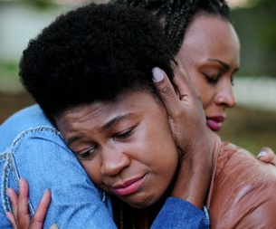
Looking Forward in Charity
Lord Jesus,
teach me to be generous.
Teach me to serve as You deserve,
To give and not to count the cost,
To fight and not to heed the wounds,
To labour and not to seek to rest,
To give of my self and not ask for a reward,
Except the reward of knowing that I am doing Your will.
BDES

Slide 4
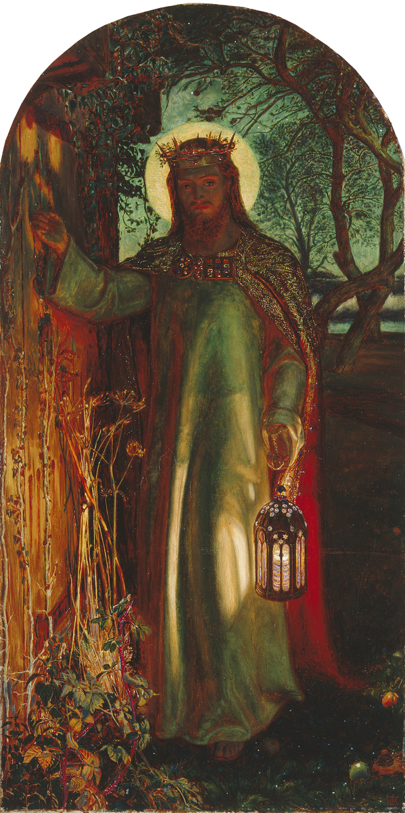
In Sunday’s Gospel Reading
12th March 2023
In the Gospel of John, Jesus tells us :
“I am the light of the world.”
BDES

Slide 5
BDES

Slide 6
IDEAS FOR YOUR LENTEN FAST
Fast from selfishness and be compassionate to others.
Fast from grudges and be reconciled.
- attributed to Pope Francis

Slide 7
Preparing for World Youth Day 2023
“Enthusiasm, when it is healthy, demonstrates this: that one has something of God inside and expresses Him joyously.”
- Papal address, July 2014
BDES

Slide 8
The Lord’s Prayer
As we look forward to World Youth Day in August this year, we remind ourselves of the things we share with our fellow Christians from all over the world. At this international event, Catholics will pray the prayer Jesus taught us in a huge number of languages. This week we have chosen the prayer in Malayalam, an Indian language spoken in the state of Kerala and the territories of Lakshadweep and Puducherry.
Swargasthanaaya Njangalude Pithaave,
Angayude Naamam Poojitham
Aakaname,
Angayude Rajyam Varaname,
Angayude Thirumanasu Swargathile
pole Bhoomiyilum Aakaname.
Anannu Vendunha Aahaaram Innu
Njangalkku Tharaname,
Njangalodu Thettu Cheyyunavarodu
Njangal Shemichirikunathu Pole
Njangalodum Shemikkaname,
Njangale Pralobanathil Ullpedutharuthe,
Thinmayil Ninnum Njangale
Rakshikkaname.
Amen
BDES

Slide 9
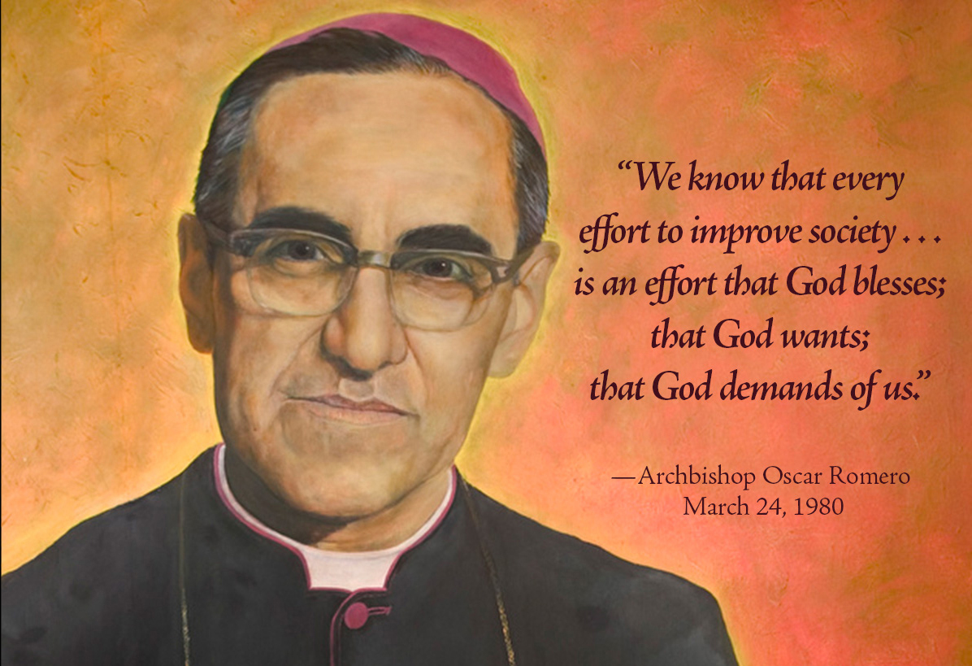
Saint Oscar Romero ~ 24th March
Oscar Romero was the Archbishop of San Salvador, in El Salvador, during a time of widespread violence and oppression of the poor by an evil dictatorship. In 1977 a personal friend was assassinated for speaking out for the poor. This profoundly affected Romero, and he wrote “If they have killed him for doing what he did, then I too have to walk the same path.” He spoke out against poverty, injustice, disappearances and torture, denounced violence and injustice, and urged people to live out Christ’s Gospel message of love for one’s neighbour.” He was shot dead by an unknown assassin while saying Mass.
BDES
BDES
BDES

Slide 10
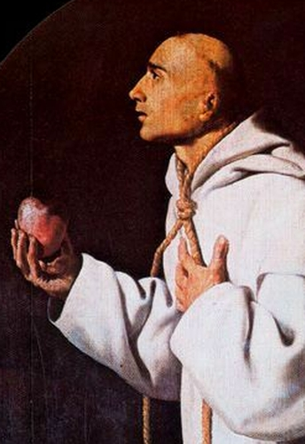
MARTYRS OF ENGLAND AND WALES
John was a Catholic priest of the Carthusian Order, and was the first Catholic martyr to die as a result of refusing to agree by oath to the Act of Supremacy of Henry VIII. He was also the first martyr of his order.
On the morning of the execution, from his prison cell in the Tower of London, Thomas More saw John Houghton and his two fellow Carthusian priors being dragged to Tyburn and exclaimed to his daughter: “Look, Meg! These blessed Fathers be now as cheerfully going to their deaths as bridegrooms to their marriage!” Prior John was the first to be executed.
St John Houghton (1486 – 1535)
BDES
BDES

Slide 11
BDES
BDES

Slide 12
Looking Forward
~ Looking Forward in Charity ~
Monday 20th March 2023
Brentwood Diocese Education Service

