Slide 1
Looking Forward
~ Looking Forward in Charity~
Monday 27th March 2023
Brentwood Diocese Education Service

Slide 2
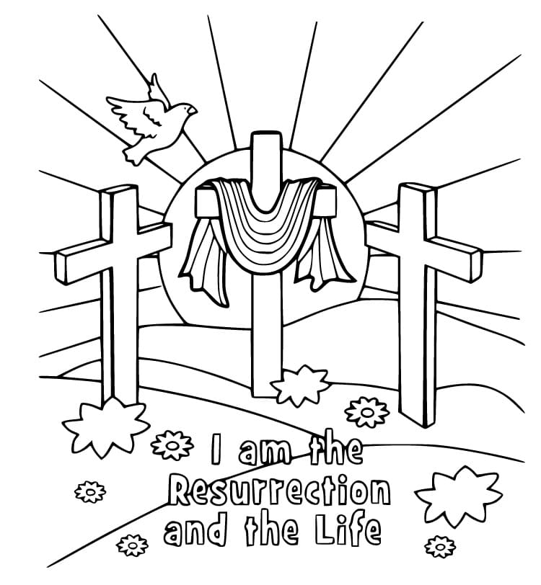
Looking Forward in Charity
The Lenten thought for this week suggests we fast from words and be silent as we listen.
It is very difficult with all the technology that surrounds us to ever have true silence.
Give yourself an opportunity to listen to the word of God without other distractions.
Spend a few moments contemplating in silence and reflect on what Lent and Easter means to you.
BDES

Slide 3
BDES

Slide 4
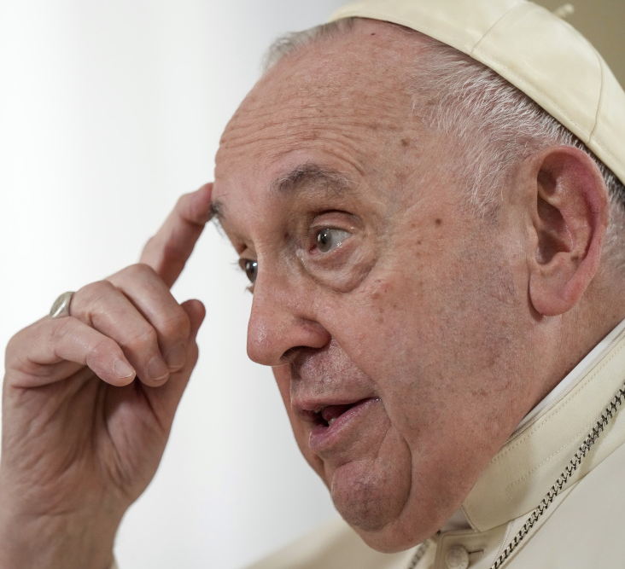
IDEAS FOR YOUR LENTEN FAST
Fast from words
and listen in silence.
- attributed to Pope Francis

Slide 5
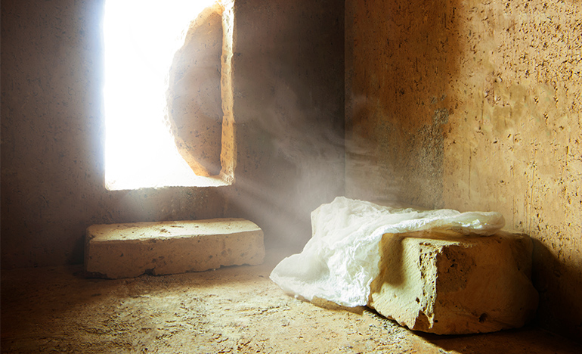
In Sunday’s Gospel Reading …
Sunday 26th March 2023 :
The Gospel of John:
“I am the resurrection and the life.”
BDES

Slide 6
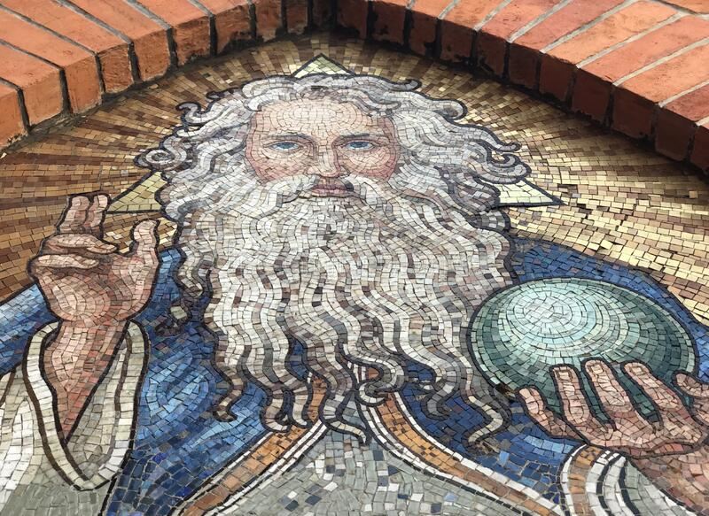
The Lord’s Prayer
Amen
As we look forward to World Youth Day in August this year, we remind ourselves of the things we share with our fellow young people from all over the world. At this international event, Catholics will pray the prayer Jesus taught us in a huge number of languages. We will mark this with a weekly inclusion of the Lord’s Prayer in the languages spoken in our schools.
This week the Lord’s Prayer is in
Twi
Yen agya a wowo soro, Wo din ho ntew, W’ahenne mmra, Dee wope nye asase so, Sedee eye osoro. Ma yen daa aduane nne, Na fa yen aka firi yen, Sedee yede firi won a wode yen aka. Na mfa yen nko sohwe mu. Na wo na ahennie ne ahooden ne Animuonyam ye wo dea daa
Amen
BDES

Slide 7
Preparing for World Youth Day 2023
“Be open to hope and to yearn for fullness.”
- Pope Francis, Papal Address, July 2014
BDES

Slide 8
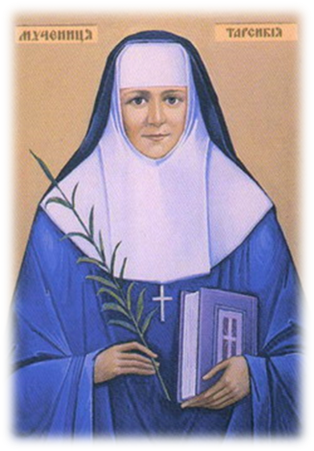
Blessed Sister Tarsykia Matskiv
~ 23rd March ~
The Servant of God Sister Tarsykia Matskiv was born on 23rd March 1919 in the village of Khodoriv, Lviv District (now a city in Ukraine). On 3rd May 1938 she entered the Sister Servants of Mary Immaculate. After professing her first vows on 5th November 1940, she worked in her convent. Before the Russian arrival in Lviv during World War II, Sister Tarsykia made a private oath to her spiritual director, Fr Volodymyr Kovalyk O.S.B.M., that she would sacrifice her life for the conversion of Russia and for the good of the Catholic Church.
The Russian army was determined to destroy the monastery.
On the morning of 17 July 1944 at 8 a.m., a Russian soldier rang the convent door. When Sr Taryskia answered the door she was shot dead without warning, simply because she was a nun.
Let us pray for Ukraine and Russia.
BDES

Slide 9
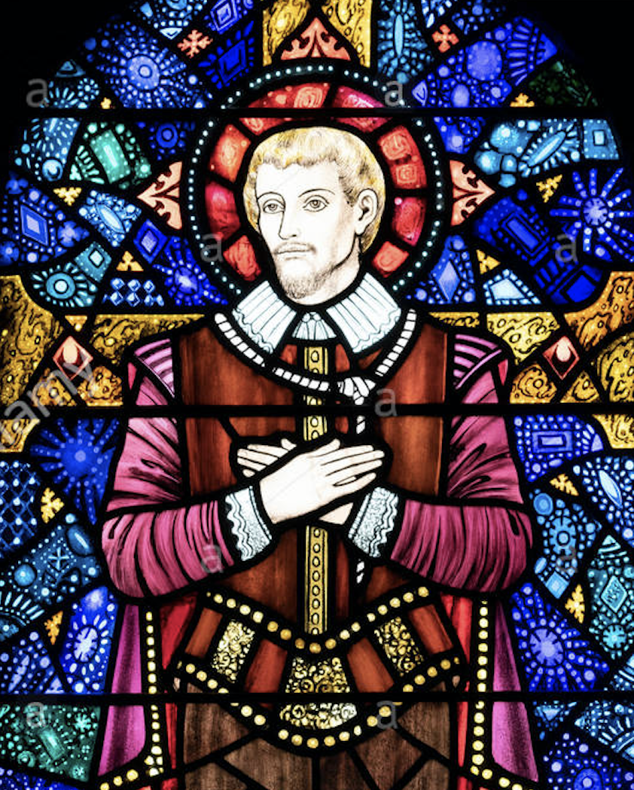
Martyrs of England and Wales : St John Rigby
St John Rigby (ca. 1570 – 21 June 1600) was a layman who was executed during the reign of Elizabeth I.
He worked as a steward for the Huddlestone family and was questioned about his beliefs. He admitted he was a Catholic and was sent to Newgate prison. Twice he was given the chance to recant, but twice refused. He told the judge that his sentence for treason “is the thing which I desire”.
As the sentence was carried out he gave the executioner who helped him up to the cart a piece of gold, saying,
“Take this in token that I freely forgive thee and others that have been accessory to my death.”
St John Rigby Catholic College in Wigan, xxxxxxxxx Greater Manchester, is named in his memory.
BDES

Slide 10
Looking Forward
~ Looking Forward in Charity~
Monday 27th March 2023
Brentwood Diocese Education Service

