Slide 1
Looking Forward
~ Looking Forward as Sisters and Brothers ~
Monday 17th April 2023
Brentwood Diocese Education Service

Slide 2
SundaySuuuuSunday 16th April 2023
BDES
BDES

Slide 3
Looking Forward as Sisters and Brothers
Dear friends,
I am not writing you a new command but an old one, which you have had since the beginning.
Anyone who claims to be in the light
but hates a brother or sister is still in the darkness.
Anyone who loves their brother and sister lives in the light,
and there is nothing in them to make them stumble.
But anyone who hates a brother or sister
is in the darkness and walks around in the darkness.
They do not know where they are going,
because the darkness has blinded them.
(1 John 2 : 7, 9-11)
BDES

Slide 4
In Sunday’s Gospel Reading
16th April 2023
In the Gospel of John, Jesus tells us :
“As the Father has sent me,
so I send you.”
BDES

Slide 5
Preparing for World Youth Day 2023
“Be open
to yearn
to give meaning
to your future.”
- Pope Francis, papal address, July 2014
BDES

Slide 6
The Lord’s Prayer
As we look forward to World Youth Day in August this year, we remind ourselves of the things we share with our fellow Christians from all over the world. At this international event, Catholics will pray the prayer Jesus taught us in a huge number of languages. This week we have chosen the prayer in French, familiar to many of our MFL learners and to those who have enjoyed a pilgrimage to Lourdes.
Notre Père,
qui es aux cieux,
Que ton nom soit sanctifié,
Que ton règne vienne,
Que ta volonté soit faite
sur la terre comme au ciel.
Donne-nous aujourd'hui
notre pain de ce jour.
Pardonne-nous nos offences
Comme nous pardonnons aussi
à ceux qui nous ont offensés.
Et ne nous soumets pas
à la tentation,
mais délivre-nous
du mal.
Amen.
BDES

Slide 7
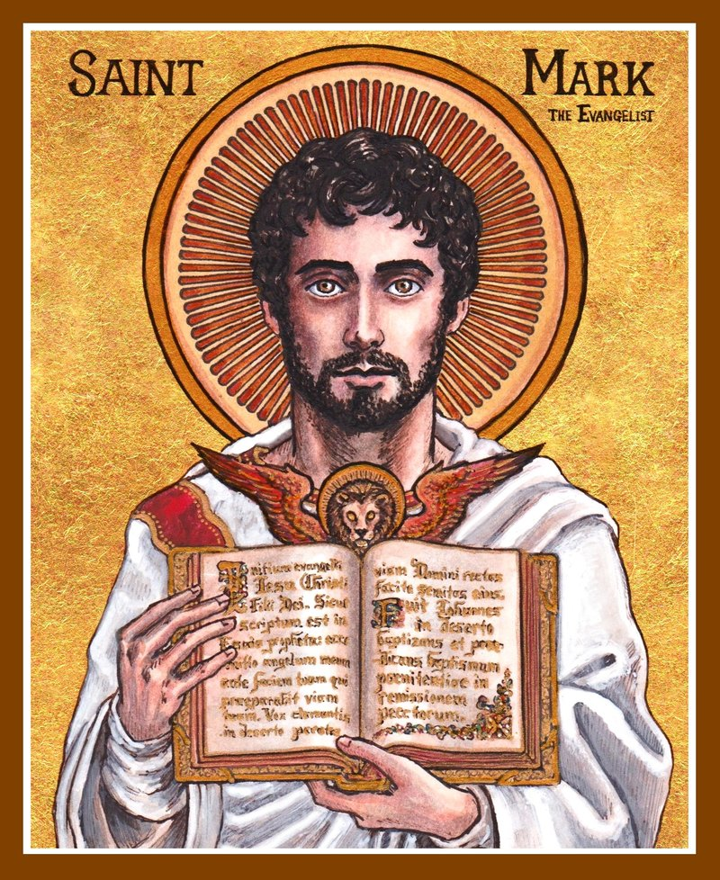
Feast Day of St Mark the Evangelist : 25th April
St Mark is credited by modern scholars with writing what may be the first surviving written Gospel.
According to tradition, he may have been a companion of Jesus on the night of his arrest. He accompanied Peter and Paul and Barnabas on missionary journeys of the early Church.
The Coptic Orthodox Church, the Greek Orthodox Church of Alexandria and the Coptic Catholic Church trace their origins to the Christian community in Alexandria which Mark is said to have founded.
He died either in Rome or Alexandria during the persecution of Christians. His relics were taken to Venice, where the famous St Mark’s Square is named after him.
BDES

Slide 8
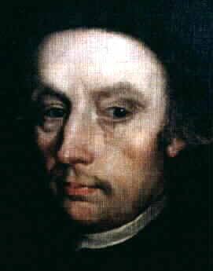
MARTYRS OF ENGLAND AND WALES
He was baptized Bryan Arrowsmith but took the confirmation name Edmund for a beloved uncle who trained English priests in Rome. His family were constantly harassed for their Catholicism and as a child saw his parents carried off to Lancaster jail by the authorities. At the age of 20 he went abroad to Douai to study for the priesthood. He was arrested, but freed under amnesty.
Edmund joined the Society of Jesus (the Jesuits) and ministered to the Catholics of Lancashire. He was arrested again 4 years later, was sentenced to death and executed at Lancaster. He was beatified in 1929 and canonized in 1970.
St Edmund Arrowsmith (1585 – 1628)
BDES
BDES

Slide 9
Looking Forward
~ Looking Forward as Sisters and Brothers ~
Monday 17th April 2023
Brentwood Diocese Education Service

