Slide 1
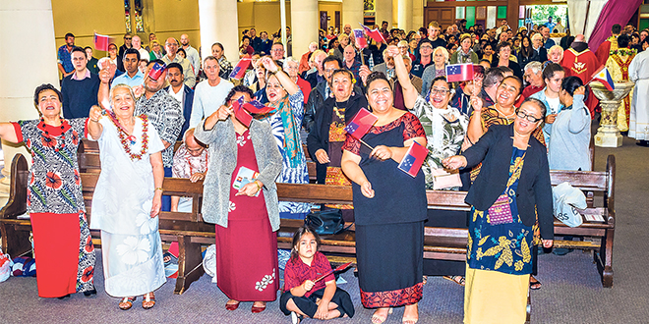
Looking Forward
~ Looking Forward as Sisters and Brothers ~
Monday 8th May 2023
Brentwood Diocese Education Service

Slide 2
Looking Forward as Sisters and Brothers
The Gospel tells us that Jesus is:
The Way and the Truth and the Life.
When Jesus ascends,
the Father sends, in Jesus’ name,
the Advocate, the Holy Spirit,
who will continue the work of the Father and of Jesus.
Unlike the disciples we have not seen Jesus in person
but we believe that in knowing and loving Jesus
we know and love God.
BDES

Slide 3
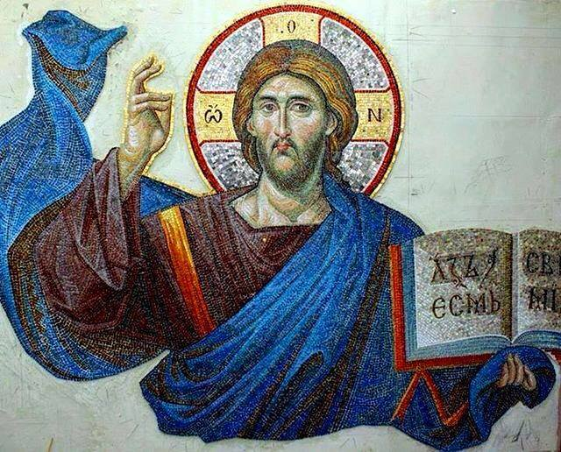
In Sunday’s Gospel Reading …
Sunday 7th May 2023 :
In the Gospel of John, Jesus tells us :
“I am the way,
the truth
and the life.”
BDES

Slide 4
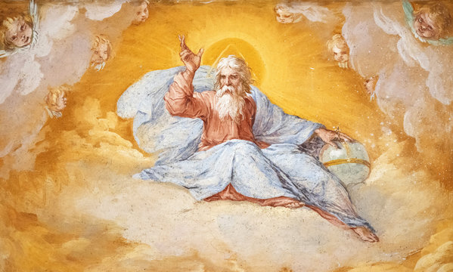
The Lord’s Prayer
As we look forward to World Youth Day in August this year, we remind ourselves of the things we share with our fellow young people from all over the world. At this international event, Catholics will pray the prayer Jesus taught us in a huge number of languages. We will mark this with a weekly inclusion of the Lord’s Prayer in the languages spoken and taught in our schools.
This week the Lord’s Prayer is in
Italian
Padre Nostro, che sei nei cieli, Sia santificato il tuo nome. Venga il tuo regno, Sia fatta la tua volontá, Come in cielo, così in terra. Dacci oggi il nostro pane quotidiano, E rimetti a noi i nostri debiti Come noi li rimettiamo ai nostri debitori. E non ci indurre in tentazione, Ma liberaci dal male. Amen.
BDES

Slide 5
Preparing for World Youth Day 2023
“Do not stand still; a young person cannot stand still.”
- Pope Francis, Papal Address 2014
BDES

Slide 6
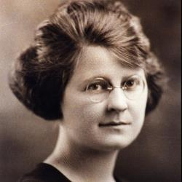
Blessed Miriam Teresa Demjanovich
Feast day : 8th May
Miriam Teresa Demjanovich, SC (26th March 1901 – 8th May 1927) was an American Ruthenian Catholic Sister of Charity who was beatified by the Catholic Church in 2014. The beatification ceremony was the first to take place in the United States, being held in Newark, New Jersey.
She desired a religious life and after caring for her sick mother she entered the convent of the Sisters of Charity of St Elizabeth.
She wrote 24 conferences which were published as a book after her death at the age of 26.
BDES

Slide 7
Martyrs of England and Wales : St John Rochester
A saint and martyr from our diocese.
John was the third son of John Rochester, of Terling, Essex, and Grisold Writtle, daughter of Walter Writtle, of Bobbingworth.
He joined the Carthusians, was a choir monk of the Charterhouse in London, and strenuously opposed the new doctrine of the royal supremacy under Henry VIII. Dom John Rochester and Dom James Walworth were taken to the Charterhouse of St. Michael in Hull, Yorkshire.
The government had succeeded in putting down a rising in Lincolnshire, when on 13 October 1536, the far more serious Pilgrimage of Grace broke out, mustering possibly 40,000 people. The government was desperate to stamp out any centres of resistance. Since one of the flashpoints had been the northern city of York, it was necessary for the government to mount a lesson in the city.
The two London monks were brought from Hull to York and brought before the Lord President of the North, the Duke of Norfolk, on trumped up xxxxxxxx treason charges where they were condemned to death and died on xxxxxxxxxxxxxxx 11th May 1537.
BDES

Slide 8
Looking Forward
~ Looking Forward as Sisters and Brothers ~
Monday 8th May 2023
Brentwood Diocese Education Service

