Slide 1
Looking Forward
~ Looking Forward as Sisters and Brothers ~
Monday 15th May 2023
Brentwood Diocese Education Service

Slide 2
Looking Forward as Sisters and Brothers
May our hearts be open to all the peoples and nations of the earth. May we recognize the goodness and beauty that you have sown in each of us, and thus forge bonds of unity, common projects, and shared dreams. Amen.
Lord, Father of our human family, you created all human beings equal in dignity: pour forth into our hearts a fraternal spirit and inspire in us a dream of renewed encounter, dialogue, justice and peace. Move us to create healthier societies and a more dignified world, a world without hunger, poverty, violence and war.
- Pope Francis, Fratelli tutti, 20th October 2020
BDES

Slide 3
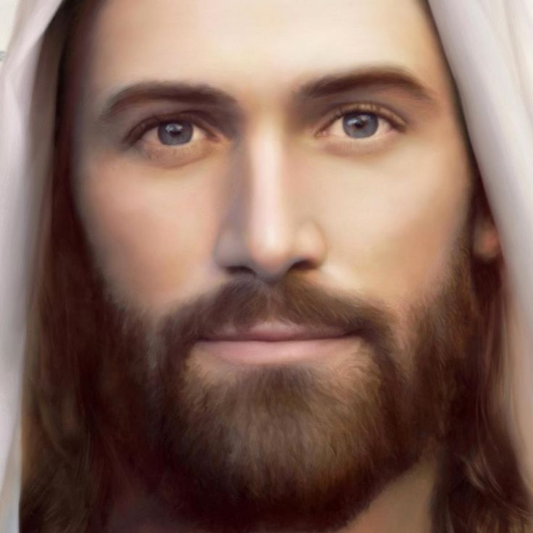
In Sunday’s Gospel Reading
14th May 2023
In the Gospel of John, Jesus tells us :
“If you love me, you will keep my commandments.”
BDES

Slide 4
Preparing for World Youth Day 2023
“Life is not made for roaming aimlessly through, it is made to journey through, and this is your challenge!”
- Pope Francis, papal address, July 2014
BDES

Slide 5
The Lord’s Prayer
As we look forward to World Youth Day in August this year, we remind ourselves of the things we share with our fellow Christians from all over the world. At this international event, Catholics will pray the prayer Jesus taught us in a huge number of languages. This week we have chosen the prayer in the xxxxxxxxxxxGa language of Ghana, Togo, Benin and Western Nigeria.
Wɔ-Tsɛ ni yɔɔ ŋwɛi!
Ogbei lɛ he atse!
Omaŋtsɛyeli lɛ aba!
Afee nɔ ni osumɔɔ yɛ shikpɔŋ lɛ nɔ,
taake afeɔ yɛ ŋwei lɛ!
Hã wɔ ŋmɛnɛ wɔdaa ŋmãa.
Ni okɛ wɔtɔmɔi lɛ afa wɔ,
tamɔ bɔ ni wɔkɛfaa mei ni tɔɔ wɔnɔ lɛ
Ni okɛ wɔ akaya kaa mli;
Shi jiemɔ wɔ keje ɛfɔŋ lɛ mli.
Shi onɔ ji maŋtsɛyeli lɛ, kɛ hewalɛ lɛ
kɛ anumnyam lɛ, kɛyashiɔ naanɔ. Amen.
BDES

Slide 6
BDES

Slide 7
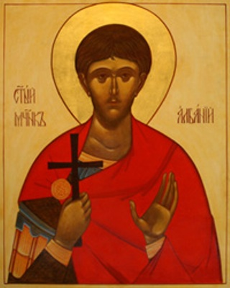
MARTYRS OF ENGLAND AND WALES
Alban was a citizen of Verulamium – an important Roman city close to present-day St Albans. He took in a Christian priest, Amphibalus, fleeing the Roman persecution of Christians. The prayer and life of the priest so impressed Alban that he accepted the Christian faith.
When the Roman authorities discovered Amphibalus, Alban exchanged clothes with him and he escaped. Alban was brought before a judge, declared his Christian faith and though tortured, refused to sacrifice to the Roman gods. As a result he was sentenced to death, the first English martyr.
St Alban of Verulamium
BDES
BDES

Slide 8
Looking Forward
~ Looking Forward as Sisters and Brothers ~
Monday 15th May 2023
Brentwood Diocese Education Service

