Slide 1
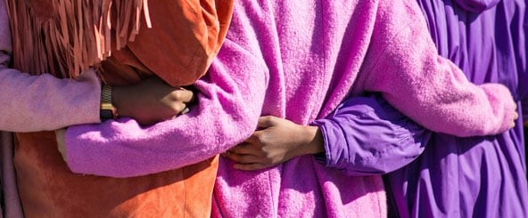
Looking Forward
~ Looking Forward as Sisters and Brothers ~
Monday 24th April 2023
Brentwood Diocese Education Service

Slide 2
Looking Forward as Sisters and Brothers
Jesus said
‘whoever does the will of my heavenly Father
is my brother, and sister, and mother’.
Sometimes it is difficult to treat everyone with care and respect,
especially those who are related to us.
However we should treat each person we encounter as our sister or brother in Christ.
We are invited to call God our Father,
Mary our mother, and Jesus as a role model and a brother.
This family has golden rule standards for all the children to live by.
As part of the family we are all loved unconditionally.
BDES

Slide 3
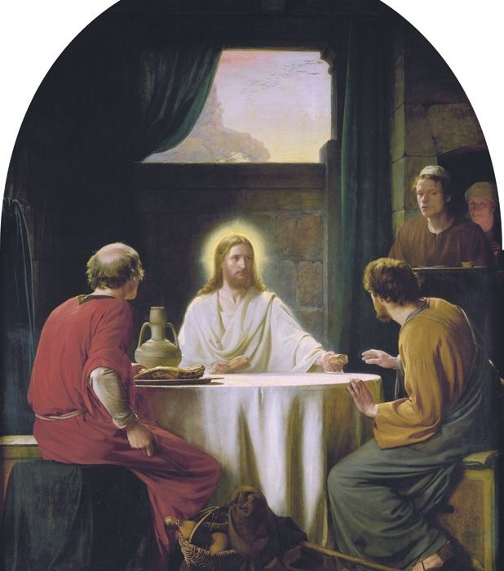
In Sunday’s Gospel Reading …
Sunday 23rd April 2023 :
In the Gospel of Luke, his friends say to Jesus:
“Stay with us.”
BDES

Slide 4
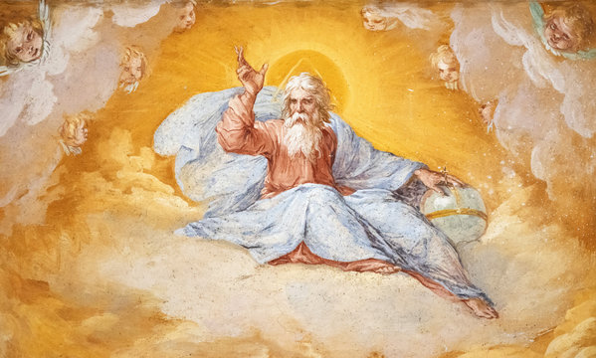
The Lord’s Prayer
As we look forward to World Youth Day in August this year, we remind ourselves of the things we share with our fellow young people from all over the world. At this international event, Catholics will pray the prayer Jesus taught us in a huge number of languages. We will mark this with a weekly inclusion of the Lord’s Prayer in the languages spoken in our schools.
This week the Lord’s Prayer is in
Chinese
我們在天上的父，
願人都尊祢的名為聖，
願祢的國降臨，
願祢的旨意行在地上，
如同行在天上。
我們日用的飲食，今日賜給我們，
免我們的債，如同我們免了人的債，
不叫我們遇見試探，
救我們脫離兇惡，
Amen.
BDES

Slide 5
Preparing for World Youth Day 2023
“Imagine the appropriate journey for each of you.” .
- Pope Francis, Papal Address 2014
BDES

Slide 6
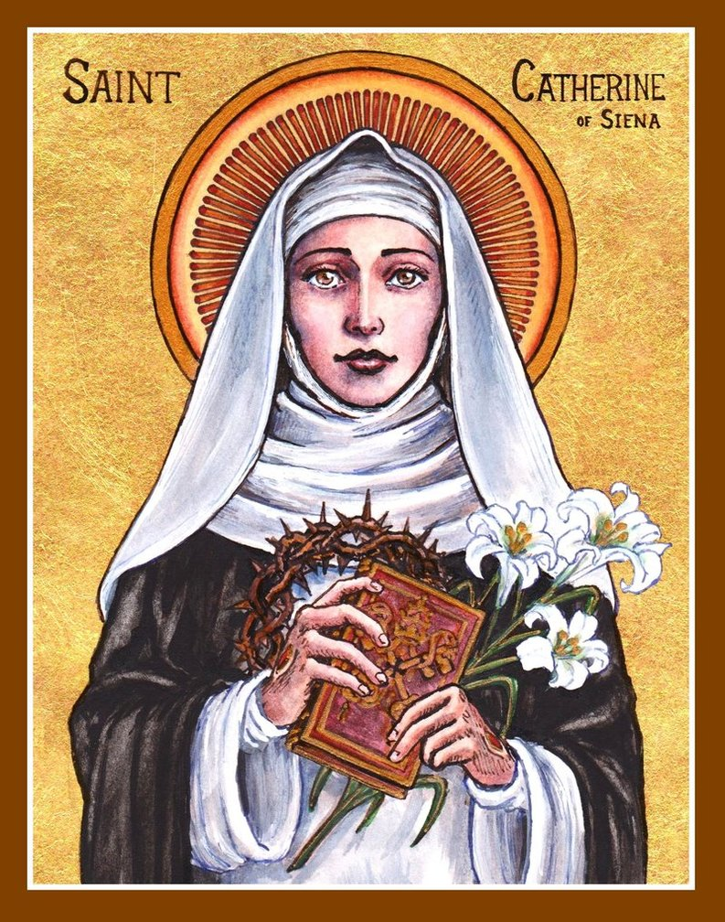
Saint Catherine of Siena
Feast day : 29th April
Catherine was a lay member of the Dominican order. She was famous as a mystic, an activist and an author. She might be described as the original “influencer”! She influenced popes and princes and cardinals with her letters, of which she wrote hundreds. She wrote numerous prayers, and a set of spiritual treatises collected together as a book under the title The Dialogue of Divine Providence. She was even sent on missions by the Pope, something extraordinarily rare for a woman in the 14th century!
BDES

Slide 7
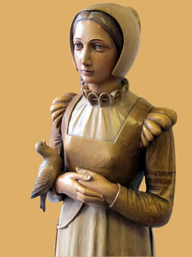
Martyrs of England and Wales : St Anne Line
St Anne Line, one of the 40 Martyrs of England and Wales, was canonised in 1970.
She was born, grew up and married in Essex. She became a Catholic some time in the 1580s despite it being illegal. She looked after a house of refuge for Catholic priests who had to hide from the authorities at the time. In 1601 she was arrested on 2nd February after allowing a number of Catholics to hear Mass. She was tried and executed in the same month. She refused to repent for hiding a priest and xxxxxxxsaid she wished it had been a thousand more.
The feast of St Anne Line is celebrated
in the first week of February.
BDES

Slide 8
Looking Forward
~ Looking Forward as Sisters and Brothers ~
Monday 24th April 2023
Brentwood Diocese Education Service

