Slide 1
Looking Forward
~ Looking Forward as Sisters and Brothers ~
Monday 1st May 2023
Brentwood Diocese Education Service

Slide 2
Looking Forward as Sisters and Brothers
God of Love,
I thank you for my friends, my sisters and brothers.
I cannot imagine my life without their fellowship and friendship.
They are a helping hand when I need one
and a shoulder to cry upon when I can’t go on.
Everything that we have together is invaluable.
Holy Spirit,
please help me to always be grateful for those people
who accompany me through life.
Help me to live out my gratitude in the way I treat all others
as good companions, as true friends, as sisters and as brothers in Christ.
Amen.
BDES

Slide 3
In Sunday’s Gospel Reading
30th April 2023
In the Gospel of John, Jesus tells us :
“I am the gate.”
BDES

Slide 4
Preparing for World Youth Day 2023
“Choose the path that brings you peace and human fulfilment.”
- Pope Francis, papal address, July 2014
BDES

Slide 5
The Lord’s Prayer
As we look forward to World Youth Day in August this year, we remind ourselves of the things we share with our fellow Christians from all over the world. At this international event, Catholics will pray the prayer Jesus taught us in a huge number of languages. This week we have chosen the prayer in Lingala, spoken by families from the DRC, the Republic of the Congo, Angola, the Central African Republic and xxx South Sudan.
Tatá na bísó, ya Likoló, Nkómbó ya Yɔ́ ezala na lokumo, Bokonzi na Yɔ́ eya, Nioso Yɔ́ olingi esalama awa na nsé Ndenge esalamaka na likoló Pésa bísó lɛlɔ́ biléi oyo ekoki límbisa bísó mabé tosali yo, lokóla bísó pe tolimbisi mabe basali bísó. Kotika monguna ameka bísó tê Kasi bikisa bíkisa bísó na mabé Po bokonzi, nguya, pe lokumu ezali ya yo seko. Amen.
BDES

Slide 6
BDES

Slide 7
MARTYRS OF ENGLAND AND WALES
The feast of the English Martyrs is celebrated on this day because 4th May 1535 is the date when the first martyrs of the Reformation were executed at Tyburn, London, for opposing the Act of Succession and the Act of Supremacy, through which King Henry VIII asserted himself to be “the only Supreme Head on earth of the Church of England”.
Feast Day : 4th May
BDES
BDES

Slide 8
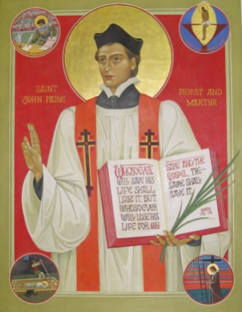
MARTYRS OF ENGLAND AND WALES
John Payne was born in Peterborough in 1532 and was ordained a priest in Douai in 1576; he returned to Elizabethan England as a missionary for the faith, basing himself in Ingatestone. He was eventually betrayed in 1581 and taken to the Tower of London where he was tortured. Finally, he was taken to Chelmsford jail to be tried at the Assizes there in 1582.
Father Payne was executed at Chelmsford on Monday 2nd April 1582. He prayed on his knees for half an hour and kissed the scaffold. He was made a saint along with the other Martyrs of England by Pope Paul VI on 25th October 1970.
Feast of St John Payne : 6th May
BDES
BDES

Slide 9
Looking Forward
~ Looking Forward as Sisters and Brothers ~
Monday 1st May 2023
Brentwood Diocese Education Service

