Slide 1
LECTIO DIVINA
Brentwood Diocese Education Service

Slide 2
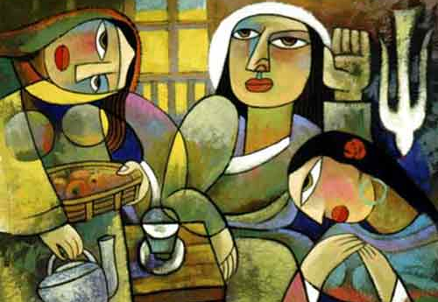
LECTIO DIVINA
Brentwood Diocese Education Service

Slide 3
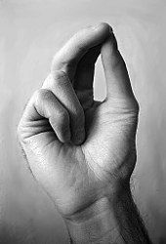
The Sign of the Cross
BDES

Slide 4
Opening Prayer
Dear God,
we abound in hope by the power of Your Holy Spirit.
Fill us with all joy and peace as we believe in You.
Holy Spirit, empower our lives
to produce Your fruit of
love, joy, peace, patience, kindness, goodness,
faithfulness, gentleness and self-control.
Let us listen attentively to Your Word.
Amen.
BDES

Slide 5
Silent Reflection
BDES

Slide 6
• LECTIO •
Jesus entered a village where a woman whose name was Martha welcomed him.
She had a sister named Mary who sat beside the Lord at his feet listening to him speak.
Martha, burdened with much serving, came to him and said, “Lord, do you not care that my sister has left me by myself to do the serving? Tell her to help me.”
BDES

Slide 7
• LECTIO •
The Lord said to her in reply, “Martha, Martha, you are anxious and worried about many things.
There is need of only one thing. Mary has chosen the better part and it will not be taken from her.”
BDES

Slide 8
• LECTIO •
Jesus entered a village where a woman whose name was Martha welcomed him.
She had a sister named Mary who sat beside the Lord at his feet listening to him speak.
Martha, burdened with much serving, came to him and said, “Lord, do you not care that my sister has left me by myself to do the serving? Tell her to help me.”
BDES

Slide 9
• LECTIO •
The Lord said to her in reply, “Martha, Martha, you are anxious and worried about many things.
There is need of only one thing. Mary has chosen the better part and it will not be taken from her.”
BDES

Slide 10
• LECTIO •
Jesus entered a village where a woman whose name was Martha welcomed him.
She had a sister named Mary who sat beside the Lord at his feet listening to him speak.
Martha, burdened with much serving, came to him and said, “Lord, do you not care that my sister has left me by myself to do the serving? Tell her to help me.”
The Lord said to her in reply, “Martha, Martha, you are anxious and worried about many things.
There is need of only one thing. Mary has chosen the better part and it will not be taken from her.”
BDES

Slide 11
• MEDITATIO •
REFLECTION
What God is saying to you?
Feel free to share ‘echoes’ of the text,
a phrase that strikes you.
If you wish, please say why.
BDES

Slide 12
• MEDITATIO •
BDES

Slide 13
• MEDITATIO •
Jesus entered a village where a woman whose name was Martha welcomed him.
She had a sister named Mary who sat beside the Lord at his feet listening to him speak.
Martha, burdened with much serving, came to him and said, “Lord, do you not care that my sister has left me by myself to do the serving? Tell her to help me.”
The Lord said to her in reply, “Martha, Martha, you are anxious and worried about many things.
There is need of only one thing. Mary has chosen the better part and it will not be taken from her.”
BDES

Slide 14
• ORATIO •
PRAYER
What would you like to say to God?
……..
Lord in your mercy …
R / Hear our prayer
BDES

Slide 15
• ORATIO •
BDES

Slide 16
• CONTEMPLATIO •
LET US
REST IN GOD
IN SILENCE
May the Holy Spirit deepen our awareness of the Word
BDES

Slide 17
• CONTEMPLATIO •
BDES

Slide 18
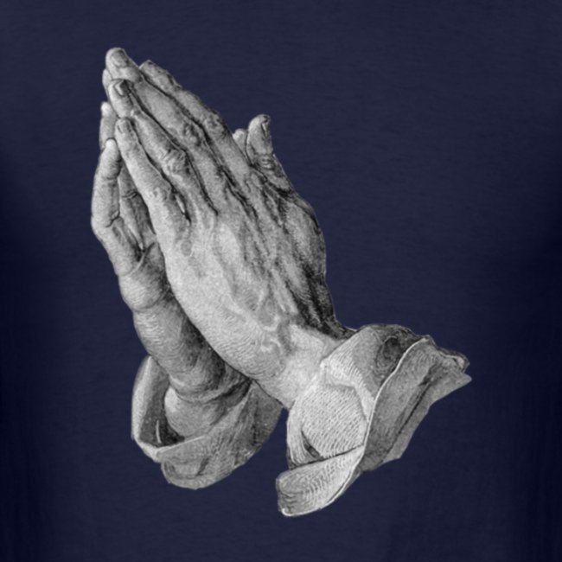
The Lord’s Prayer
BDES

Slide 19
• ACTIO •
Brentwood Diocese Education Service

