Slide 1
LECTIO DIVINA
Brentwood Diocese Education Service

Slide 2
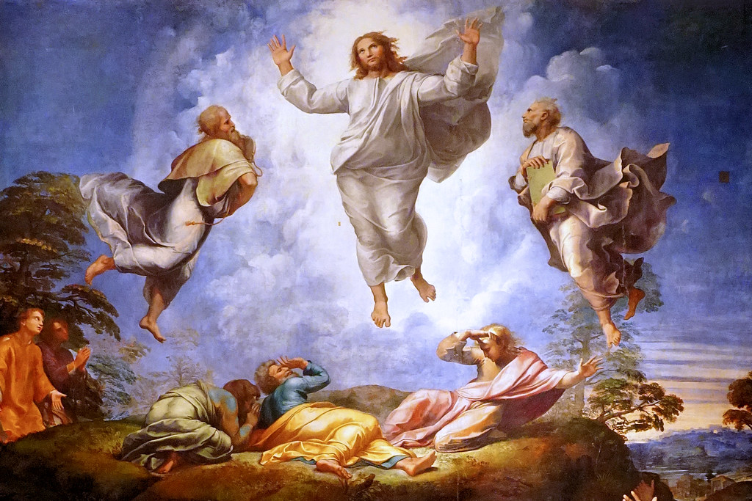
LECTIO DIVINA
Brentwood Diocese Education Service

Slide 3
The Sign of the Cross
BDES

Slide 4
Opening Prayer
Holy Spirit of truth, love and holiness,
Fill my heart with reverence and love.
Give me integrity and patience, and do not let me fall into sin. Increase faith, hope and charity in me and bring forth in me
all the virtues proper to my vocation. Make me a faithful follower of Jesus, an obedient child of the Church,
a help to my neighbour and a servant to Your children.
Let me be open and receptive to Your Holy Word.
Through Jesus Christ, our Lord.
Amen.
BDES

Slide 5
Silent Reflection
BDES

Slide 6
• LECTIO •
Jesus took Peter, James, and John his brother, and led them up a high mountain by themselves. And he was transfigured before them; his face shone like the sun and his clothes became white as light.
And behold, Moses and Elijah appeared to them, conversing with him.
Then Peter said to Jesus in reply, “Lord, it is good that we are here. If you wish, I will make three tents here, one for you, one for Moses, and one for Elijah.”
While he was still speaking, behold, a bright cloud cast a shadow over them, then from the cloud came a voice that said, “This is my beloved Son, with whom I am well pleased; listen to him.”
BDES

Slide 7
• LECTIO •
When the disciples heard this, they fell prostrate and were very much afraid. But Jesus came and touched them, saying, “Rise, and do not be afraid.” And when the disciples raised their eyes, they saw no one else but Jesus alone.
As they were coming down from the mountain, Jesus charged them, “Do not tell the vision to anyone until the Son of Man has been raised from the dead.”
BDES

Slide 8
• LECTIO •
Jesus took Peter, James, and John his brother, and led them up a high mountain by themselves. And he was transfigured before them; his face shone like the sun and his clothes became white as light.
And behold, Moses and Elijah appeared to them, conversing with him.
Then Peter said to Jesus in reply, “Lord, it is good that we are here. If you wish, I will make three tents here, one for you, one for Moses, and one for Elijah.”
While he was still speaking, behold, a bright cloud cast a shadow over them, then from the cloud came a voice that said, “This is my beloved Son, with whom I am well pleased; listen to him.”
BDES

Slide 9
• LECTIO •
When the disciples heard this, they fell prostrate and were very much afraid. But Jesus came and touched them, saying, “Rise, and do not be afraid.” And when the disciples raised their eyes, they saw no one else but Jesus alone.
As they were coming down from the mountain, Jesus charged them, “Do not tell the vision to anyone until the Son of Man has been raised from the dead.”
BDES

Slide 10
• MEDITATIO •
REFLECTION
What God is saying to you?
Feel free to share ‘echoes’ of the text,
a phrase that strikes you.
If you wish, please say why.
BDES

Slide 11
• MEDITATIO •
BDES

Slide 12
• MEDITATIO •
Jesus took Peter, James, and John his brother, and led them up a high mountain by themselves. And he was transfigured before them; his face shone like the sun and his clothes became white as light.
And behold, Moses and Elijah appeared to them, conversing with him.
Then Peter said to Jesus in reply, “Lord, it is good that we are here. If you wish, I will make three tents here, one for you, one for Moses, and one for Elijah.”
While he was still speaking, behold, a bright cloud cast a shadow over them, then from the cloud came a voice that said, “This is my beloved Son, with whom I am well pleased; listen to him.”
When the disciples heard this, they fell prostrate and were very much afraid. But Jesus came and touched them, saying, “Rise, and do not be afraid.” And when the disciples raised their eyes, they saw no one else but Jesus alone.
As they were coming down from the mountain, Jesus charged them, “Do not tell the vision to anyone until the Son of Man has been raised from the dead.”
BDES

Slide 13
• ORATIO •
PRAYER
What would you like to say to God?
……..
Lord in your mercy …
R / Hear our prayer
BDES

Slide 14
• ORATIO •
BDES

Slide 15
• CONTEMPLATIO •
LET US
REST IN GOD
IN SILENCE
May the Holy Spirit deepen our awareness of the Word
BDES

Slide 16
• CONTEMPLATIO •
BDES

Slide 17
The Lord’s Prayer
BDES

Slide 18
• ACTIO •
Brentwood Diocese Education Service

