Slide 1
LECTIO DIVINA
Brentwood Diocese Education Service

Slide 2
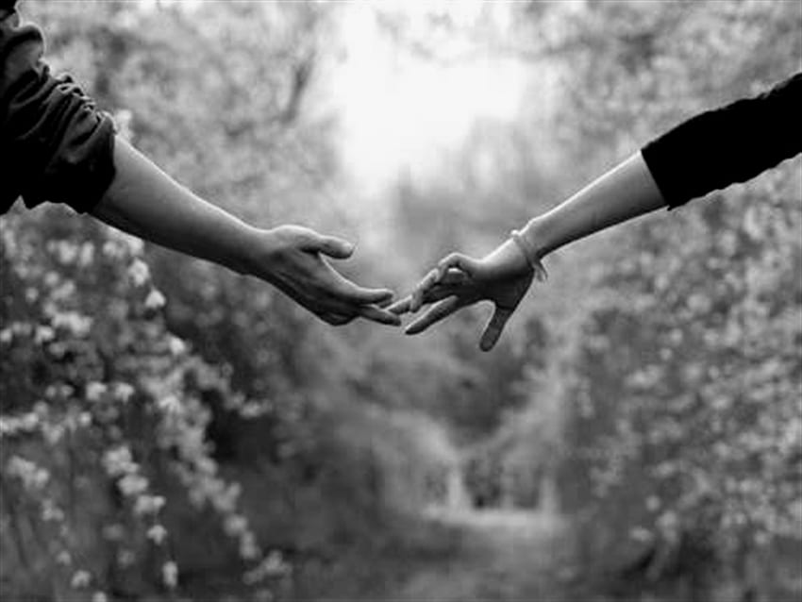
LECTIO DIVINA
BDES

Slide 3
The Sign of the Cross
BDES

Slide 4
Opening Prayer
Breathe into me, Holy Spirit, that my thoughts may all be holy.
Move in me, Holy Spirit, that my work, too, may be holy.
Attract my heart, Holy Spirit, that I may love only what is holy.
Strengthen me, Holy Spirit, that I may defend all that is holy.
Protect me, Holy Spirit, that I may always be holy.
Let me be open and receptive to Your Holy Word.
Amen.
BDES

Slide 5
Silent Reflection
BDES

Slide 6
• LECTIO •
“As the Father has loved me, so have I loved you. Remain in my love. If you keep my commandments, you will remain in my love, just as I have kept my Father’s commandments and remain in his love. “I have told you these things so that my joy may be in you and your joy may be complete.
“This is my commandment: love one another as I have loved you. No one can have greater love than to lay down his life for his friends. You are my friends if you do what I command you. “I shall no longer call you servants, because a servant does not know what his master is doing.
BDES

Slide 7
• LECTIO •
I have called you friends because I have revealed to you everything that I have heard from my Father. “You did not choose me. Rather, I chose you. And I appointed you to go out and bear fruit, fruit that will remain, so that the Father may give you whatever you ask him in my name. The command I give you is this: love one another.
BDES

Slide 8
• LECTIO •
“As the Father has loved me, so have I loved you. Remain in my love. If you keep my commandments, you will remain in my love, just as I have kept my Father’s commandments and remain in his love. “I have told you these things so that my joy may be in you and your joy may be complete.
“This is my commandment: love one another as I have loved you. No one can have greater love than to lay down his life for his friends. You are my friends if you do what I command you. “I shall no longer call you servants, because a servant does not know what his master is doing.
BDES

Slide 9
• LECTIO •
I have called you friends because I have revealed to you everything that I have heard from my Father. “You did not choose me. Rather, I chose you. And I appointed you to go out and bear fruit, fruit that will remain, so that the Father may give you whatever you ask him in my name. The command I give you is this: love one another.
BDES

Slide 10
• MEDITATIO •
REFLECTION
What God is saying to you?
Feel free to share ‘echoes’ of the text,
a phrase that strikes you.
If you wish, please say why.
BDES

Slide 11
• MEDITATIO •
BDES

Slide 12
• MEDITATIO •
“As the Father has loved me, so have I loved you. Remain in my love. If you keep my commandments, you will remain in my love, just as I have kept my Father’s commandments and remain in his love. “I have told you these things so that my joy may be in you and your joy may be complete.
“This is my commandment: love one another as I have loved you. No one can have greater love than to lay down his life for his friends. You are my friends if you do what I command you. “I shall no longer call you servants, because a servant does not know what his master is doing. I have called you friends because I have revealed to you everything that I have heard from my Father. “You did not choose me. Rather, I chose you. And I appointed you to go out and bear fruit, fruit that will remain, so that the Father may give you whatever you ask him in my name. The command I give you is this: love one another.

Slide 13
• ORATIO •
PRAYER
What would you like to say to God?
……..
Lord in your mercy …
R / Hear our prayer
BDES

Slide 14
• ORATIO •
BDES

Slide 15
• CONTEMPLATIO •
LET US
REST IN GOD
IN SILENCE
May the Holy Spirit deepen our awareness of the Word
BDES

Slide 16
• CONTEMPLATIO •
BDES

Slide 17
The Lord’s Prayer
BDES

Slide 18
• ACTIO •
BDES

