Slide 1
LECTIO DIVINA
Brentwood Diocese Education Service

Slide 2
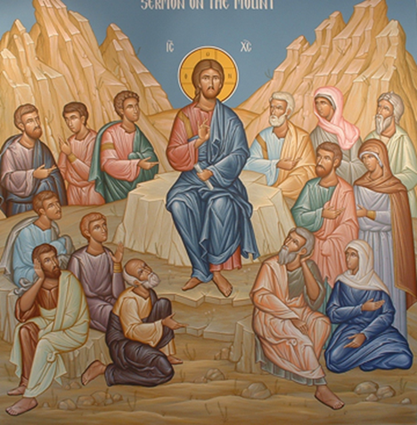
LECTIO DIVINA
BDES

Slide 3
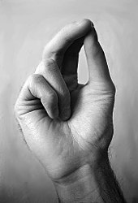
The Sign of the Cross
BDES

Slide 4
Opening Prayer
Holy Spirit,
Open my heart and my mind To Your inspired word,
That it might shape and direct my life
According to the Gospel of Jesus, the Lord.
I make this prayer to You In His name.
Amen.
BDES

Slide 5
Silent Reflection
BDES

Slide 6
• LECTIO •
Then Jesus addressed the crowds and his disciples: “The scribes and the Pharisees sit on Moses’ seat. Therefore, be careful to do whatever they tell you, but do not follow their example, for they do not practice what they preach. They tie up heavy burdens that are difficult to bear and lay them on the shoulders of others, but they will not lift a finger to be of assistance.
“Everything they do is meant to attract the attention of others. They widen their phylacteries and lengthen their tassels. They love to have places of honor at banquets and the best seats in synagogues, and to be greeted with respect in the marketplaces and to be addressed as ‘Rabbi.’
BDES

Slide 7
• LECTIO •
But do not allow yourselves to be called ‘Rabbi,’ for you have only one Master, and you are all brethren. Call no one on earth your father, for you have but one Father, and he is in heaven. You must not be called ‘teacher,’ for you have only one Teacher, the Christ. The greatest among you must be your servant. All those who exalt themselves will be humbled, and all those who humble themselves will be exalted.
BDES

Slide 8
• LECTIO •
Then Jesus addressed the crowds and his disciples: “The scribes and the Pharisees sit on Moses’ seat. Therefore, be careful to do whatever they tell you, but do not follow their example, for they do not practice what they preach. They tie up heavy burdens that are difficult to bear and lay them on the shoulders of others, but they will not lift a finger to be of assistance.
“Everything they do is meant to attract the attention of others. They widen their phylacteries and lengthen their tassels. They love to have places of honor at banquets and the best seats in synagogues, and to be greeted with respect in the marketplaces and to be addressed as ‘Rabbi.’
BDES

Slide 9
• LECTIO •
But do not allow yourselves to be called ‘Rabbi,’ for you have only one Master, and you are all brethren. Call no one on earth your father, for you have but one Father, and he is in heaven. You must not be called ‘teacher,’ for you have only one Teacher, the Christ. The greatest among you must be your servant. All those who exalt themselves will be humbled, and all those who humble themselves will be exalted.
BDES

Slide 10
• MEDITATIO •
REFLECTION
What God is saying to you?
Feel free to share ‘echoes’ of the text,
a phrase that strikes you.
If you wish, please say why.
BDES

Slide 11
• MEDITATIO •
BDES

Slide 12
• MEDITATIO •
Then Jesus addressed the crowds and his disciples: “The scribes and the Pharisees sit on Moses’ seat. Therefore, be careful to do whatever they tell you, but do not follow their example, for they do not practice what they preach. They tie up heavy burdens that are difficult to bear and lay them on the shoulders of others, but they will not lift a finger to be of assistance. “Everything they do is meant to attract the attention of others. They widen their phylacteries and lengthen their tassels. They love to have places of honor at banquets and the best seats in synagogues, and to be greeted with respect in the marketplaces and to be addressed as ‘Rabbi.’ But do not allow yourselves to be called ‘Rabbi,’ for you have only one Master, and you are all brethren. Call no one on earth your father, for you have but one Father, and he is in heaven. You must not be called ‘teacher,’ for you have only one Teacher, the Christ. The greatest among you must be your servant. All those who exalt themselves will be humbled, and all those who humble themselves will be exalted.
BDES

Slide 13
• ORATIO •
PRAYER
What would you like to say to God?
……..
Lord in your mercy …
R / Hear our prayer
BDES

Slide 14
• ORATIO •
BDES

Slide 15
• CONTEMPLATIO •
LET US
REST IN GOD
IN SILENCE
May the Holy Spirit deepen our awareness of the Word
BDES

Slide 16
• CONTEMPLATIO •
BDES

Slide 17
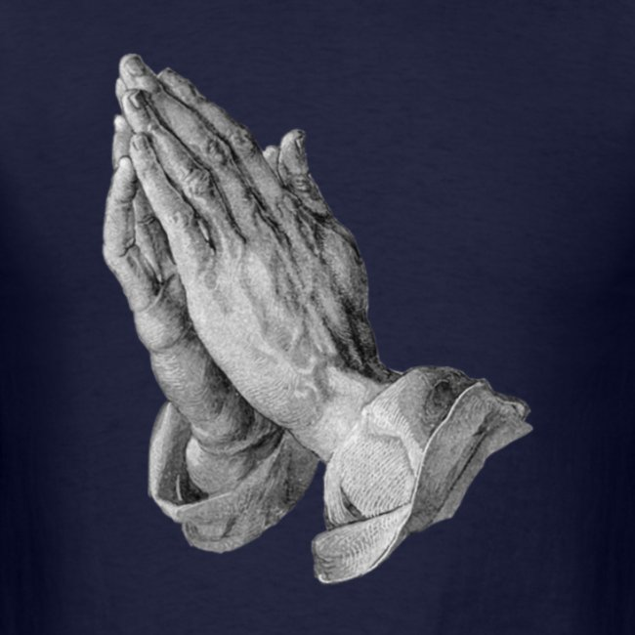
The Lord’s Prayer
BDES

Slide 18
• ACTIO •
BDES

