Slide 1
LECTIO DIVINA
Brentwood Diocese Education Service

Slide 2
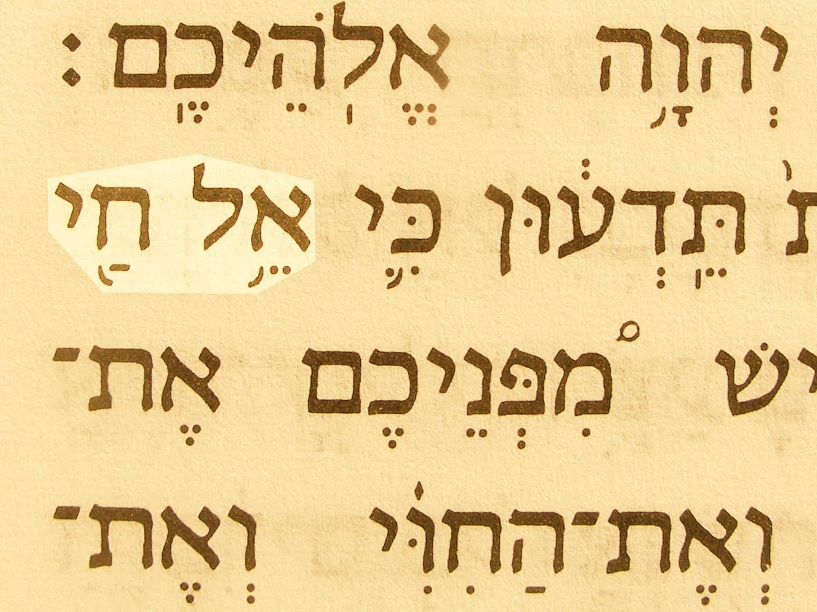
LECTIO DIVINA
Brentwood Diocese Education Service

Slide 3
The Sign of the Cross
BDES

Slide 4
Opening Prayer
Holy Spirit,
Open my heart and my mind To Your inspired word,
That it might shape and direct my life
According to the Gospel of Jesus, the Lord.
I make this prayer to You In His name.
Amen.
BDES

Slide 5
Silent Reflection
BDES

Slide 6
• LECTIO •
Some Sadducees, those who deny that there is a resurrection, came forward. Jesus said to them, “The children of this age marry and remarry; but those who are deemed worthy to attain to the coming age and to the resurrection of the dead neither marry nor are given in marriage.
BDES

Slide 7
• LECTIO •
They can no longer die, for they are like angels; and they are the children of God because they are the ones who will rise.
That the dead will rise even Moses made known in the passage about the bush, when he called out ‘Lord, ‘ the God of Abraham, the God of Isaac, and the God of Jacob; and he is not God of the dead, but of the living, for to him all are alive.”
BDES

Slide 8
• LECTIO •
Some Sadducees, those who deny that there is a resurrection, came forward. Jesus said to them, “The children of this age marry and remarry; but those who are deemed worthy to attain to the coming age and to the resurrection of the dead neither marry nor are given in marriage.
BDES

Slide 9
• LECTIO •
They can no longer die, for they are like angels; and they are the children of God because they are the ones who will rise.
That the dead will rise even Moses made known in the passage about the bush, when he called out ‘Lord, ‘ the God of Abraham, the God of Isaac, and the God of Jacob; and he is not God of the dead, but of the living, for to him all are alive.”
BDES

Slide 10
• MEDITATIO •
REFLECTION
What God is saying to you?
Feel free to share ‘echoes’ of the text,
a phrase that strikes you.
If you wish, please say why.
BDES

Slide 11
• MEDITATIO •
BDES

Slide 12
• MEDITATIO •
Some Sadducees, those who deny that there is a resurrection, came forward. Jesus said to them, “The children of this age marry and remarry; but those who are deemed worthy to attain to the coming age and to the resurrection of the dead neither marry nor are given in marriage.
They can no longer die, for they are like angels; and they are the children of God because they are the ones who will rise.
That the dead will rise even Moses made known in the passage about the bush, when he called out ‘Lord, ‘ the God of Abraham, the God of Isaac, and the God of Jacob; and he is not God of the dead, but of the living, for to him all are alive.”
BDES

Slide 13
• ORATIO •
PRAYER
What would you like to say to God?
……..
Lord in your mercy …
R / Hear our prayer
BDES

Slide 14
• ORATIO •
BDES

Slide 15
• CONTEMPLATIO •
LET US
REST IN GOD
IN SILENCE
May the Holy Spirit deepen our awareness of the Word
BDES

Slide 16
• CONTEMPLATIO •
BDES

Slide 17
The Lord’s Prayer
BDES

Slide 18
• ACTIO •
Brentwood Diocese Education Service

