Slide 1
LECTIO DIVINA
Brentwood Diocese Education Service

Slide 2
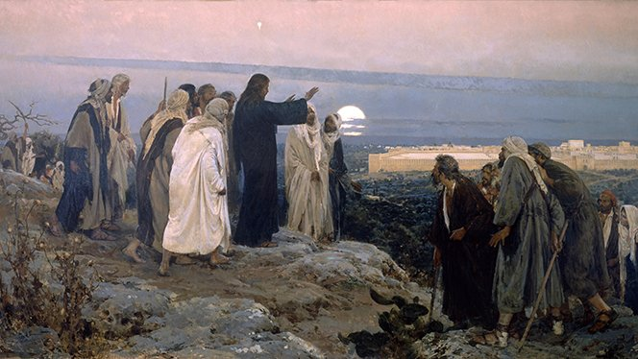
LECTIO DIVINA
BDES

Slide 3
The Sign of the Cross
BDES

Slide 4
Opening Prayer
Lord, in your presence, let us prepare our hearts for this moment of prayer. Send your Holy Spirit to enlighten us and open our minds and hearts to everything You want to tell us today.
Thank you, Lord, for nourishing us with your Word.
Amen
BDES

Slide 5
Silent Reflection
BDES

Slide 6
• LECTIO •
Departing from that district, Jesus went to his hometown accompanied by his disciples. On the Sabbath, he began to teach in the synagogue, and many of those who heard him asked in amazement, “Where did this man get all this? What is this wisdom that he has been granted? What mighty deeds he performs! Is this not the carpenter, the son of Mary, and the brother of James and Joses and Judas and Simon? Are not his sisters here with us?” And so they took offence at him.
BDES

Slide 7
• LECTIO •
Then Jesus said to them, “A prophet is always treated with honor except in his hometown, and among relatives, and in his own house.” And he was unable to perform any mighty works there, aside from curing a few sick people by laying his hands on them. He was amazed at their lack of faith.
BDES

Slide 8
• LECTIO •
Departing from that district, Jesus went to his hometown accompanied by his disciples. On the Sabbath, he began to teach in the synagogue, and many of those who heard him asked in amazement, “Where did this man get all this? What is this wisdom that he has been granted? What mighty deeds he performs! Is this not the carpenter, the son of Mary, and the brother of James and Joses and Judas and Simon? Are not his sisters here with us?” And so they took offence at him.
BDES

Slide 9
• LECTIO •
Then Jesus said to them, “A prophet is always treated with honor except in his hometown, and among relatives, and in his own house.” And he was unable to perform any mighty works there, aside from curing a few sick people by laying his hands on them. He was amazed at their lack of faith.
BDES

Slide 10
• MEDITATIO •
REFLECTION
What God is saying to you?
Feel free to share ‘echoes’ of the text,
a phrase that strikes you.
If you wish, please say why.
BDES

Slide 11
• MEDITATIO •
BDES

Slide 12
• MEDITATIO •
Departing from that district, Jesus went to his hometown accompanied by his disciples. On the Sabbath, he began to teach in the synagogue, and many of those who heard him asked in amazement, “Where did this man get all this? What is this wisdom that he has been granted? What mighty deeds he performs! Is this not the carpenter, the son of Mary, and the brother of James and Joses and Judas and Simon? Are not his sisters here with us?” And so they took offence at him.
Then Jesus said to them, “A prophet is always treated with honor except in his hometown, and among relatives, and in his own house.” And he was unable to perform any mighty works there, aside from curing a few sick people by laying his hands on them. He was amazed at their lack of faith.
BDES

Slide 13
• ORATIO •
PRAYER
What would you like to say to God?
……..
Lord in your mercy …
R / Hear our prayer
BDES

Slide 14
• ORATIO •
BDES

Slide 15
• CONTEMPLATIO •
LET US
REST IN GOD
IN SILENCE
May the Holy Spirit deepen our awareness of the Word
BDES

Slide 16
• CONTEMPLATIO •
BDES

Slide 17
The Lord’s Prayer
BDES

Slide 18
• ACTIO •
BDES

