Slide 1
LECTIO DIVINA
Brentwood Diocese Education Service

Slide 2
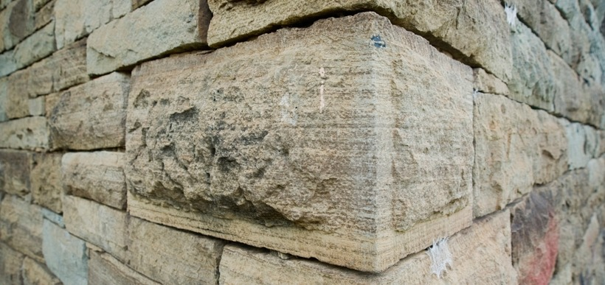
LECTIO DIVINA
BDES

Slide 3
The Sign of the Cross
BDES

Slide 4
Opening Prayer
Spirit of wisdom and understanding, enlighten our minds to perceive the mysteries of the universe in relation to eternity.
Spirit of right judgment and courage, guide us and make us firm in our baptismal decision to follow Jesus' way of love.
Spirit of knowledge and reverence, help us to see the lasting value of justice and mercy in our everyday dealings with one another. May we respect life as we work to solve problems
of family and nation, economy and ecology.
Spirit of God, spark our faith, hope and love into new action each day. Fill our lives with wonder and awe in your presence which penetrates all creation. Amen.
BDES

Slide 5
Silent Reflection
BDES

Slide 6
• LECTIO •
“Listen to another parable. There was a landowner who planted a vineyard, fenced it in on all sides, dug a winepress in it, and built a watchtower. Then he leased it to tenants and went off on a journey.
“When the time for harvest approached, he sent his servants to the tenants to collect his share of the produce. But the tenants seized his servants and beat one of them, killed another, and stoned a third. Again, he sent more servants, but they treated them in the same manner.
“Finally, he sent his son to them, thinking, ‘They will respect my son.’ But when the tenants saw the son, they said to one another, ‘This is the heir. Come, let us kill him and get his inheritance.’ And so they seized him, threw him out of the vineyard, and killed him.
“Now what do you think the owner of the vineyard will do to those tenants when he comes?” They said to him, “He will kill those evil men, and then he will lease his vineyard to other tenants who will give him the produce at the harvest.”
BDES

Slide 7
• LECTIO •
Jesus then said to them, “Have you never read in the Scriptures:
‘The stone that the builders rejectedhas become the cornerstone; by the Lord has this been done, and it is wonderful in our eyes’?
Therefore, I tell you, the kingdom of God will be taken away from you and given to a people that will produce fruit in abundance.
BDES

Slide 8
• LECTIO •
“Listen to another parable. There was a landowner who planted a vineyard, fenced it in on all sides, dug a winepress in it, and built a watchtower. Then he leased it to tenants and went off on a journey.
“When the time for harvest approached, he sent his servants to the tenants to collect his share of the produce. But the tenants seized his servants and beat one of them, killed another, and stoned a third. Again, he sent more servants, but they treated them in the same manner.
“Finally, he sent his son to them, thinking, ‘They will respect my son.’ But when the tenants saw the son, they said to one another, ‘This is the heir. Come, let us kill him and get his inheritance.’ And so they seized him, threw him out of the vineyard, and killed him.
“Now what do you think the owner of the vineyard will do to those tenants when he comes?” They said to him, “He will kill those evil men, and then he will lease his vineyard to other tenants who will give him the produce at the harvest.”
BDES

Slide 9
• LECTIO •
Jesus then said to them, “Have you never read in the Scriptures:
‘The stone that the builders rejectedhas become the cornerstone; by the Lord has this been done, and it is wonderful in our eyes’?
Therefore, I tell you, the kingdom of God will be taken away from you and given to a people that will produce fruit in abundance.
BDES

Slide 10
• MEDITATIO •
REFLECTION
What God is saying to you?
Feel free to share ‘echoes’ of the text,
a phrase that strikes you.
If you wish, please say why.
BDES

Slide 11
• MEDITATIO •
BDES

Slide 12
• MEDITATIO •
“Listen to another parable. There was a landowner who planted a vineyard, fenced it in on all sides, dug a winepress in it, and built a watchtower. Then he leased it to tenants and went off on a journey. “When the time for harvest approached, he sent his servants to the tenants to collect his share of the produce. But the tenants seized his servants and beat one of them, killed another, and stoned a third. Again, he sent more servants, but they treated them in the same manner. “Finally, he sent his son to them, thinking, ‘They will respect my son.’ But when the tenants saw the son, they said to one another, ‘This is the heir. Come, let us kill him and get his inheritance.’ And so they seized him, threw him out of the vineyard, and killed him. “Now what do you think the owner of the vineyard will do to those tenants when he comes?” They said to him, “He will kill those evil men, and then he will lease his vineyard to other tenants who will give him the produce at the harvest.” Jesus then said to them, “Have you never read in the Scriptures: ‘The stone that the builders rejected has become the cornerstone; by the Lord has this been done, and it is wonderful in our eyes’? Therefore, I tell you, the kingdom of God will be taken away from you and given to a people that will produce fruit in abundance.
BDES

Slide 13
• ORATIO •
PRAYER
What would you like to say to God?
……..
Lord in your mercy …
R / Hear our prayer
BDES

Slide 14
• ORATIO •
BDES

Slide 15
• CONTEMPLATIO •
LET US
REST IN GOD
IN SILENCE
May the Holy Spirit deepen our awareness of the Word
BDES

Slide 16
• CONTEMPLATIO •
BDES

Slide 17
The Lord’s Prayer
BDES

Slide 18
• ACTIO •
BDES

