Slide 1
LECTIO DIVINA
Brentwood Diocese Education Service

Slide 2
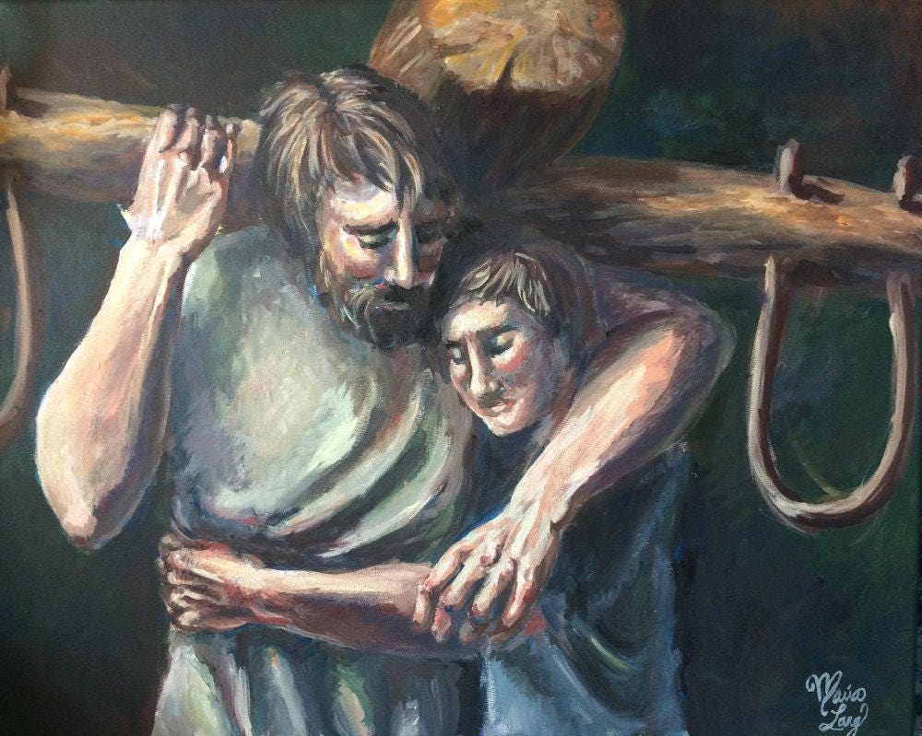
LECTIO DIVINA
Brentwood Diocese Education Service

Slide 3
The Sign of the Cross
BDES

Slide 4
Opening Prayer
Lord, in your presence, let us prepare our hearts for this moment of prayer. Send your Holy Spirit to enlighten us and open our minds and hearts to everything You want to tell us today.
Thank you, Lord, for nourishing us with your Word.
Amen
BDES

Slide 5
Silent Reflection
BDES

Slide 6
• LECTIO •
At that time Jesus exclaimed: “I give praise to you, Father, Lord of heaven and earth, for although you have hidden these things from the wise and the learned you have revealed them to little ones.
Yes, Father, such has been your gracious will.
All things have been handed over to me by my Father. No one knows the Son except the Father, and no one knows the Father except the Son and anyone to whom the Son wishes to reveal him.
BDES

Slide 7
• LECTIO •
Come to me, all you who labor and are burdened, and I will give you rest. Take my yoke upon you and learn from me, for I am meek and humble of heart; and you will find rest for yourselves. For my yoke is easy, and my burden light.”
BDES

Slide 8
• LECTIO •
At that time Jesus exclaimed: “I give praise to you, Father, Lord of heaven and earth, for although you have hidden these things from the wise and the learned you have revealed them to little ones.
Yes, Father, such has been your gracious will.
All things have been handed over to me by my Father. No one knows the Son except the Father, and no one knows the Father except the Son and anyone to whom the Son wishes to reveal him.
BDES

Slide 9
• LECTIO •
Come to me, all you who labor and are burdened, and I will give you rest. Take my yoke upon you and learn from me, for I am meek and humble of heart; and you will find rest for yourselves. For my yoke is easy, and my burden light.”
BDES

Slide 10
• MEDITATIO •
REFLECTION
What God is saying to you?
Feel free to share ‘echoes’ of the text,
a phrase that strikes you.
If you wish, please say why.
BDES

Slide 11
• MEDITATIO •
BDES

Slide 12
• MEDITATIO •
At that time Jesus exclaimed: “I give praise to you, Father, Lord of heaven and earth, for although you have hidden these things from the wise and the learned you have revealed them to little ones.
Yes, Father, such has been your gracious will.
All things have been handed over to me by my Father. No one knows the Son except the Father, and no one knows the Father except the Son and anyone to whom the Son wishes to reveal him.
Come to me, all you who labor and are burdened, and I will give you rest. Take my yoke upon you and learn from me, for I am meek and humble of heart; and you will find rest for yourselves. For my yoke is easy, and my burden light.”
BDES

Slide 13
• ORATIO •
PRAYER
What would you like to say to God?
……..
Lord in your mercy …
R / Hear our prayer
BDES

Slide 14
• ORATIO •
BDES

Slide 15
• CONTEMPLATIO •
LET US
REST IN GOD
IN SILENCE
May the Holy Spirit deepen our awareness of the Word
BDES

Slide 16
• CONTEMPLATIO •
BDES

Slide 17
The Lord’s Prayer
BDES

Slide 18
• ACTIO •
Brentwood Diocese Education Service

