Slide 1
LECTIO DIVINA
Brentwood Diocese Education Service

Slide 2
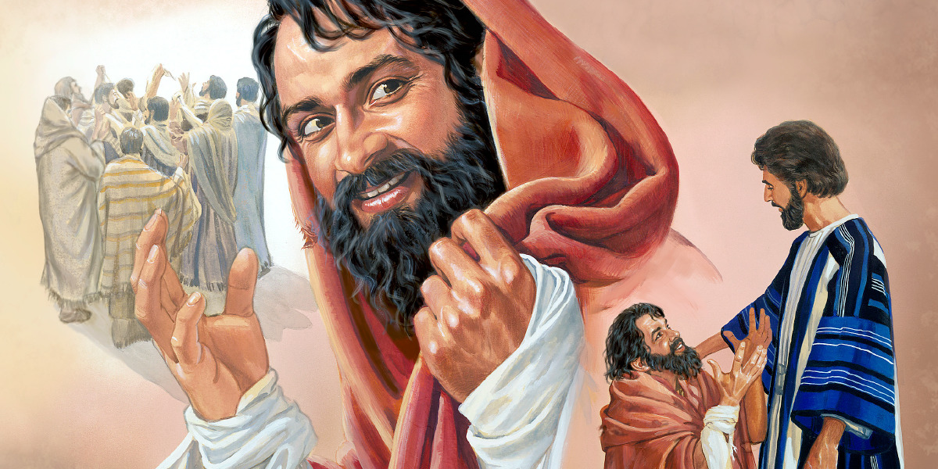
LECTIO DIVINA
Brentwood Diocese Education Service

Slide 3
The Sign of the Cross
BDES

Slide 4
Opening Prayer
Spirit of wisdom and understanding, enlighten our minds to perceive the mysteries of the universe in relation to eternity.
Spirit of right judgment and courage, guide us and make us firm in our baptismal decision to follow Jesus' way of love.
Spirit of knowledge and reverence, help us to see the lasting value of justice and mercy in our everyday dealings with one another. May we respect life as we work to solve problems
of family and nation, economy and ecology.
Spirit of God, spark our faith, hope and love into new action each day. Fill our lives with wonder and awe in your presence which penetrates all creation. Amen.
BDES

Slide 5
Silent Reflection
BDES

Slide 6
• LECTIO •
As Jesus continued his journey to Jerusalem, he traveled through Samaria and Galilee.
As he was entering a village, ten lepers met him. They stood at a distance from him and raised their voices, saying, “Jesus, Master! Have pity on us!”
And when he saw them, he said, “Go show yourselves to the priests.” As they were going they were cleansed.
BDES

Slide 7
• LECTIO •
And one of them, realizing he had been healed, returned, glorifying God in a loud voice; and he fell at the feet of Jesus and thanked him. He was a Samaritan.
Jesus said in reply, “Ten were cleansed, were they not? Where are the other nine?
Has none but this foreigner returned to give thanks to God?”
Then he said to him, “Stand up and go; your faith has saved you.”
BDES

Slide 8
• LECTIO •
As Jesus continued his journey to Jerusalem, he traveled through Samaria and Galilee.
As he was entering a village, ten lepers met him. They stood at a distance from him and raised their voices, saying, “Jesus, Master! Have pity on us!”
And when he saw them, he said, “Go show yourselves to the priests.” As they were going they were cleansed.
BDES

Slide 9
• LECTIO •
And one of them, realizing he had been healed, returned, glorifying God in a loud voice; and he fell at the feet of Jesus and thanked him. He was a Samaritan.
Jesus said in reply, “Ten were cleansed, were they not? Where are the other nine?
Has none but this foreigner returned to give thanks to God?”
Then he said to him, “Stand up and go; your faith has saved you.”
BDES

Slide 10
• MEDITATIO •
REFLECTION
What God is saying to you?
Feel free to share ‘echoes’ of the text,
a phrase that strikes you.
If you wish, please say why.
BDES

Slide 11
• MEDITATIO •
BDES

Slide 12
• MEDITATIO •
As Jesus continued his journey to Jerusalem, he traveled through Samaria and Galilee.
As he was entering a village, ten lepers met him. They stood at a distance from him and raised their voices, saying, “Jesus, Master! Have pity on us!”
And when he saw them, he said, “Go show yourselves to the priests.” As they were going they were cleansed.
And one of them, realizing he had been healed, returned, glorifying God in a loud voice; and he fell at the feet of Jesus and thanked him. He was a Samaritan.
Jesus said in reply, “Ten were cleansed, were they not? Where are the other nine?
Has none but this foreigner returned to give thanks to God?”
Then he said to him, “Stand up and go; your faith has saved you.”
BDES

Slide 13
• ORATIO •
PRAYER
What would you like to say to God?
……..
Lord in your mercy …
R / Hear our prayer
BDES

Slide 14
• ORATIO •
BDES

Slide 15
• CONTEMPLATIO •
LET US
REST IN GOD
IN SILENCE
May the Holy Spirit deepen our awareness of the Word
BDES

Slide 16
• CONTEMPLATIO •
BDES

Slide 17
The Lord’s Prayer
BDES

Slide 18
• ACTIO •
Brentwood Diocese Education Service

