Slide 1
LECTIO DIVINA
Brentwood Diocese Education Service

Slide 2
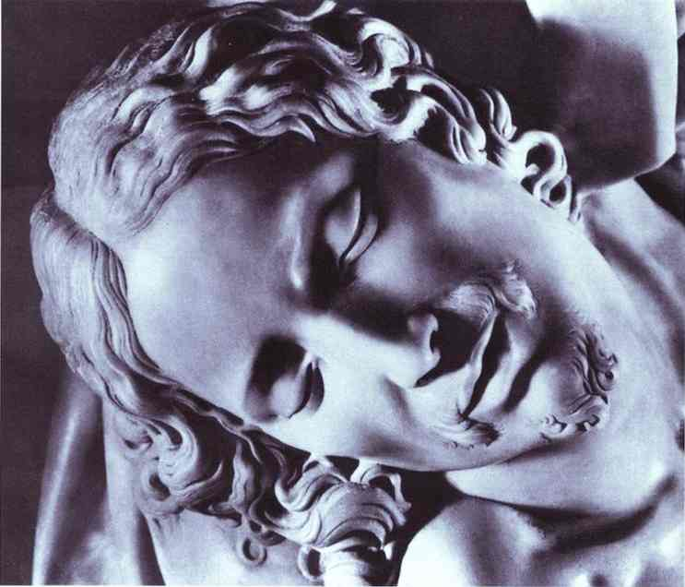
LECTIO DIVINA
BDES

Slide 3
The Sign of the Cross
BDES

Slide 4
Opening Prayer
Holy Spirit of truth, love and holiness,
Fill my heart with reverence and love.
Give me integrity and patience, and do not let me fall into sin. Increase faith, hope and charity in me and bring forth in me
all the virtues proper to my vocation. Make me a faithful follower of Jesus, an obedient child of the Church,
a help to my neighbour and a servant to Your children.
Let me be open and receptive to Your Holy Word.
Through Jesus Christ, our Lord.
Amen.
BDES

Slide 5
Silent Reflection
BDES

Slide 6
• LECTIO •
And just as Moses lifted up the serpent in the desert, so must the Son of Man be lifted up, in order that everyone who believes in him may have eternal life. “For God so loved the world that he gave his only Son, so that everyone who believes in him may not perish but may attain eternal life. “For God did not send his Son into the world to condemn the world but in order that the world might be saved through him. Whoever believes in him is not condemned, but whoever does not believe in him already stands condemned, because he has not believed in the name of the only-begotten Son of God.
BDES

Slide 7
• LECTIO •
“And the judgment is this: the light has come into the world, but people preferred darkness to light because their deeds were evil. Everyone who does evil hates the light and avoids coming near the light so that his misdeeds may not be exposed. However, whoever lives by the truth comes to the light so that it may be clearly seen that his deeds have been done in God.”
BDES

Slide 8
• LECTIO •
And just as Moses lifted up the serpent in the desert, so must the Son of Man be lifted up, in order that everyone who believes in him may have eternal life. “For God so loved the world that he gave his only Son, so that everyone who believes in him may not perish but may attain eternal life. “For God did not send his Son into the world to condemn the world but in order that the world might be saved through him. Whoever believes in him is not condemned, but whoever does not believe in him already stands condemned, because he has not believed in the name of the only-begotten Son of God.
BDES

Slide 9
• LECTIO •
“And the judgment is this: the light has come into the world, but people preferred darkness to light because their deeds were evil. Everyone who does evil hates the light and avoids coming near the light so that his misdeeds may not be exposed. However, whoever lives by the truth comes to the light so that it may be clearly seen that his deeds have been done in God.”
BDES

Slide 10
• MEDITATIO •
REFLECTION
What God is saying to you?
Feel free to share ‘echoes’ of the text,
a phrase that strikes you.
If you wish, please say why.
BDES

Slide 11
• MEDITATIO •
BDES

Slide 12
• MEDITATIO •
And just as Moses lifted up the serpent in the desert, so must the Son of Man be lifted up, in order that everyone who believes in him may have eternal life. “For God so loved the world that he gave his only Son, so that everyone who believes in him may not perish but may attain eternal life. “For God did not send his Son into the world to condemn the world but in order that the world might be saved through him. Whoever believes in him is not condemned, but whoever does not believe in him already stands condemned, because he has not believed in the name of the only-begotten Son of God. “And the judgment is this: the light has come into the world, but people preferred darkness to light because their deeds were evil. Everyone who does evil hates the light and avoids coming near the light so that his misdeeds may not be exposed. However, whoever lives by the truth comes to the light so that it may be clearly seen that his deeds have been done in God.”
BDES

Slide 13
• ORATIO •
PRAYER
What would you like to say to God?
……..
Lord in your mercy …
R / Hear our prayer
BDES

Slide 14
• ORATIO •
BDES

Slide 15
• CONTEMPLATIO •
LET US
REST IN GOD
IN SILENCE
May the Holy Spirit deepen our awareness of the Word
BDES

Slide 16
• CONTEMPLATIO •
BDES

Slide 17
The Lord’s Prayer
BDES

Slide 18
• ACTIO •
BDES

