Slide 1
LECTIO DIVINA
Brentwood Diocese Education Service

Slide 2
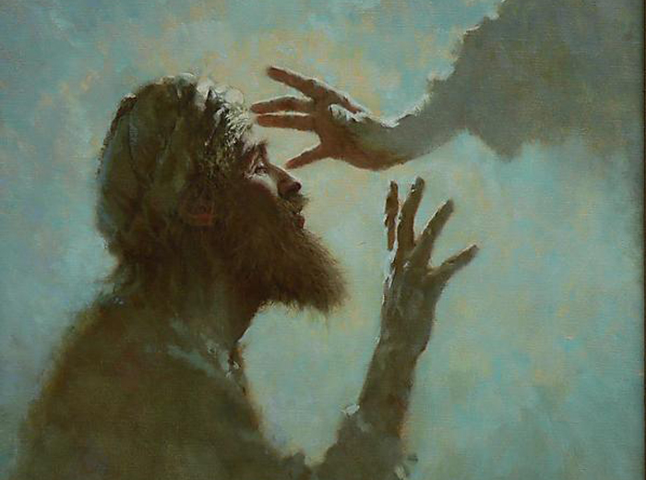
LECTIO DIVINA
BDES

Slide 3
The Sign of the Cross
BDES

Slide 4
Opening Prayer
With Your Holy Word
Breathe in me, O Holy Spirit,
that my thoughts may all be holy.
Act in me, O Holy Spirit,
that my work, too, may be holy.
Draw my heart, O Holy Spirit,
that I love but what is holy.
Strengthen me, O Holy Spirit,
to defend all that is holy.
Guard me, then, O Holy Spirit,
that I always may be holy.
Amen.
BDES

Slide 5
Silent Reflection
BDES

Slide 6
• LECTIO •
Immediately on leaving the synagogue, he went with James and John into the house of Simon and Andrew. Simon’s mother-in-law was lying in bed, sick with a fever, and they informed Jesus at once about her. Jesus approached her, grasped her by the hand, and helped her up. Then the fever left her, and she began to serve them. That evening, after sunset, they brought to him all those who were sick or possessed by demons. The whole town was present, crowded around the door. He cured many who were afflicted with various diseases, and he drove out many demons, although he would not permit them to speak because they knew who he was.
BDES

Slide 7
• LECTIO •
Early the next morning, long before dawn, he arose and went off to a secluded place, where he prayed. Simon and his companions set forth in search of him, and when they found him they said, “Everybody is looking for you.” He replied, “Let us move on to the neighboring towns so that I may proclaim the message there as well. For this is the reason why I came.” Then he traveled all throughout Galilee, preaching in their synagogues and driving out demons.
BDES

Slide 8
• LECTIO •
Immediately on leaving the synagogue, he went with James and John into the house of Simon and Andrew. Simon’s mother-in-law was lying in bed, sick with a fever, and they informed Jesus at once about her. Jesus approached her, grasped her by the hand, and helped her up. Then the fever left her, and she began to serve them. That evening, after sunset, they brought to him all those who were sick or possessed by demons. The whole town was present, crowded around the door. He cured many who were afflicted with various diseases, and he drove out many demons, although he would not permit them to speak because they knew who he was.
BDES

Slide 9
• LECTIO •
Early the next morning, long before dawn, he arose and went off to a secluded place, where he prayed. Simon and his companions set forth in search of him, and when they found him they said, “Everybody is looking for you.” He replied, “Let us move on to the neighboring towns so that I may proclaim the message there as well. For this is the reason why I came.” Then he traveled all throughout Galilee, preaching in their synagogues and driving out demons.
BDES

Slide 10
• MEDITATIO •
REFLECTION
What God is saying to you?
Feel free to share ‘echoes’ of the text,
a phrase that strikes you.
If you wish, please say why.
BDES

Slide 11
• MEDITATIO •
BDES

Slide 12
• MEDITATIO •
Immediately on leaving the synagogue, he went with James and John into the house of Simon and Andrew. Simon’s mother-in-law was lying in bed, sick with a fever, and they informed Jesus at once about her. Jesus approached her, grasped her by the hand, and helped her up. Then the fever left her, and she began to serve them. That evening, after sunset, they brought to him all those who were sick or possessed by demons. The whole town was present, crowded around the door. He cured many who were afflicted with various diseases, and he drove out many demons, although he would not permit them to speak because they knew who he was. Early the next morning, long before dawn, he arose and went off to a secluded place, where he prayed. Simon and his companions set forth in search of him, and when they found him they said, “Everybody is looking for you.” He replied, “Let us move on to the neighboring towns so that I may proclaim the message there as well. For this is the reason why I came.” Then he traveled all throughout Galilee, preaching in their synagogues and driving out demons.
BDES

Slide 13
• ORATIO •
PRAYER
What would you like to say to God?
……..
Lord in your mercy …
R / Hear our prayer
BDES

Slide 14
• ORATIO •
BDES

Slide 15
• CONTEMPLATIO •
LET US
REST IN GOD
IN SILENCE
May the Holy Spirit deepen our awareness of the Word
BDES

Slide 16
• CONTEMPLATIO •
BDES

Slide 17
The Lord’s Prayer
BDES

Slide 18
• ACTIO •
BDES

