Slide 1
LECTIO DIVINA
Brentwood Diocese Education Service

Slide 2
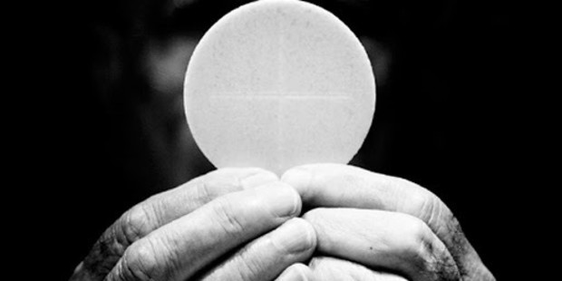
LECTIO DIVINA
Brentwood Diocese Education Service

Slide 3
The Sign of the Cross
BDES

Slide 4
Opening Prayer
Dear God,
we abound in hope by the power of Your Holy Spirit.
Fill us with all joy and peace as we believe in You.
Holy Spirit, empower our lives
to produce Your fruit of
love, joy, peace, patience, kindness, goodness,
faithfulness, gentleness and self-control.
Let us listen attentively to Your Word.
Amen.
BDES

Slide 5
Silent Reflection
BDES

Slide 6
• LECTIO •
Jesus said to the Jewish crowds: “I am the living bread that came down from heaven; whoever eats this bread will live forever; and the bread that I will give is my flesh for the life of the world.”
The Jews quarreled among themselves, saying, “How can this man give us his flesh to eat?”
Jesus said to them, “Amen, amen, I say to you, unless you eat the flesh of the Son of Man and drink his blood, you do not have life within you. Whoever eats my flesh and drinks my blood has eternal life, and I will raise him on the last day.
BDES

Slide 7
• LECTIO •
For my flesh is true food, and my blood is true drink. Whoever eats my flesh and drinks my blood remains in me and I in him. Just as the living Father sent me and I have life because of the Father, so also the one who feeds on me will have life because of me. This is the bread that came down from heaven. Unlike your ancestors who ate and still died, whoever eats this bread will live forever.”
BDES

Slide 8
• LECTIO •
Jesus said to the Jewish crowds: “I am the living bread that came down from heaven; whoever eats this bread will live forever; and the bread that I will give is my flesh for the life of the world.”
The Jews quarreled among themselves, saying, “How can this man give us his flesh to eat?”
Jesus said to them, “Amen, amen, I say to you, unless you eat the flesh of the Son of Man and drink his blood, you do not have life within you. Whoever eats my flesh and drinks my blood has eternal life, and I will raise him on the last day.
BDES

Slide 9
• LECTIO •
For my flesh is true food, and my blood is true drink. Whoever eats my flesh and drinks my blood remains in me and I in him. Just as the living Father sent me and I have life because of the Father, so also the one who feeds on me will have life because of me. This is the bread that came down from heaven. Unlike your ancestors who ate and still died, whoever eats this bread will live forever.”
BDES

Slide 10
• MEDITATIO •
REFLECTION
What God is saying to you?
Feel free to share ‘echoes’ of the text,
a phrase that strikes you.
If you wish, please say why.
BDES

Slide 11
• MEDITATIO •
BDES

Slide 12
• MEDITATIO •
Jesus said to the Jewish crowds: “I am the living bread that came down from heaven; whoever eats this bread will live forever; and the bread that I will give is my flesh for the life of the world.”
The Jews quarreled among themselves, saying, “How can this man give us his flesh to eat?”
Jesus said to them, “Amen, amen, I say to you, unless you eat the flesh of the Son of Man and drink his blood, you do not have life within you. Whoever eats my flesh and drinks my blood has eternal life, and I will raise him on the last day. For my flesh is true food, and my blood is true drink. Whoever eats my flesh and drinks my blood remains in me and I in him. Just as the living Father sent me and I have life because of the Father, so also the one who feeds on me will have life because of me. This is the bread that came down from heaven. Unlike your ancestors who ate and still died, whoever eats this bread will live forever.”
BDES

Slide 13
• ORATIO •
PRAYER
What would you like to say to God?
……..
Lord in your mercy …
R / Hear our prayer
BDES

Slide 14
• ORATIO •
BDES

Slide 15
• CONTEMPLATIO •
LET US
REST IN GOD
IN SILENCE
May the Holy Spirit deepen our awareness of the Word
BDES

Slide 16
• CONTEMPLATIO •
BDES

Slide 17
The Lord’s Prayer
BDES

Slide 18
• ACTIO •
Brentwood Diocese Education Service

