Slide 1
LECTIO DIVINA
Brentwood Diocese Education Service

Slide 2
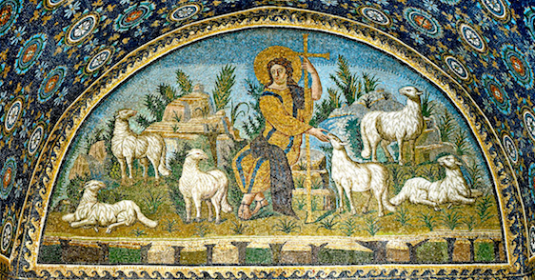
LECTIO DIVINA
Brentwood Diocese Education Service

Slide 3
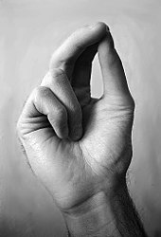
The Sign of the Cross
BDES

Slide 4
Opening Prayer
Lord,
in your presence,
let us prepare our hearts for this moment of prayer.
Send your Holy Spirit to enlighten us
and open our minds and hearts
to everything You want to tell us today.
Thank you Lord,
for nourishing us with your Word.
BDES

Slide 5
Silent Reflection
BDES

Slide 6
• LECTIO •
Tax collectors and sinners were all drawing near to listen to Jesus, but the Pharisees and scribes began to complain, saying, “This man welcomes sinners and eats with them.”
So to them he addressed this parable.
“What man among you having a hundred sheep and losing one of them would not leave the ninety-nine in the desert and go after the lost one until he finds it?
BDES

Slide 7
• LECTIO •
And when he does find it, he sets it on his shoulders with great joy and, upon his arrival home, he calls together his friends and neighbours and says to them, ‘Rejoice with me because I have found my lost sheep.’
I tell you, in just the same way there will be more joy in heaven over one sinner who repents than over ninety-nine righteous people who have no need of repentance.
BDES

Slide 8
• LECTIO •
Tax collectors and sinners were all drawing near to listen to Jesus, but the Pharisees and scribes began to complain, saying, “This man welcomes sinners and eats with them.”
So to them he addressed this parable.
“What man among you having a hundred sheep and losing one of them would not leave the ninety-nine in the desert and go after the lost one until he finds it?
BDES

Slide 9
• LECTIO •
And when he does find it, he sets it on his shoulders with great joy and, upon his arrival home, he calls together his friends and neighbours and says to them, ‘Rejoice with me because I have found my lost sheep.’
I tell you, in just the same way there will be more joy in heaven over one sinner who repents than over ninety-nine righteous people who have no need of repentance.
BDES

Slide 10
• MEDITATIO •
REFLECTION
What God is saying to you?
Feel free to share ‘echoes’ of the text,
a phrase that strikes you.
If you wish, please say why.
BDES

Slide 11
• MEDITATIO •
Tax collectors and sinners were all drawing near to listen to Jesus, but the Pharisees and scribes began to complain, saying, “This man welcomes sinners and eats with them.”
So to them he addressed this parable.
“What man among you having a hundred sheep and losing one of them would not leave the ninety-nine in the desert and go after the lost one until he finds it?
And when he does find it, he sets it on his shoulders with great joy and, upon his arrival home, he calls together his friends and neighbours and says to them, ‘Rejoice with me because I have found my lost sheep.’
I tell you, in just the same way there will be more joy in heaven over one sinner who repents than over ninety-nine righteous people who have no need of repentance.
BDES

Slide 12
• ORATIO •
PRAYER
What would you like to say to God?
……..
Lord in your mercy …
R / Hear our prayer
BDES

Slide 13
• ORATIO •
BDES

Slide 14
• CONTEMPLATIO •
LET US
REST IN GOD
IN SILENCE
May the Holy Spirit deepen our awareness of the Word
BDES

Slide 15
• CONTEMPLATIO •
BDES

Slide 16
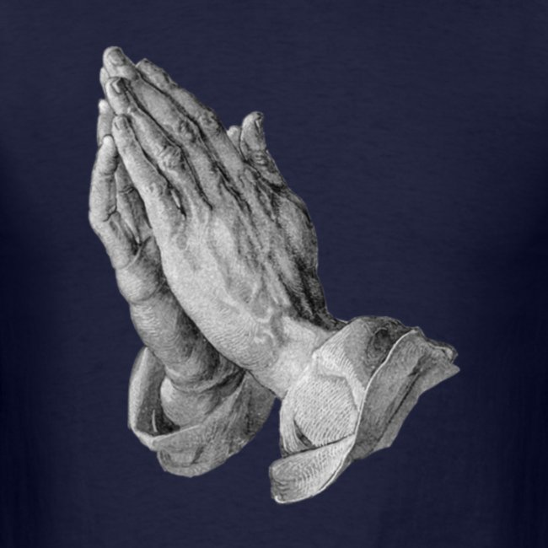
The Lord’s Prayer
BDES

Slide 17
• ACTIO •
Brentwood Diocese Education Service

