Slide 1
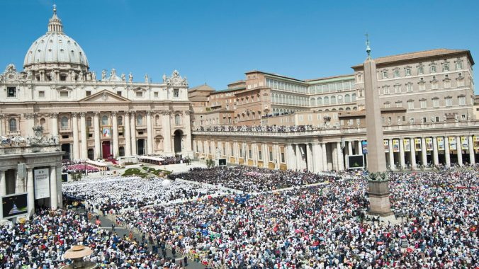
Looking Forward
~ Looking Forward as Sisters and Brothers ~
Monday 22nd May 2023
Brentwood Diocese Education Service

Slide 2
Looking Forward as Sisters and Brothers
This week’s Sunday Gospel reading tells us that Jesus prays for his disciples.
The disciples are part of the world but have been chosen
to make God and Jesus known to the world
and to serve for the salvation of the world.
We are the followers of Jesus in the world today
and like the disciples we work for the salvation of ourselves and others
and make Jesus known through our words and actions.
BDES

Slide 3
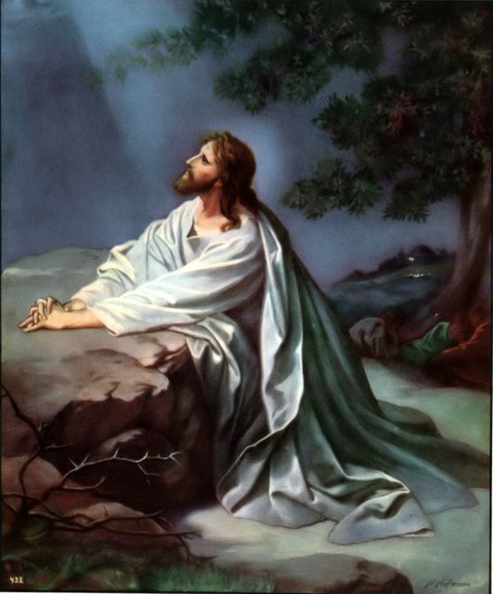
In Sunday’s Gospel Reading …
Sunday 21st May 2023 :
In the Gospel of John, Jesus says :
“I pray for them.”
BDES

Slide 4
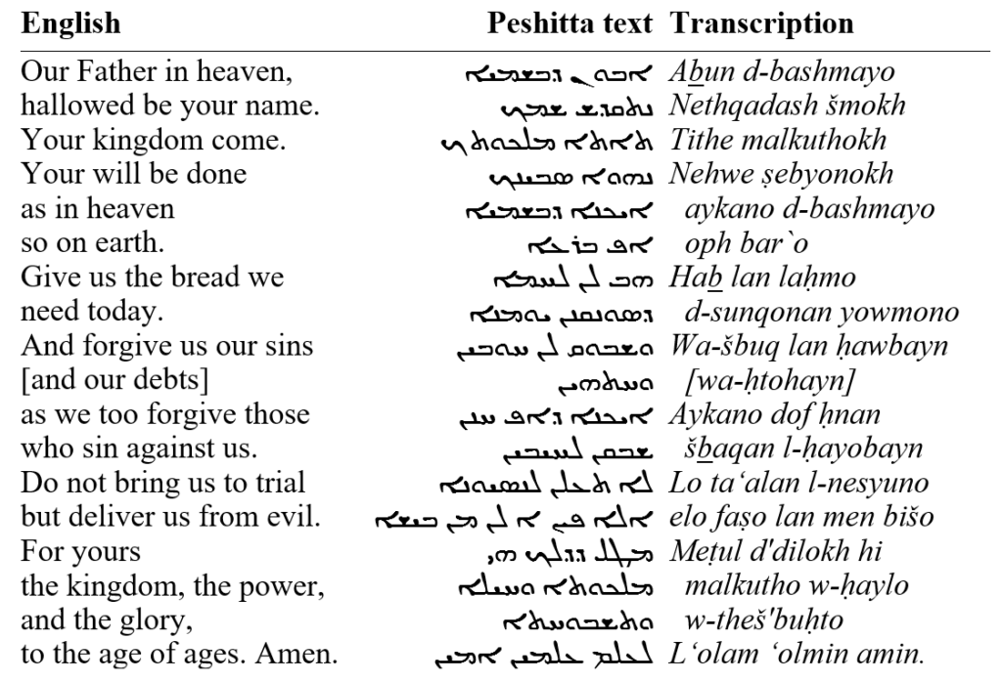
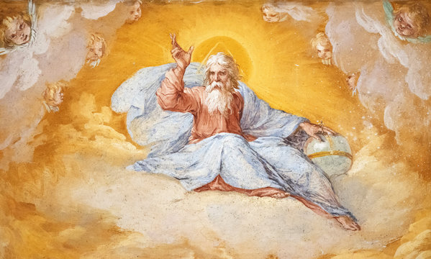
The Lord’s Prayer
As we look forward to World Youth Day in August this year, we remind ourselves of the things we share with our fellow young people from all over the world. At this international event, Catholics will pray the prayer Jesus taught us in a huge number of languages. We will mark this with a weekly inclusion of the Lord’s Prayer in the languages spoken in our schools.
Aramaic
is a language spoken by many Syrian refugees … and was also the language of Jesus himself!
BDES

Slide 5
Preparing for World Youth Day 2023
“Youth cannot remain on hold.”
- Pope Francis : Young People, Faith and Discernment, 2018)
BDES

Slide 6
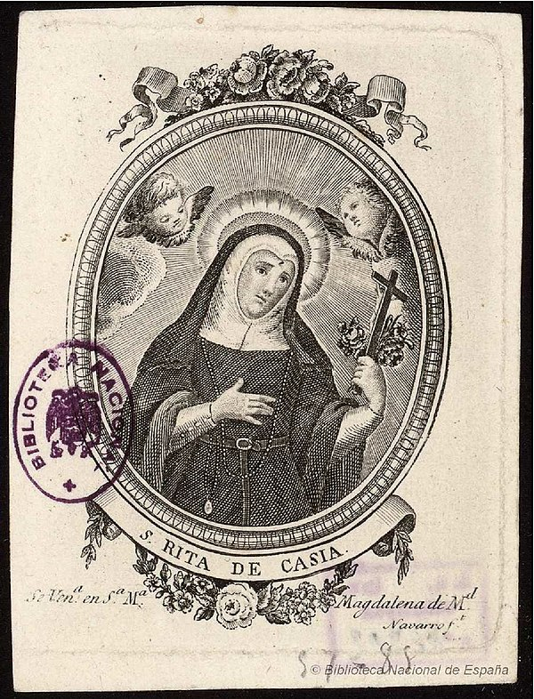
St Rita of Cascia
Feast day : 22nd May
Rita was a widow who joined the Augustinian order as a nun after the death of her husband.
She was born in Italy in the 14th Century and was married to an Italian nobleman. She was married for eighteen years and after her husband was murdered Rita forgave his killers.
She then joined the order at the age of 36 and died in her 70s.
She was canonised in 1900 and is the patron saint of lost and impossible causes, as well as of mothers.
BDES

Slide 7
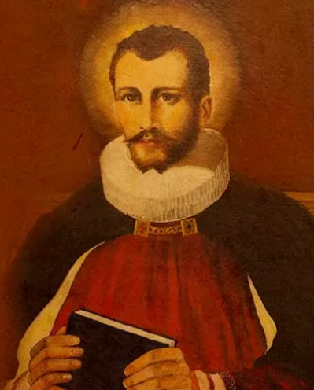
Martyrs of England and Wales : St Edmund Campion
Edmund Campion (1540- 1581) was such an accomplished scholar that he was made a fellow of St John’s College, Oxford, at the age of only 17. His Catholic faith led him to walk barefoot to Rome, where he joined the Society of Jesus.
He returned to England as a priest where he ministered to Catholics secretly until he was betrayed. He was imprisoned in the Tower of London, and sentenced to death. He was martyred at Tyburn on 1st December 1581 and canonised by Pope Paul VI in 1970.
In 1962 The Campion School in Hornchurch was founded in his honour and memory by the Society of Jesus.
BDES

Slide 8
Looking Forward
~ Looking Forward as Sisters and Brothers ~
Monday 22nd May 2023
Brentwood Diocese Education Service

