Slide 1
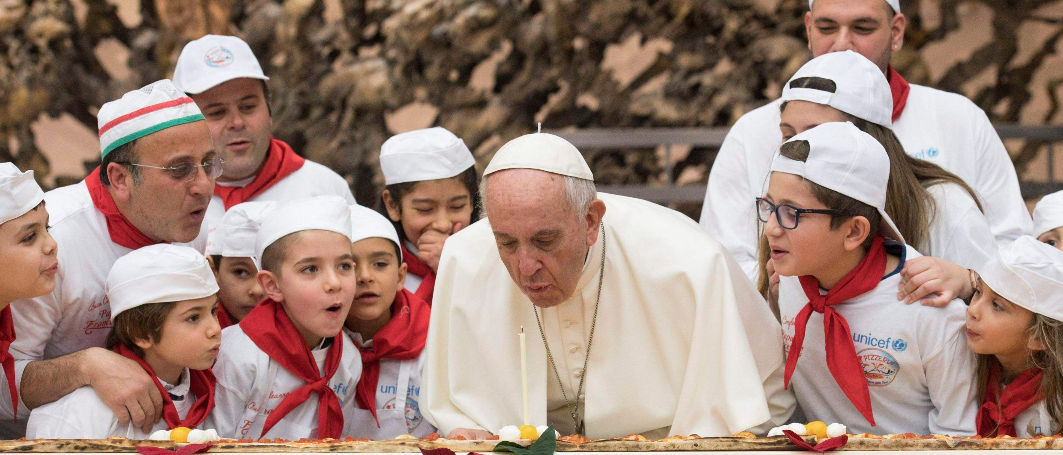
Looking Forward
~ Looking Forward Together~
Monday 5th June 2023
Brentwood Diocese Education Service

Slide 2
Looking Forward Together
Live in harmony, united together,
all of one heart and one will.
Be bound to one another
by the bond of charity,
esteeming each other,
bearing with each other
in Jesus Christ.
- The “Last Counsel” of St Angela Merici
BDES

Slide 3
In Sunday’s Gospel Reading
4th June 2023
In the Gospel of John, we hear :
“God so loved the world, He gave His only Son.”
BDES

Slide 4
Preparing for World Youth Day 2023
“Youth is the age of choices and here lies its fascination and its greatest responsibility.”
- Pope Francis,
Young People, Faith and Discernment, 2018
BDES

Slide 5
BDES

Slide 6
The Lord’s Prayer
As we look forward to World Youth Day in August this year, we remind ourselves of the things we share with our fellow Christians from all over the world. At this international event, Catholics will pray the prayer Jesus taught us in a huge number of languages. You might even hear it in the international language of the Catholic Church : xxxxxxxxLatin
Pater noster,
qui es in caelis,
sanctificetur nomen tuum.
Adveniat regnum tuum.
Fiat voluntas tua,
sicut in caelo et in terra.
Panem nostrum quotidianum
da nobis hodie,
et dimitte nobis debita nostra
sicut et nos dimittimus
debitoribus nostris.
Et ne nos inducas in tentationem, sed libera nos a malo.
Amen.
BDES

Slide 7
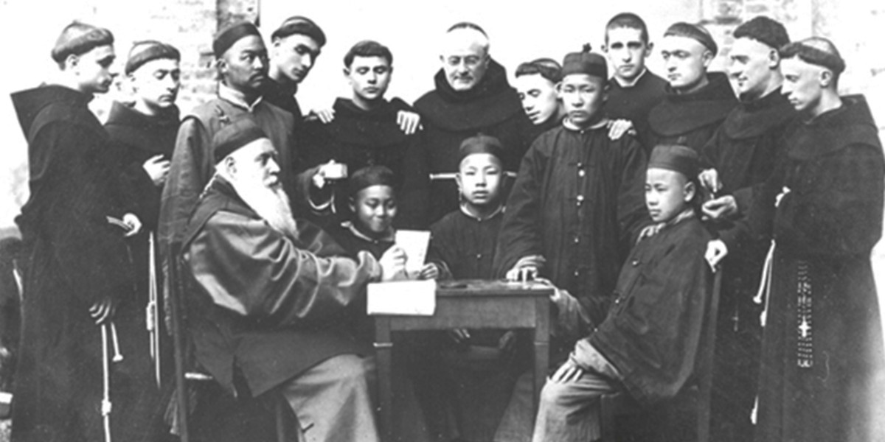
BLESSED FRANCISCAN MARTYRS OF CHINA
Feast Day : 5th June
BDES
BDES

Slide 8
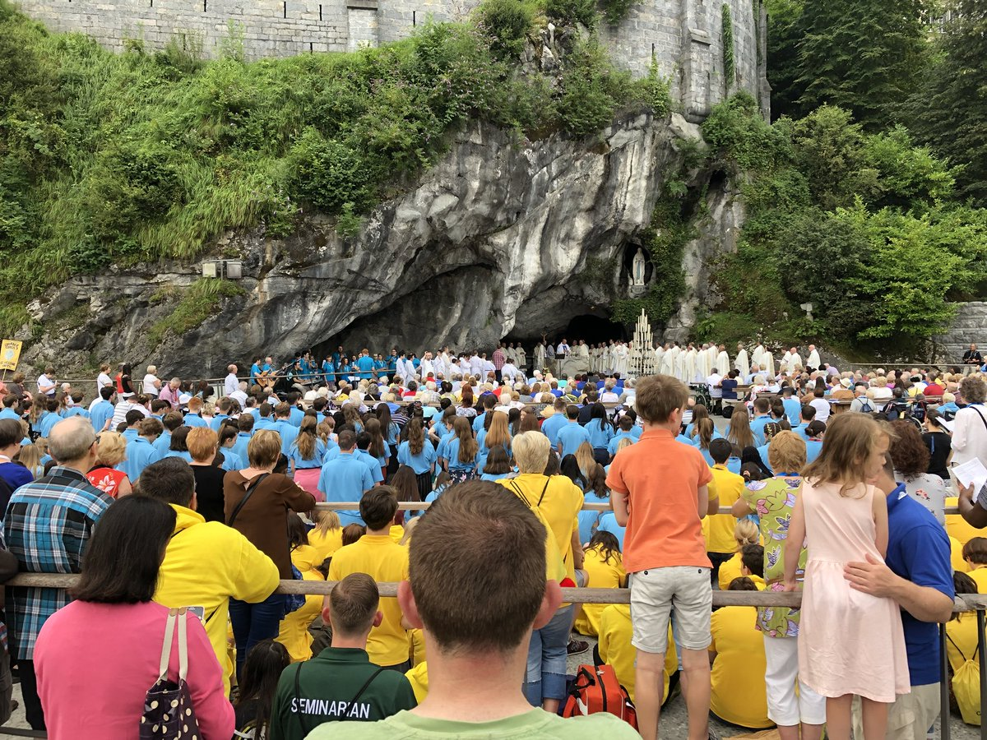
Diocesan Pilgrimage to Lourdes, July 2023
At the very beginning of the summer holidays, the Diocese of Brentwood will be undertaking its annual pilgrimage to Lourdes. As part of this pilgrimage, a large group of young people will be attending in order to help less able pilgrims and to celebrate the journey and the destination in their own unique style. They will visit
THE GROTTO
where Our Lady appeared to St Bernadette eighteen times from February to July 1858.
Are you going this year? Would you like to go one day? Maybe you too will get to wear the famous “Brentwood blue” of the Brentwood Catholic Youth Service? ☺
BDES

Slide 9
Looking Forward
~ Looking Forward Together~
Monday 5th June 2023
Brentwood Diocese Education Service

