Slide 1
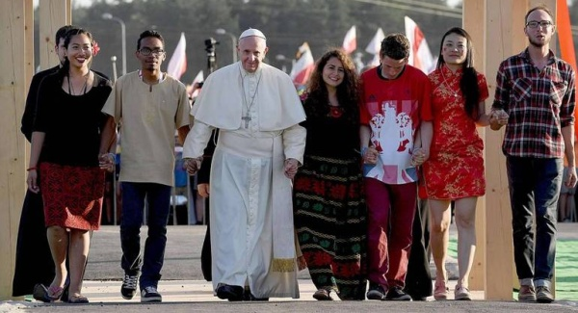
Looking Forward
~ Looking Forward Together~
Monday 19th June 2023
Brentwood Diocese Education Service

Slide 2
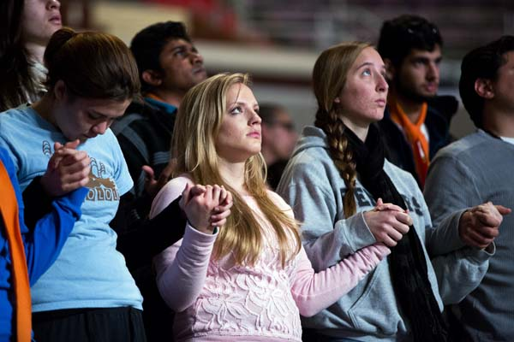
Looking Forward Together
God of Our Journey,
as we gather together
we lift up our voices
to give praise and thanksgiving to your name,
the God of encounter
who, by the power of the Holy Spirit,
makes us one in Christ, our Saviour.
- Prayer for Journeying Together (US Conference of Catholic Bishops, 2023)
BDES

Slide 3
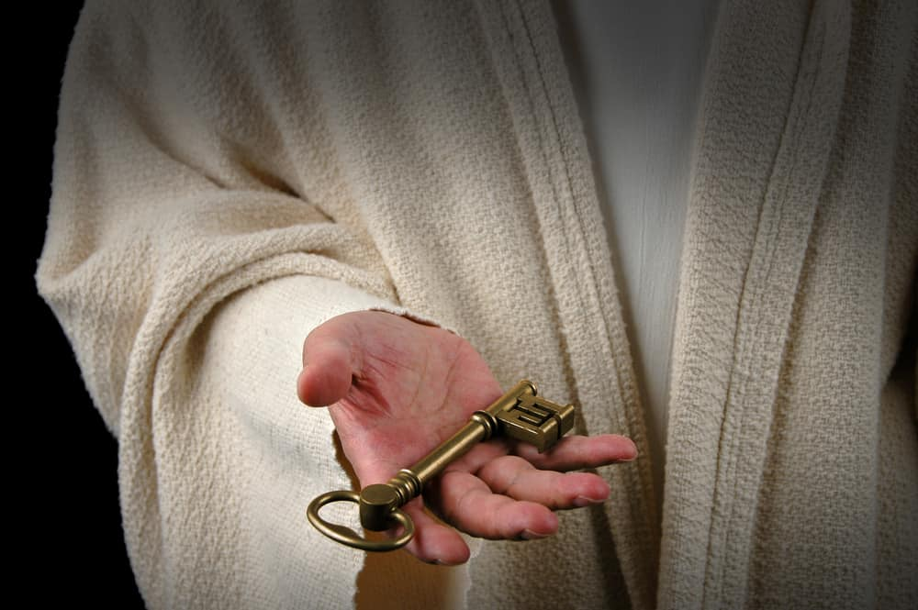
In Sunday’s Gospel Reading
18th June 2023
In the Gospel of Matthew, Jesus tells His friends :
“The kingdom of heaven is at hand.”
BDES

Slide 4
Preparing for World Youth Day 2023
“Jesus looks at you
and invites you
to go with Him.”
- Pope Francis,
Letter to Young People, 2018
BDES

Slide 5
The Lord’s Prayer
As we look forward to World Youth Day in August this year, we remind ourselves of the things we share with our fellow Christians from all over the world. At this international event, Catholics will pray the prayer Jesus taught us in a huge number of languages. You might hear it in xxxxxxxxSwahili
an East African language spoken by 20 million people.
Baba Yetu uliye mbinguni, Jina lako litukuzwe; Ufalme wako ufike, Utakalo lifanyike Duniani kama mbinguni. Utupe leo mkate wetu wa kila siku, Utusamehe makosa yetu, Kama nasi tunavyowasamehe waliotukosea. Usitutie katika kishawishi, Lakini utuopoe maovuni. Amina.
BDES

Slide 6
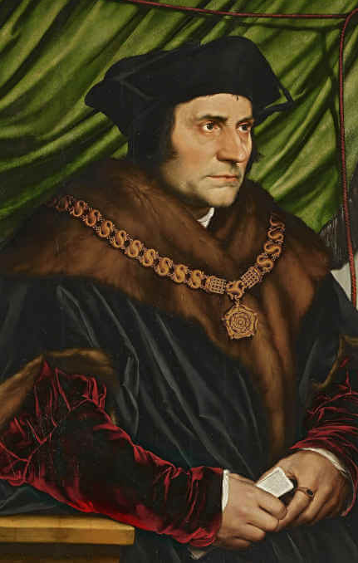
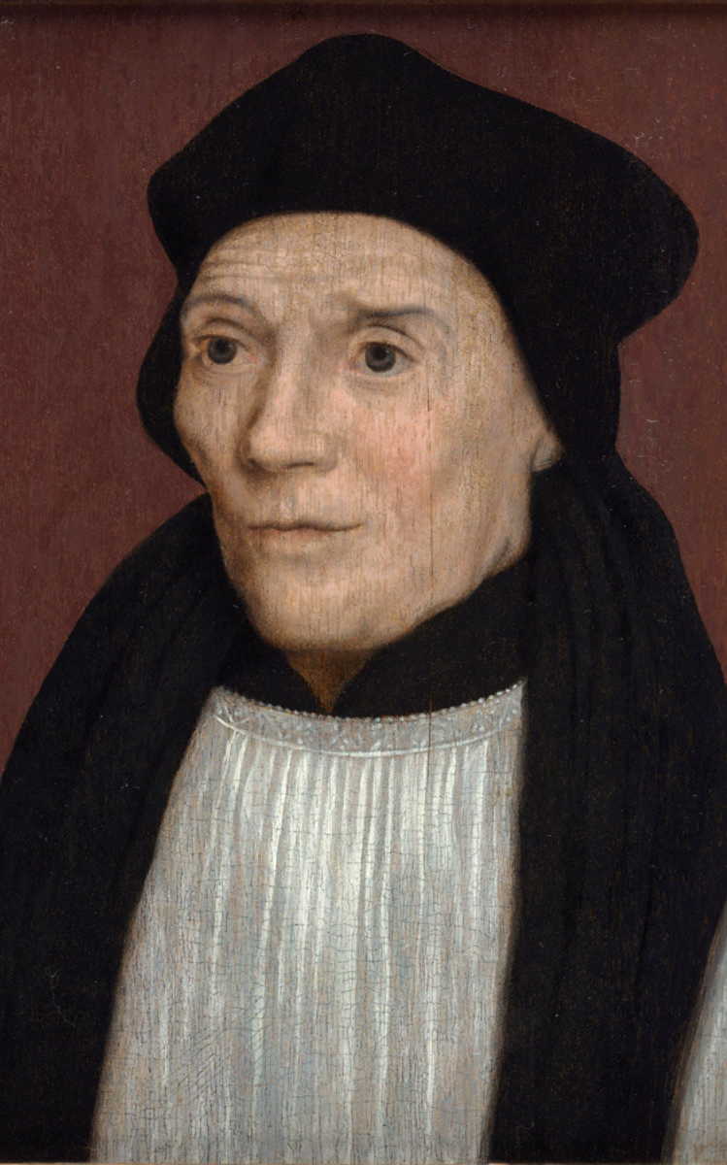
St John Fisher and St Thomas More were put to death on the orders of Henry VIII for refusing to accept Henry as Supreme Head of the Church in England.
They were both executed in the Tower of London and their headless corpses buried in the church of St Peter ad Vincula inside the walls of the Tower. Fisher’s head was displayed on London Bridge and then thrown into the Thames to be replaced by More’s head. This was later rescued by More’s daughter Margaret.
The two men were made saints in 1935 and their feast is 22nd June, the date of Fisher’s execution.
Before he was martyred, More is reported to have said “I die the King’s good servant, but God’s first”.
St John Fisher and St Thomas More
Feast day : 22nd June
BDES

Slide 7
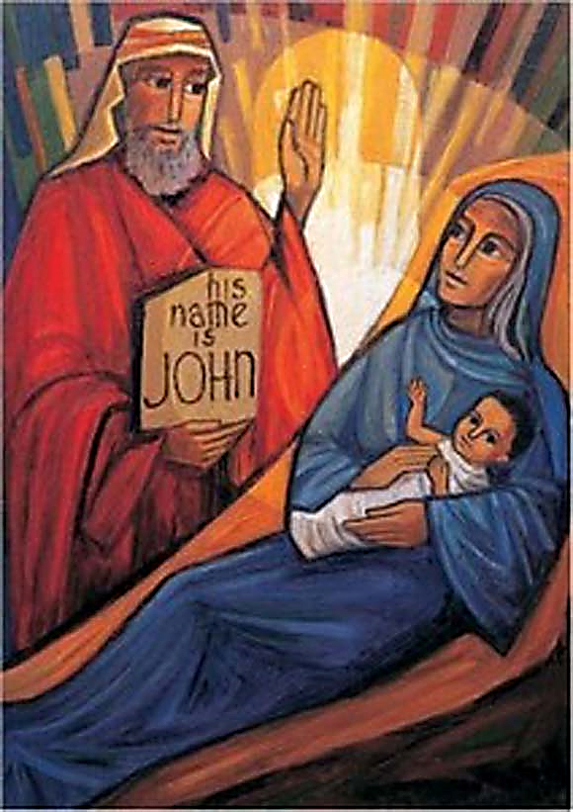
BDES

Slide 8
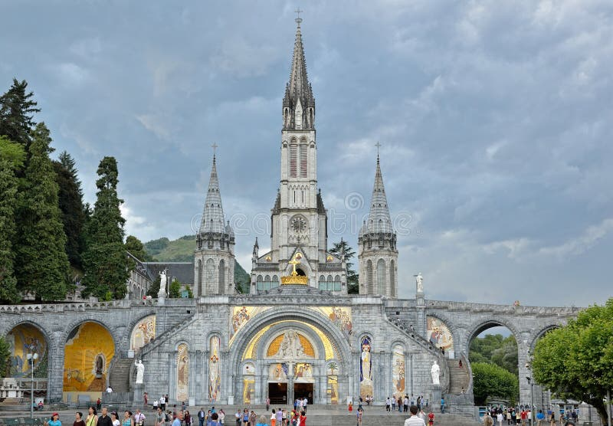
Diocesan Pilgrimage to Lourdes, July 2023
At the very beginning of the summer holidays, the Diocese of Brentwood will be undertaking its annual pilgrimage to Lourdes. As part of this pilgrimage, a large group of young people will be attending in order to help less able pilgrims and to celebrate the journey and the destination in their own unique style. They will visit, amongst other places,
THE ROSARY BASILICA
the third church completed in the Domain and full of beautiful and inspirational mosaics.
Are you going this year? Would you like to go one day? Maybe you too will get to wear the famous “Brentwood blue” of the Brentwood Catholic Youth Service? ☺
BDES

Slide 9
Looking Forward
~ Looking Forward Together~
Monday 19th June 2023
Brentwood Diocese Education Service

