Slide 1
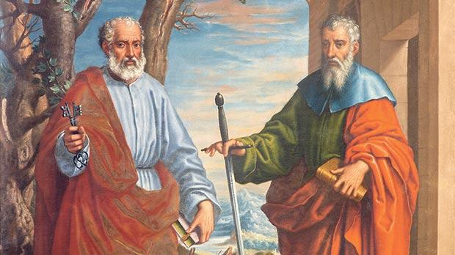
Looking Forward
~ Looking Forward Together ~
Monday 26th June 2023
Brentwood Diocese Education Service

Slide 2
Looking Forward Together
The Church proclaimed by Peter and Paul, is one, holy, catholic and apostolic.
In the red vestments of their feast, celebrated this week,
which represent Peter and Paul’s martyrdom,
we also recall the red vestments of Pentecost –
when the Holy Spirit breathed into a new community
that would speak all languages and unite all peoples into one people,
in one family of God,
guaranteed by their fidelity to the truth.
Our schools reflect this unity and fidelity.
BDES

Slide 3
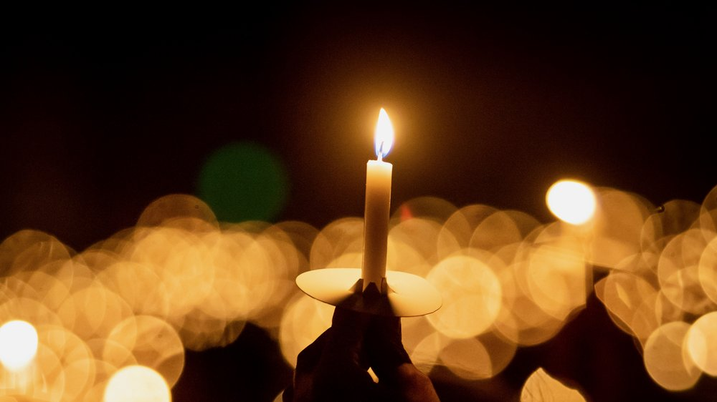
In Sunday’s Gospel Reading …
Sunday 25th June 2023 :
In the Gospel of Matthew, Jesus tell his friends :
“Speak in the light.”
BDES

Slide 4
The Lord’s Prayer
Tėve Mūsų, kuris esi danguje! Teesie šventas tavo vardas, teateinie tàvo karalystė Teesie tàvo valià, Kaip danguje, taip ir žemėje. Kasdienes mūsų dúonos
dúok mùms šiañdien ir atlèisk mums mūsų kaltès, kaip ir mes atleidžiame
sàvo kaltiniñkams. Ir neléisk mūsų gùndyti, Bet gelbėk mus nuo pikto. Amen.
As we look forward to World Youth Day in August this year, we remind ourselves of the things we share with our fellow young people from all over the world.
At this international event, Catholics will pray the prayer Jesus taught us in a huge number of languages. We will mark this with a weekly inclusion of the Lord’s Prayer in the languages spoken in our schools.
This week the Lord’s Prayer is in
Lithuanian
BDES

Slide 5
Preparing for World Youth Day 2023
“Even when the journey is uncertain and you fall, God, rich in mercy, will extend his hand to pick you up.”
- Pope Francis, Letter to Young People, 2018
BDES

Slide 6
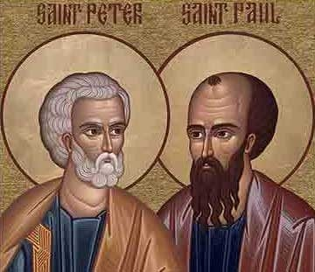
Saints Peter and Paul
Solemnity : 29th June
Thursday 29th June is a Holy Day of Obligation
St. Peter and Paul’s day is the feast day that honours the martyrdom of the two saints, sometime between AD 64 and 68. While the Church recognizes that they may not have died on the same day, tradition says that this is the day that they were both martyred in Rome by Emperor Nero.
The day is a solemnity or a feast day of the highest rank. This honour is reserved for only the most important events, such as those in the lives of Jesus or Mary. Therefore this xxxx emphasizes just how important the two saints are to the Catholic faith.
BDES

Slide 7
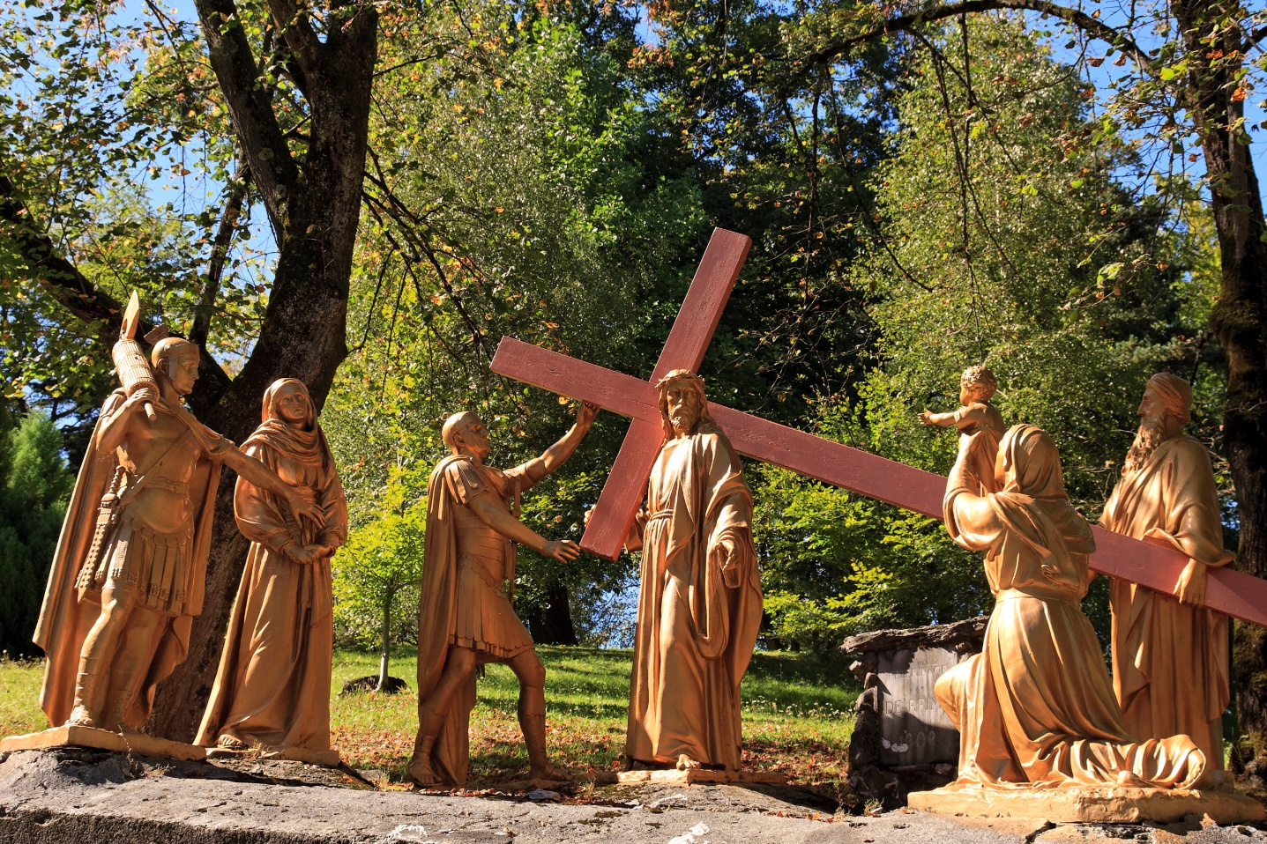
Diocesan Pilgrimage to Lourdes, July 2023
At the very beginning of the summer holidays, the Diocese of Brentwood will be undertaking its annual pilgrimage to Lourdes.
The High Stations of the Cross
These Stations of the Cross, opened in September 1912, covers 1,500 metres and involves difficult climbs and descents. Its 15 stations are interspersed with 115 life-size statues in patinated cast iron.
Each tableau of statues illustrates a key event in the life of Christ during his Passion: from His condemnation by Pontius Pilate to His entombment on Good Friday evening.
To follow the Stations of the Cross is to discover, as Bernadette did, how much we are loved by Jesus and to take our burdens to Him in complete trust.
Do you have the ambition to visit Lourdes one day?
BDES

Slide 8
Looking Forward
~ Looking Forward Together ~
Monday 26th June 2023
Brentwood Diocese Education Service

