Slide 1
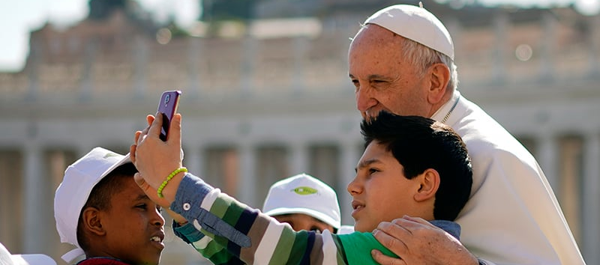
Looking Forward
~ Looking Forward Together~
Monday 3rd July 2023
Brentwood Diocese Education Service

Slide 2
Looking Forward Together
“For where two or three gather in my name, there am I with them.” - Matthew 18:20
Lord Jesus,
we are all different people,
from different backgrounds and different races,
with different stories and maybe different languages,
from different families, with different viewpoints,
sometimes with different beliefs;
but we in our school we are gathered together in one name.
One beautiful and matchless name: Jesus!
Jesus, come into our midst as we pray today.
BDES

Slide 3
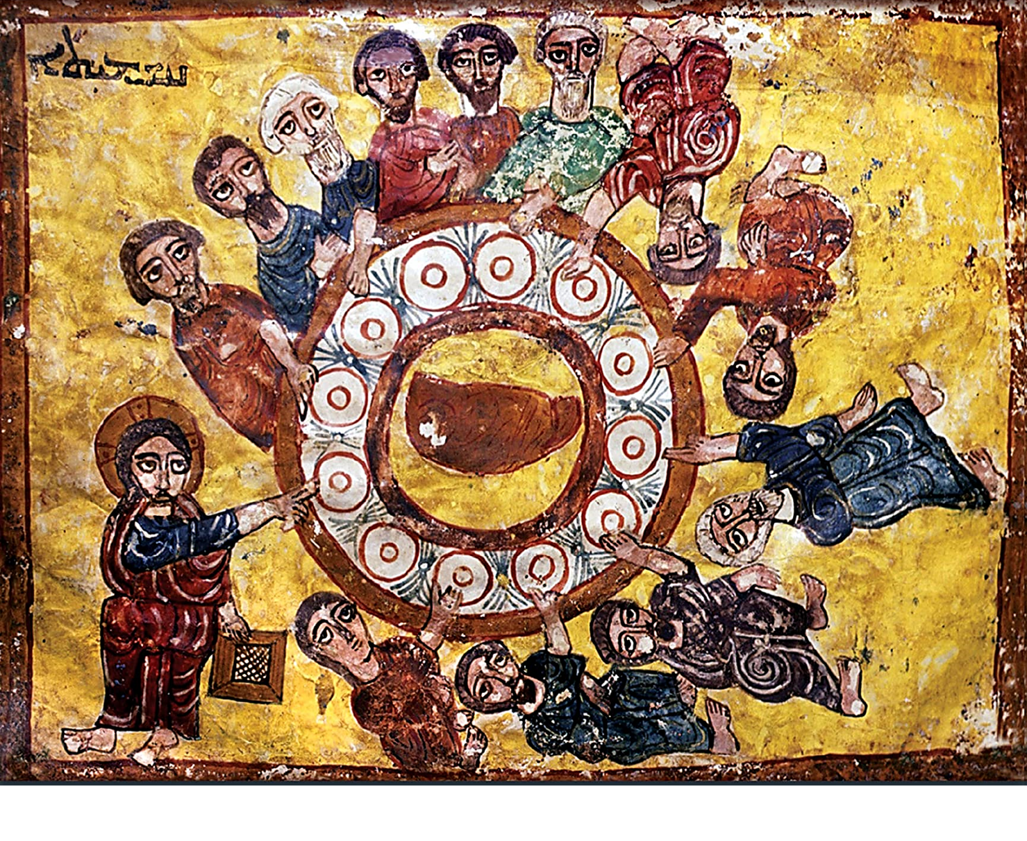
In Sunday’s Gospel Reading
2nd July 2023
In the Gospel of Matthew, Jesus tells His friends :
“Whoever receives you, receives me.”
BDES

Slide 4
Preparing for World Youth Day 2023
“A better world can be built as a result of your efforts, your desire to change and your generosity.”
- Pope Francis,
Letter to Young People, 2018
BDES

Slide 5
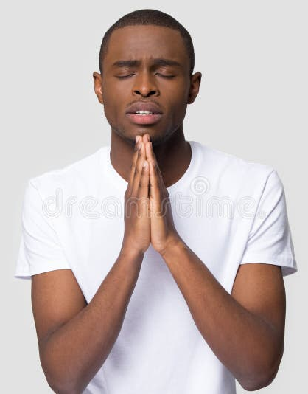
The Lord’s Prayer
As we look forward to World Youth Day in August this year, we remind ourselves of the things we share with our fellow Christians from all over the world. At this international event, Catholics will pray the prayer Jesus taught us in a huge number of languages, languages often familiar to those in our schools, e.g. xxxxxxxxIgbo
a South Nigerian language.
Nna anyịnọn'eluigwe.
Ka otito dịrịaha Gị.
Ka ọchịchịGịbịa; ka eme uche Gị n'ụwa,
ka esi eme ya n'eluigwe.
Nye anyịtata, nri nke ụbọchịanyị:
Gbahara anyịnmehie anyịga,
dịka anyịsi gbaghara ndịmehiere anyị.
E kwela k'anyịkwenye na nranye;
ma zọpụta anyịn'ajọihe. Amịn.
BDES

Slide 6
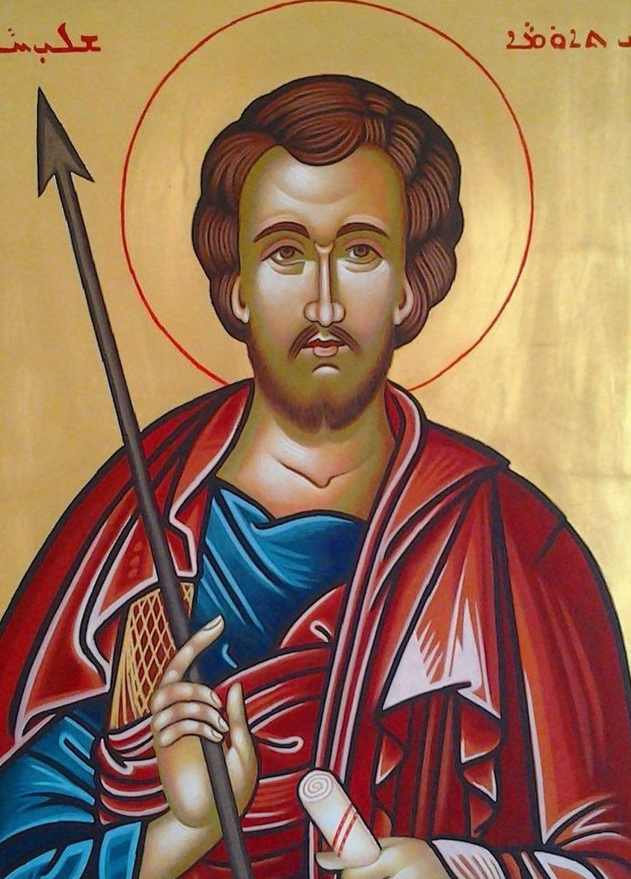
St Thomas the Apostle
Feast day : 3rd July
St Thomas the Apostle, also known as Didymus (in Greek : “the twin”) was one of the twelve apostles of Jesus. He is often referred to as “Doubting Thomas” because he initially doubted the Resurrection when he was told about it, as related in the Gospel of John; he later confessed his faith (“My lord and my God”) on seeing the wounds of the crucifixion.
According to traditional accounts of the Saint Thomas Christians of modern-day Kerala in India, St Thomas travelled outside the Roman Empire to preach the Gospel, travelling as far as the Tamalikam in southern India AD 52. In 1258, some of his relics were brought to Italy, where they have since been held in the Church of Saint Thomas the Apostle in Ortona. He is regarded as the patron saint of India and the Feast of Saint Thomas is celebrated as Indian Christians’ Day.
BDES

Slide 7
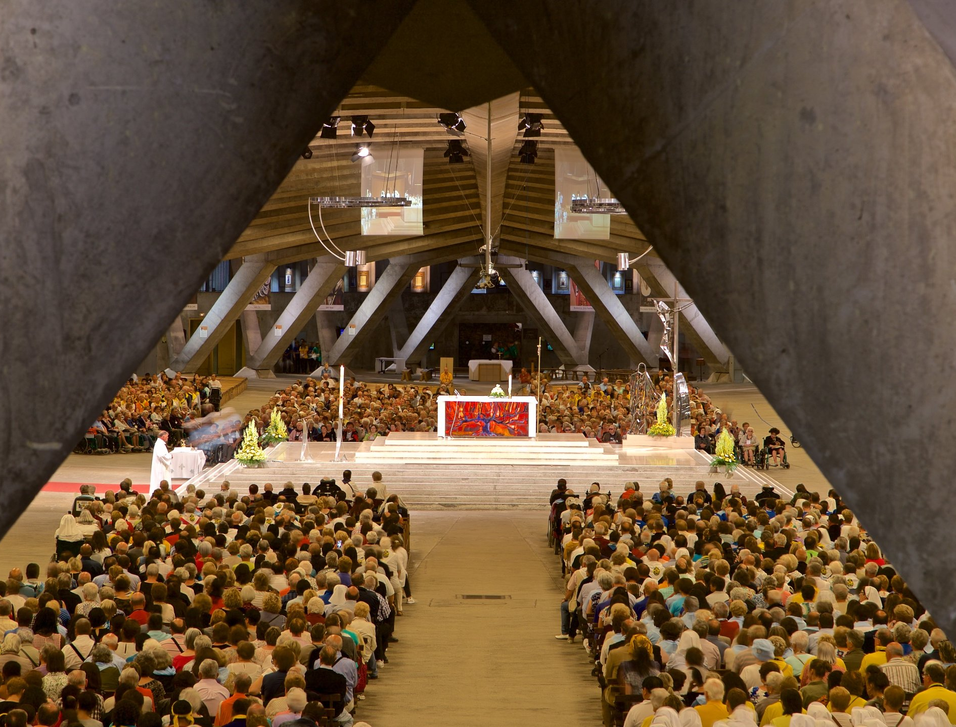
Diocesan Pilgrimage to Lourdes, July 2023
At the very beginning of the summer holidays, the Diocese of Brentwood will be undertaking its annual pilgrimage to Lourdes. As part of this pilgrimage, a large group of young people will be attending in order to help less able pilgrims and to celebrate the journey and the destination in their own unique style. They will visit, amongst other places,
THE UNDERGROUND BASILICA OF ST PIUS X
built in a very modern style in 1958 for the centenary of the Apparitions of Our Lady to St Bernadette.
Are you going this year? Will you go one day?
Will you wear the “Brentwood blue”?
BDES

Slide 8
Looking Forward
~ Looking Forward Together~
Monday 3rd July 2023
Brentwood Diocese Education Service

