Slide 1
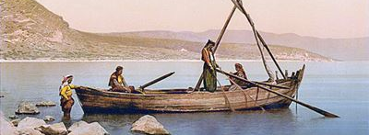
Looking Forward
~ Looking Forward Together ~
Monday 10th July 2023
Brentwood Diocese Education Service

Slide 2
Looking Forward Together
Yesterday was Sea Sunday.
It is very easy to forget the role that the sea and seafarers play in our lives.
Britain imports over 25 billion pounds worth
of food and drink each year, for example.
The seafarers who crew the ships are looked after and visited
by the charity Stella Maris who helped 113,982 seafarers
and fishers in the UK in 2021.
They make 70,000 ship visits around the world each year.
Seafarers were helped in 328 ports across 54 countries in 2021.
There are chaplains in London and in other ports who help seafarers in need with practical, spiritual, and emotional support.
BDES

Slide 3
In Sunday’s Gospel Reading …
Sunday 9th July 2023 :
In the Gospel of Matthew,
Jesus says :
“Come to me, all you who labour, and are burdened,
and I will give you rest.”
BDES

Slide 4
The Lord’s Prayer
Padre nuestro, que estás en el cielo. Santificado sea tu nombre. Venga tu reino. Hágase tu voluntad en la
tierra como en el cielo. Danos hoy nuestro pan de cada día. Perdona nuestras ofensas, como también nosotros
perdonamos a los
que nos ofenden. No nos dejes caer en tentación
y líbranos del mal. Amén.
As we look forward to World Youth Day in August this year, we remind ourselves of the things we share with our fellow young people from all over the world. At this international event, Catholics will pray the prayer Jesus taught us in a huge number of languages. We will mark this with a weekly inclusion of the Lord’s Prayer in the languages spoken in our schools.
This week the Lord’s Prayer is in Spanish
BDES

Slide 5
Preparing for World Youth Day 2023
“A better world can be built as a result of your efforts, your desire to change and your generosity.”
- Pope Francis, Letter to Young People, 2018
BDES

Slide 6
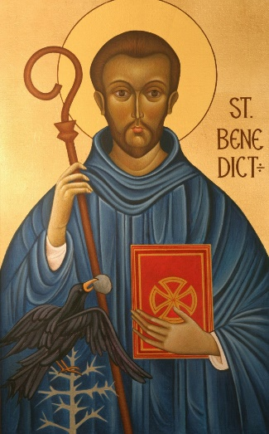
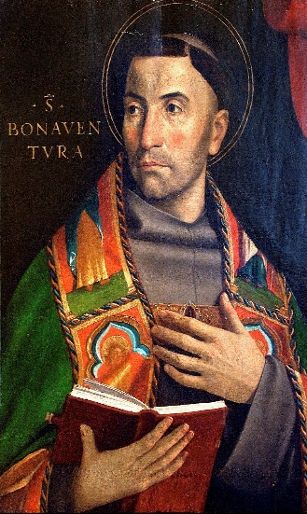
St Benedict & St Bonaventure
St Benedict (480-548) founded 12 monasteries at Subiaco before moving on to found the great monastery of Monte Cassino. His Rule for his followers and communities is based on a spirit of balance, moderation and common sense. His feast day is this week, on 11th July. In 1980 Pope John Paul II declared St Benedict to be one of the patron saints of Europe. FEAST DAY : 11th JUNE.
St. Bonaventure (1221-1274) was actually born as Giovanni di Fidanza and became the seventh Minister General of the Franciscans, who gave him the name Bonaventura, meaning “good fortune.” He was a scholar of the University of Paris, and is regarded as one of the greatest philosophers of the Middle Ages. Canonised in 1484, he was declared to be one of the Doctors of the Church in 1587 by the Franciscan pope Sixtus V. FEAST DAY : 15th JUNE.
BDES

Slide 7
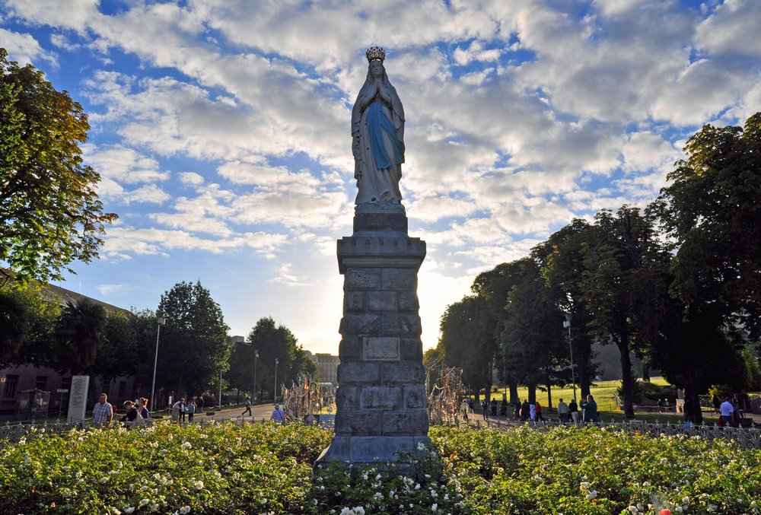
Diocesan Pilgrimage to Lourdes, July 2023
At the very beginning of the summer holidays, the Diocese of Brentwood will be undertaking its annual pilgrimage to Lourdes.
The Domain and the Statue
The statue of the Crowned Virgin is a statue of Our Lady of Lourdes very similar to the statue in the grotto of Massabielle. It has been known as the "crowned statue" after its canonical coronation on 3 July 1876 by the papal legate. The statue stands across Rosary Square from the Rosary Basilica and faces the entrance. This prominent statue is a familiar landmark and a traditional meeting point. The statue is 2.5m high and cast in bronze, painted white and blue in the traditional colours. Her rosary is of the Brigittine style and incorporates six decades. Behind the Crowned Statue is the Esplanade, a large open walkway which is used for the processions.
Will you walk in procession at Lourdes one day?
BDES

Slide 8
Looking Forward
~ Looking Forward Together ~
Monday 10th July 2023
Brentwood Diocese Education Service

