Slide 1
Looking Forward
Monday 3rd July 2023
~ Looking Forward Together~
Monday 17th July 2023
Brentwood Diocese Education Service

Slide 2
Looking Forward Together
BDES

Slide 3
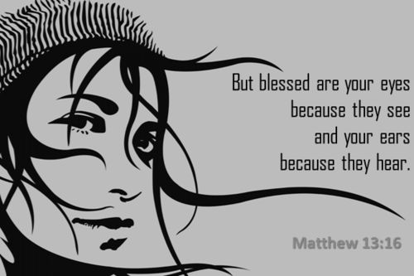
In Sunday’s Gospel Reading
16th July 2023
In the Gospel of Matthew, Jesus tells His friends :
“Blessed are your eyes, because they see, and your ears, because they hear.”
BDES

Slide 4
Preparing for World Youth Day 2023
“Do not be afraid to listen
to the Spirit
who proposes bold choices.”
- Pope Francis,
Letter to Young People, 2018
BDES

Slide 5
The Lord’s Prayer
As we look forward to World Youth Day in August this year, we remind ourselves of the things we share with our fellow Christians from all over the world. At this international event, Catholics will pray the prayer Jesus taught us in a huge number of languages, languages often familiar to those in our schools, e.g. xxxPortuguese
the language of the host nation.
Pai nosso,
que estáis no céu, Santificado seja o Teu Nome, Venha o Teu Reino,
Seja feita a Tua Vontade
Assim na terra como no céu. O pão nosso de cada dia
nos dai hoje
E perdoai as nossas ofensas
Assim como nós perdoamos, E não nos cair em tentação,
Mas livrai-nos do mal.
Amém.
BDES

Slide 6
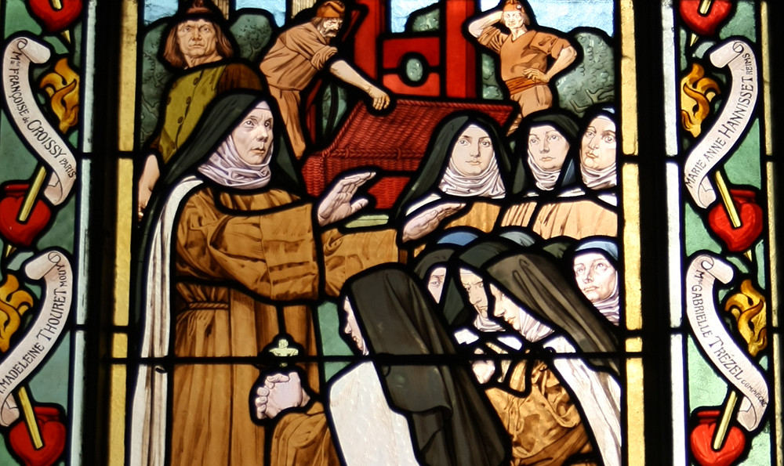
The Carmelite Nuns of Compiegne, 17th July
The Martyrs of Compiègne were the 16 members of the Carmelite convent of Compiègne in Northern France. Eleven nuns, three lay sisters and two externs (nuns who deal with the outside world) were executed by the guillotine towards the end of the Terror during the French Revolution, near the site of the Bastille in Paris on 17th July 1794. They went to their deaths singing hymns of praise and are venerated as beatified martyrs of the Catholic Church. Their story has inspired a novella, movies for television and the big screen, and even an opera, the Dialogues of the Carmelites by the French composer Francis Poulenc.
BDES

Slide 7
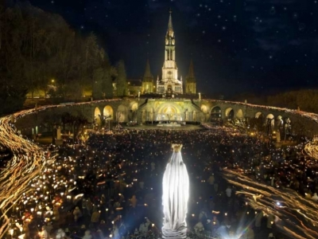
Diocesan Pilgrimage to Lourdes, July 2023
At the very beginning of the summer holidays, the Diocese of Brentwood will be undertaking its annual pilgrimage to Lourdes. As part of this pilgrimage, a large group of young people will be attending in order to help less able pilgrims and to celebrate the journey and the destination in their own unique style. Their experiences will include taking part in
THE TORCHLIGHT PROCESSION
known throughout the world and introduced in 1863 by Father Marie-Antoine, the ‘Saint of Toulouse’.
Are you going this year? Will you go one day?
Will you wear the “Brentwood blue”?
BDES

Slide 8
Looking Forward
Monday 3rd July 2023
~ Looking Forward Together~
Monday 17th July 2023
Brentwood Diocese Education Service

