Slide 1
Season of Creation
1st September - 4th October
A Mighty River
Amos 5: 24

Slide 2
1st September
God of creation,
who loves all he has made and all that has evolved,
open the eyes of your people, that your love might be reflected in our care for the planet.
Through Jesus Christ, who walked this earth and calls us by name. Amen.
A Mighty River
Amos 5: 24

Slide 3
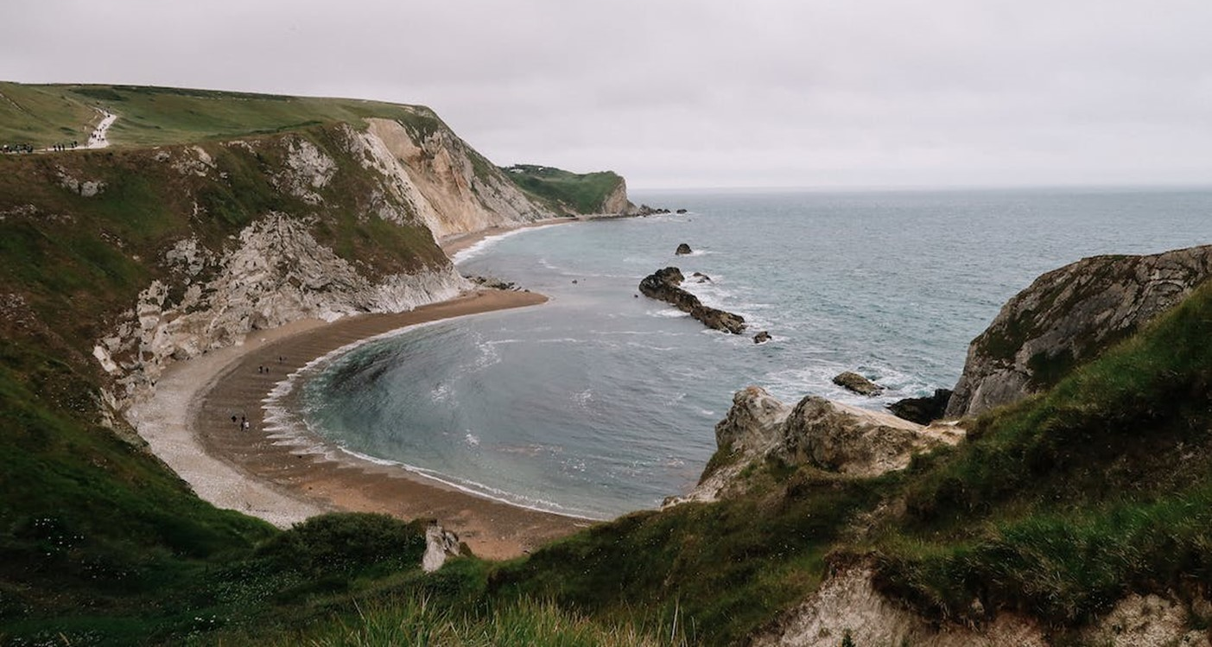
2nd September
If we approach nature and the environment without openness to awe and wonder, if we no longer speak the language of fraternity and beauty in our relationship with the world, our attitude will be that of masters, consumers, ruthless exploiters, unable to set limits on their immediate needs. By contrast, if we feel intimately united with all that exists, then sobriety and care will well up spontaneously.
A Mighty River
Amos 5: 24
(Laudato Si 11 - Pope Francis)

Slide 4
3rd September
The God who created the universe out of nothing can also intervene in this world and overcome every form of evil. Injustice is not invincible.
(Laudato Si 74 - Pope Francis)
A Mighty River
Amos 5: 24

Slide 5
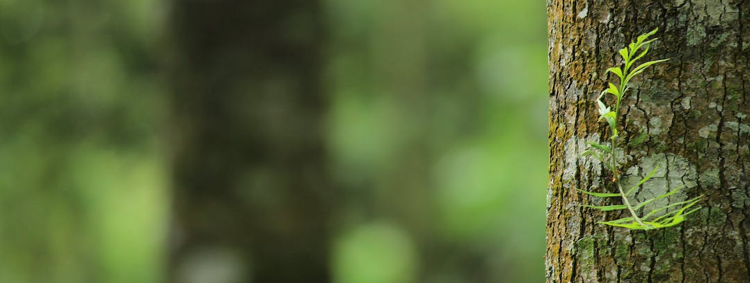
4th September
There is a growing sensitivity to the environment and the need to protect nature, along with a growing concern, both genuine and distressing, for what is happening to our planet… Our goal is not to amass information or to satisfy curiosity, but rather to become painfully aware, to dare to turn what is happening to the world into our own personal suffering and thus to discover
A Mighty River
Amos 5: 24
what each of us can do about it. (Laudato Si 19 - Pope Francis)

Slide 6
5th September
Lord Jesus,
the earth is yours and you have commanded the winds
and the sea; help us to leave behind our consumer demanding lifestyle and move towards behaviours that are environmentally healthy;
help us to follow your lead in caring for the world you love.
A Mighty River
Amos 5: 24
Amen.

Slide 7
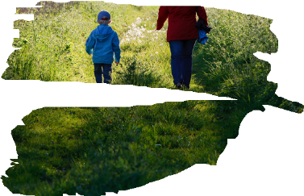
6th September
Season of
Creation
Going for a walk with a friend.
Its a great way to take in the beauty of creation on our doorsteps.
SUGGESTION:
TO TAKE A WALK SOMEWHERE LOCAL IN
NATURE AND CAPTURE AN IMAGE TO SHARE ON SOCIAL MEDIA OF GOD IN CREATION
A Mighty River
Amos 5: 24

Slide 8
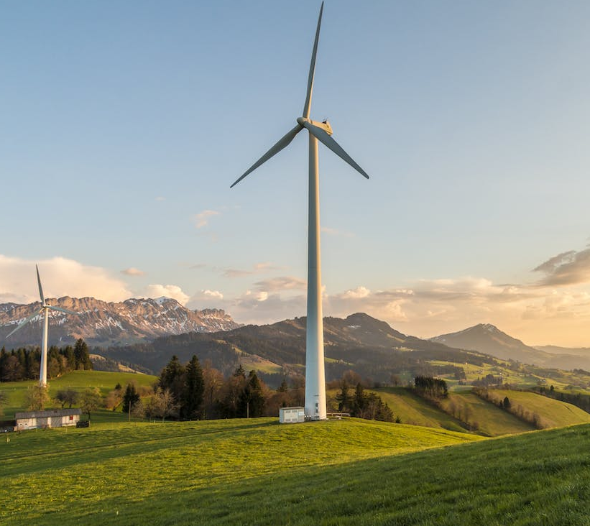
7th September
When nature is viewed solely as a source of profit and gain, this has serious consequences for society. This… has engendered immense inequality, injustice, and acts of violence against the majority of humanity, since resources end up in the hands of the firstcomer
or the most powerful: the winner takes all. Completely at odds with this model are the ideals of harmony, justice, fraternity, and peace as proposed by Jesus.
A Mighty River
Amos 5: 24
Laudato Si 82 Pope Francis

Slide 9
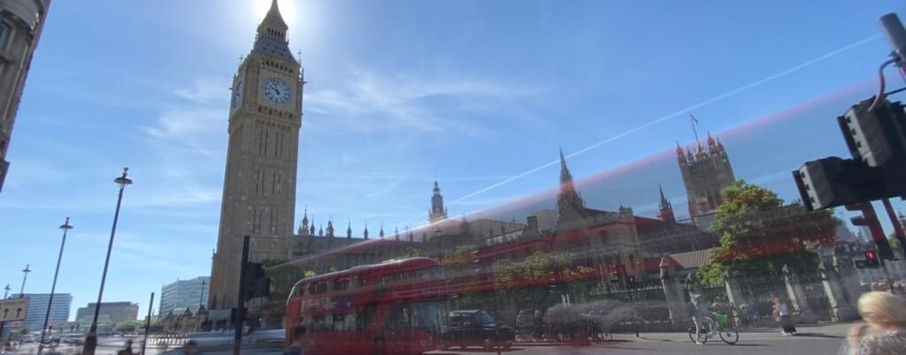
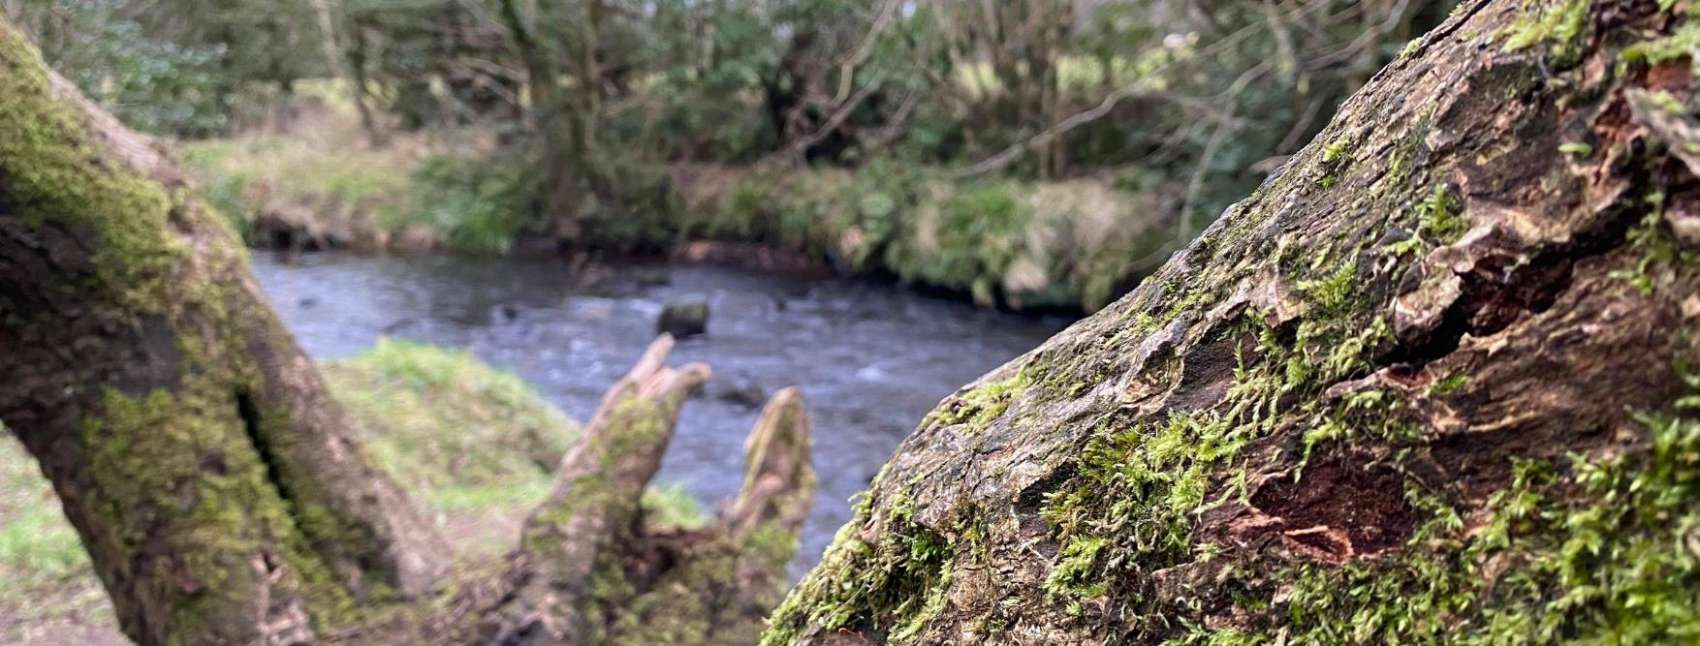
8th September
We do not have much time, according to scientific evidence, I extend an invitation to undertake a 'journey' together. The journey, is one of 'transformation and action'. Its objective, is to build within the next decade 'a world capable of responding to present generations, inclusive of everyone, without compromising the possibilities of future generations'
A Mighty River
Amos 5: 24
Pope Francis, Vatican News 11th October 2020

Slide 10
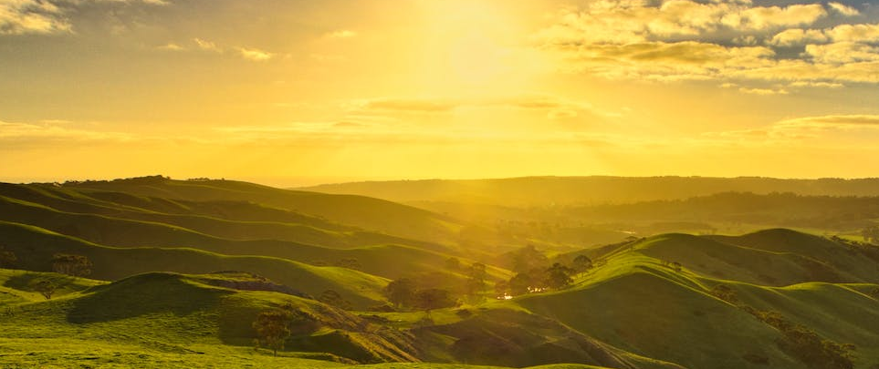
9th September
’Nature is a constant source of wonder & awe. It is also a continuing revelation of the divine’
(Laudato Si 85- Pope Francis)
A Mighty River
Amos 5: 24

Slide 11
10th September
‘We are part of nature, included in it and
thus in constant interaction with it.’
(Laudato Si 139 - Pope Francis)
A Mighty River
Amos 5: 24

Slide 12
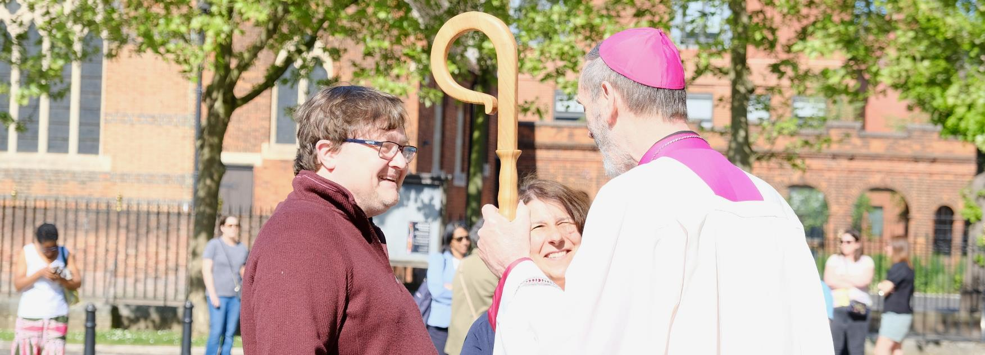
11th September
This is not just another environmental campaign; it is an integral part of our faith.
In making your personal pledges – in working to heal the planet, and in striving for justice for the poorest people in the world, you are a living witness to Jesus Christ: do not be afraid to tell people why you are doing whatever you choose to do.
Bishop Alan Williams
A Mighty River
Amos 5: 24

Slide 13
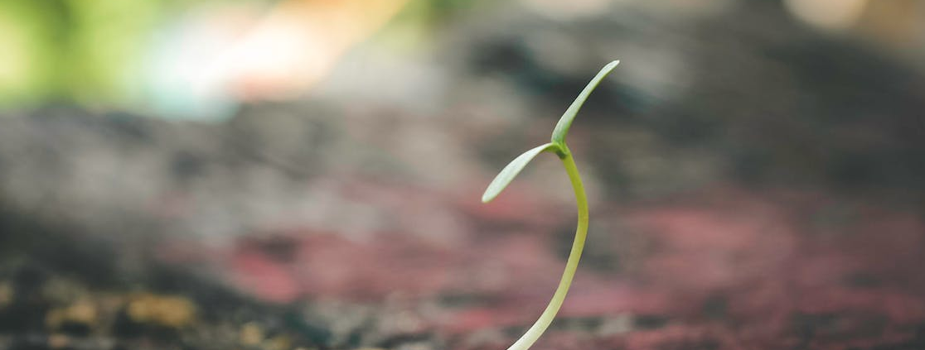
12th September
Our insistence that each human being is an image of God should not make us overlook the fact that each creature has its own purpose. None is superfluous. The entire material universe speaks of God’s love, his boundless affection for us. Soil, water, mountains: everything is, as it were, a caress of God.
A Mighty River
Amos 5: 24
(Laudato Si 84 - Pope Francis)

Slide 14
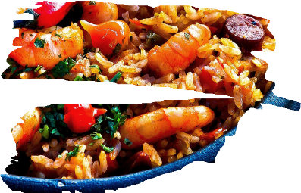
13th September
Season of
So much of our food is high in air miles. This is having a knock on effect to our world and the climate. We have a huge wealth of local produce on our doorsteps.
SUGGESTION:
SHARE A MEAL USING ONLY LOCALLY SOURCED AND SEASONAL FOODS THIS WEEK
WITH FRIENDS OR FAMILY.
Creation
A Mighty River
Amos 5: 24

Slide 15
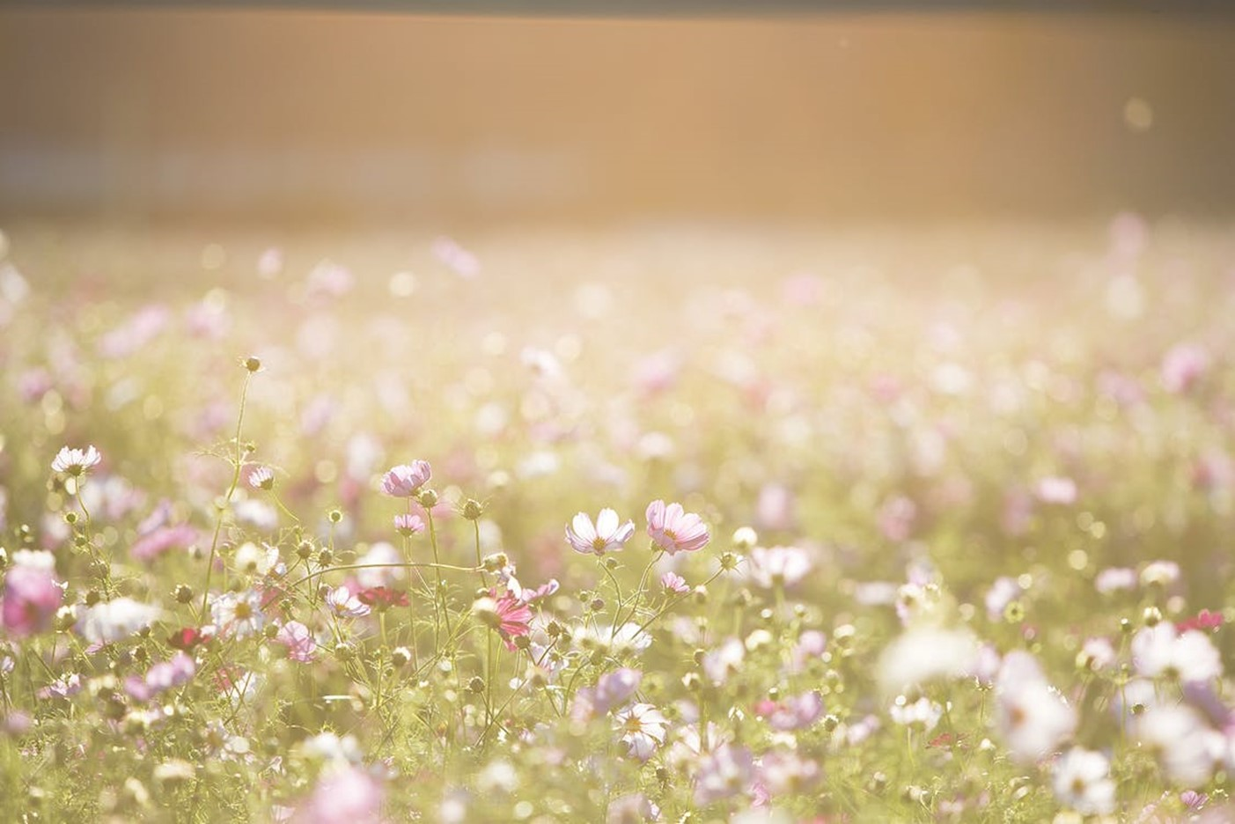
14th September
Creator God, We acknowledge that as your handiwork, we stand alongside all that you have made. Trees and rivers, mountains and valleys, soaring birds and creatures that crawl, all are held within your care.
May we grow in our love and appreciation for the variety around us; and may our awe and wonder draw us closer to the natural world, and
A Mighty River
Amos 5: 24
through it to you, the God of all things. Amen

Slide 16
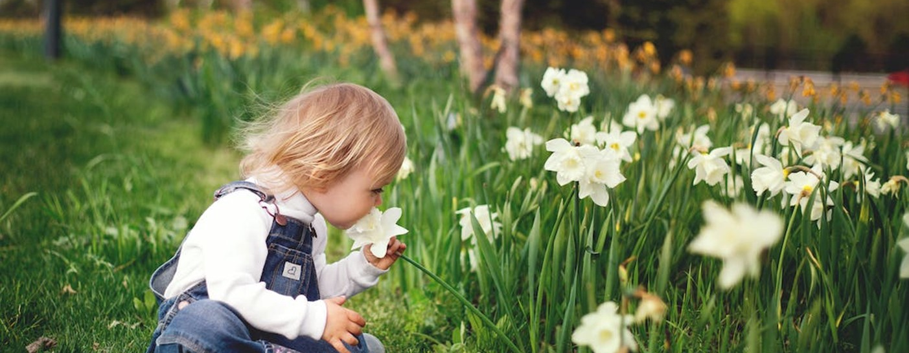
15th September
Once we start to think about the kind of world we are leaving to future generations, we look at things differently; we realize that the world is a gift which we have freely received and must share with others…
the world we have received also belongs to those who will follow us.
A Mighty River
Amos 5: 24
(Laudato Si 159 - Pope Francis)

Slide 17
16th September
Simplicity is not a superficial reduction of stuff, but what Pope Francis calls “an attitude of the heart
(Laudato Si 226 - Pope Francis)
A Mighty River
Amos 5: 24

Slide 18
17th September
Everlasting God, whose Spirit broods everlastingly over the lands
and the waters, and endows them with form and colour: give us, we pray, the mind and heart to rejoice in the majesty of creation.
Teach us to be responsible stewards of this world and to seek the common good, that through your blessing all may flourish,
A Mighty River
Amos 5: 24
and creation sing your praise. Amen

Slide 19
18th September
Season of
How we choose to bank impacts our common home. Using banks that are ethical help to support those most in need and shift the balance of power.
QUESTION:
WHO DO I TRUST WITH MY MONEY?
WHAT REPUTATION DOES MY BANK HAVE?
PERHAPS EXPLORE THESE QUESTIONS TO HELP YOU MAKE SOME INFORMED CHOICES.
Creation
A Mighty River
Amos 5: 24

Slide 20
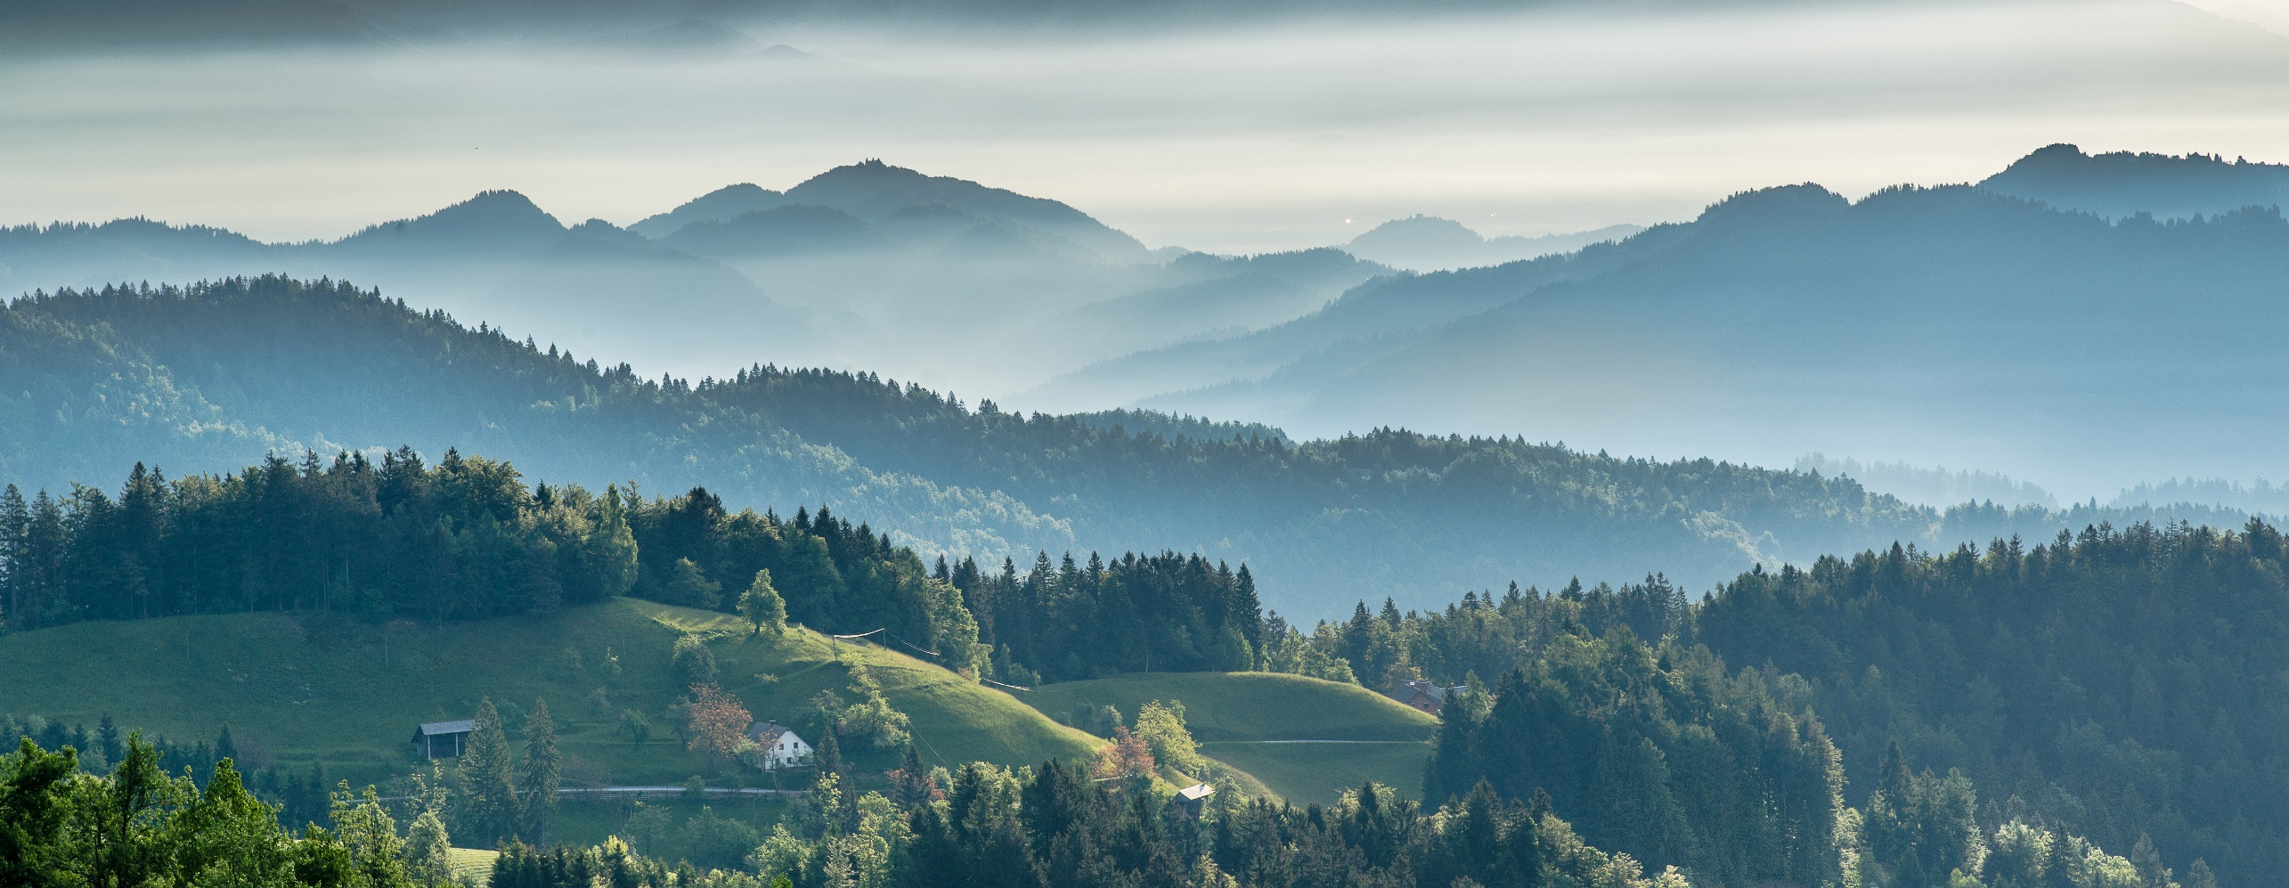
19th September
Saint Therese of Lisieux invites us to practise the little way of love, not to miss out on a kind word, a smile or any small gesture which sows peace and friendship.
An integral ecology is also made up of simple daily gestures whic
A Mighty River
Amos 5: 24
break with the logic of violence, exploitation and selfishness. (Laudato Si 230 - Pope Francis)

Slide 21
20th September
Quoting Saint John Paul II: Christians in their turn “realise that their responsibility within creation, and their duty towards nature and the Creator, are an essential part of their faith.
(Laudato Si 64 - Pope Francis).
A Mighty River
Amos 5: 24

Slide 22
21st September
Season of
Creation
How we choose to bank impacts our common home. Using banks that are ethical help to support those most in need and shift the balance of power.
QUESTION:
WHAT ARE YOU ALREADY DOING?
WHAT COULD YOU ADD TO YOUR HOUSEHOLD ROUTINE TO FURTHER LESSEN YOUR
ENVIRONMENTAL FOOTPRINT?
A Mighty River
Amos 5: 24

Slide 23
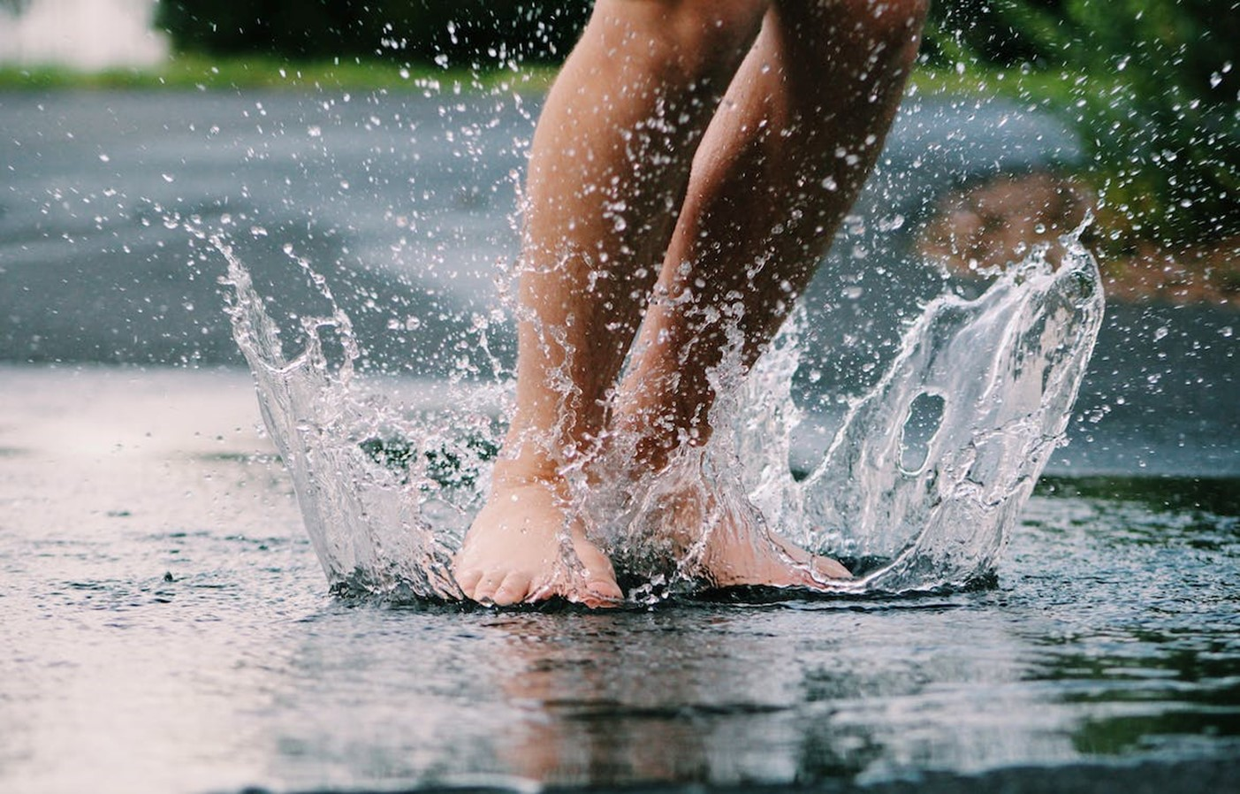
22nd September
What kind of world do we want to leave to those who come after us, to children who are now growing up?
A Mighty River
Amos 5: 24
(Laudato Si 160 - Pope Francis)

Slide 24
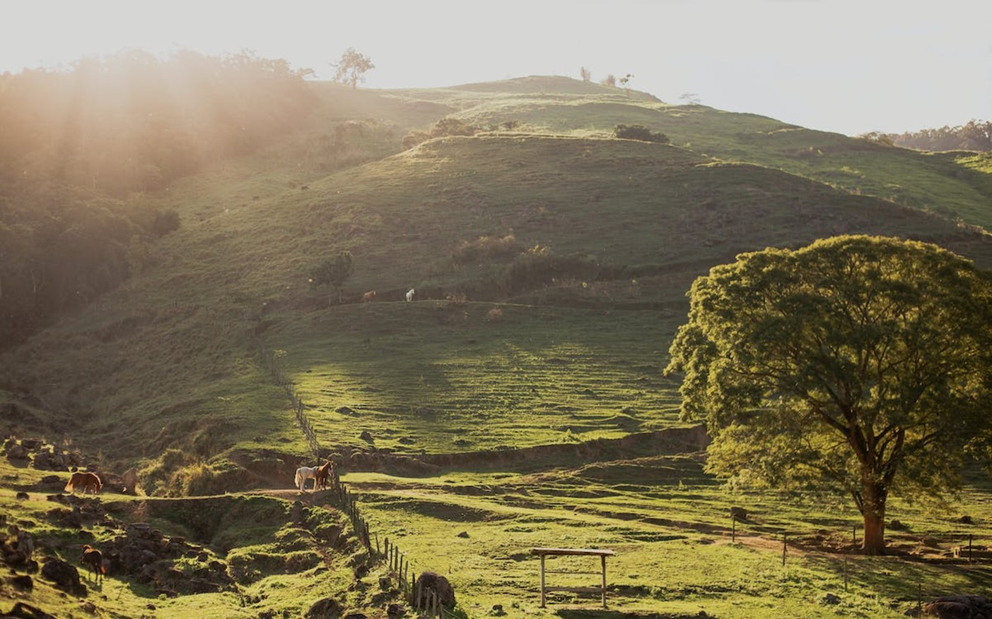
23rd September
Happiness means knowing how to limit some needs which only diminish us, and being open to the many different possibilities which life can offer.
A Mighty River
Amos 5: 24
(Laudato Si 223 - Pope Francis)

Slide 25
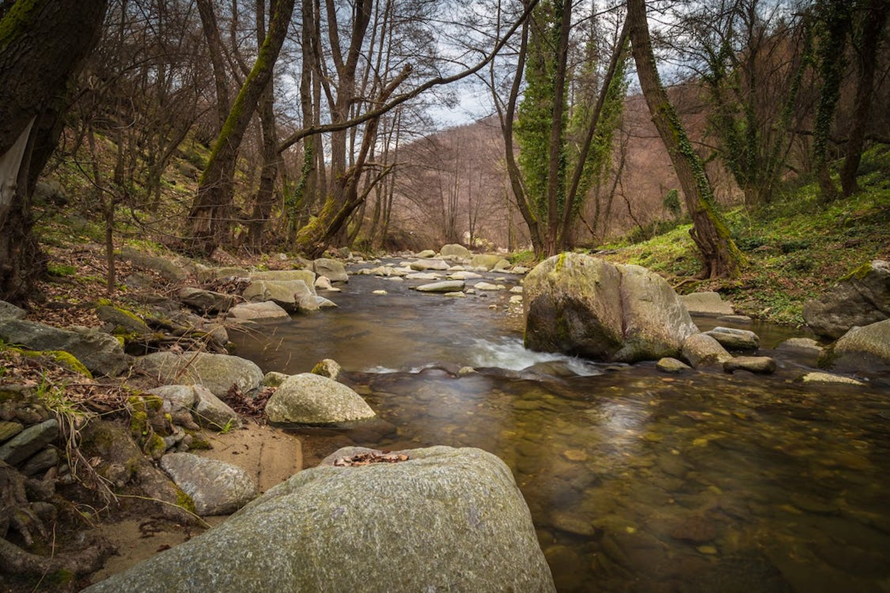
24th September
The ecological crisis is also a summons to profound interior conversion… Living our vocation to be protectors of God’s handiwork is essential
to a life of virtue; it is not an optional or a secondary aspect of our Christian experience.
A Mighty River
Amos 5: 24
(Laudato Si 217 - Pope Francis)

Slide 26
Novena to St Francis
For a world under threat
Day 1: Thankyou for the Sun
“We praise you, Lord, for all your creatures, especially for Brother Sun, who is the day through whom you give us light.” (St Francis of Assisi)
“I dream that this Amazon, so beautiful and diverse, a gift from God, this earth which gives life, our life, our mother,
is not transformed into a desert.”
(Fr. Henri de Roziers, Pastoral Land Commission, Brazil)
Creator God,
We are nourished by your radiance.
Forgive us for the harm we cause your earth,
the heat and drought unleashed by climate change.
St Francis, you loved our sacred world, you praised God ceaselessly
for his dazzling creation. May we learn from your example.
St Francis, pray for us.
25th September
A Mighty River
Amos 5: 24

Slide 27
Novena to St Francis
For a world under threat
Day 2: Thankyou for the night sky
“We praise you, Lord, for Sister Moon and the Stars,
in the heavens you have made them bright, precious and fair.” (St Francis of Assisi)
“We want the forest to remain quiet, the sky to remain clear, the evening darkness to really fall and for the stars to be seen.” (Davi Kopenawa, spokesperson for the Yanomami people of Brazil)
Creator God, your night sky offers rest and stillness, yet we flood our cities with light.
Forgive us for our wasteful ways.
Brother Francis, you chose poverty not plenty, walking lightly on the earth.
May we follow in your path and reduce the trace we leave.
St Francis, pray for us.
26th September
A Mighty River
Amos 5: 24

Slide 28
Novena to St Francis
For a world under threat
Day 3: Thankyou for Wind and air
“We praise you, Lord, for Brothers Wind and Air, fair and stormy, all weather's moods,
by which you cherish all that you have made.” (St Francis of Assisi)
“We ourselves are water, air, earth and life of this environment created by God.”
(Guaviare people, Colombia)
Creator God,
we have disturbed the natural cycle, upset Earth’s fragile balance.
Forgive us for our lack of care.
St Francis, joyful steward of creation,
you lived in peace with nature and with God.
Inspired by your witness, may we defend our common home.
St Francis, pray for us.
A Mighty River
Amos 5: 24

Slide 29
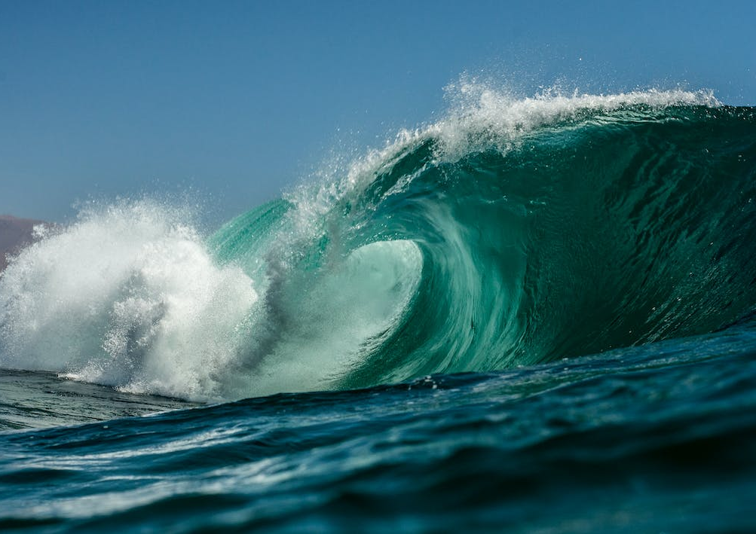
Novena to St Francis
For a world under threat
Day 4: Thankyou for Water
“We praise you, Lord, for Sister Water,
so useful, humble, precious and pure.” (St Francis of Assisi)
“Now they even want to take our rivers, which have been ours forever.” (Rusbel Castornoque, Kukama people, Peruvian Amazon)
Creator God, from your gift of water flows all life,
yet we pollute your clear springs. Forgive us, as the earth cries out.
St Francis, you drank deeply from Christ’s living water.
May we, like you, live simply and prize the good things of the earth.
St Francis, pray for us.
A Mighty River
Amos 5: 24

Slide 30
Novena to St Francis
For a world under threat
Day 5: Thankyou for Fire
“We praise you, Lord, for Brother Fire, through whom you light the night. He is beautiful, playful, robust, and strong.”
(St Francis of Assisi)
“The gift we have received is a fire,
a burning love for God and for our brothers and sisters.” (Pope Francis, homily, 6 October 2019)
Creator God, your flames blaze yet leave us whole.
But our fires destroy at reckless speed;
great forests fall beneath our feet. Forgive us for our part in this.
St Francis, you loved wild places, the trees, and all their birds within.
May we protect each blade of grass, be mindful of each breath of air.
St Francis, pray for us.
A Mighty River
Amos 5: 24

Slide 31
Novena to St Francis
For a world under threat
Day 6: Thankyou for the Earth
“We praise you, Lord, for Sister Earth,
who sustains us with her fruits, coloured flowers, and herbs.” (St Francis of Assisi)
“There will be a point when we will not have this richness.
And then what will we do?”
(Yésica Patiachi Tayori, Harakbut indigenous people, Peru)
Creator God,
we grieve for our Amazon sisters and brothers whose lands are wrecked by greed.
We take more from the earth than we need. Forgive us.
St Francis, joyful steward of creation,
from you we learn to live with less, to give and not to take.
St Francis, pray for us.
A Mighty River
Amos 5: 24

Slide 32
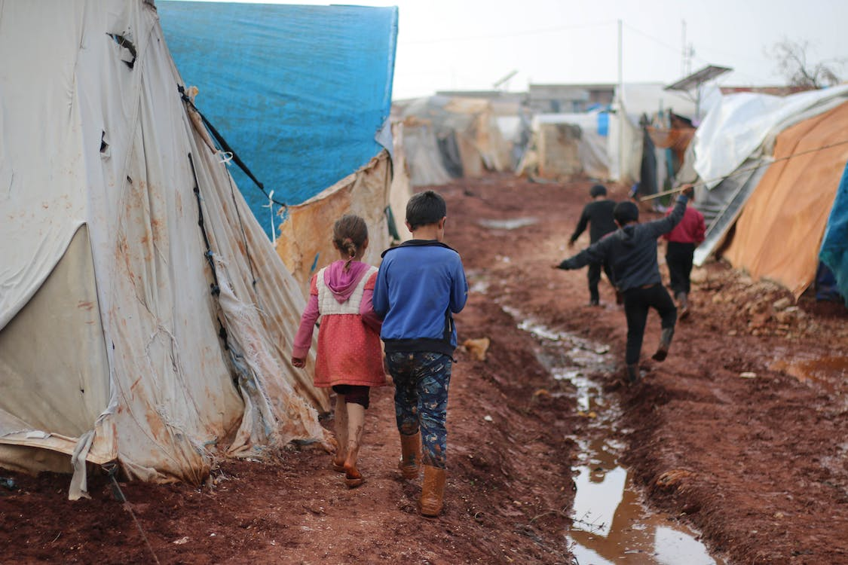
Novena to St Francis
For a world under threat
Day 7: We pray for those who suffer
“We praise you, Lord, for those who pardon for love of you, who bear sickness and trial.”
(St Francis of Assisi)
“I speak for my brothers and sisters who are threatened, assassinated, who do not hold the rights to their land...
How long must we wait for a reply?” (Rosildo da Silva, Jaminawa Arará people, Brazil)
Creator God, open our hearts to the sufferings of the landless poor who endure violence and threat. Forgive us for the sin of indifference.
St Francis,
you were jailed and beaten, brother to the outcast.
May your compassion be our guide.
St Francis, pray for us.
1st October
A Mighty River
Amos 5: 24

Slide 33
Novena to St Francis
For a world under threat
Day 8: We pray for Peace
“Blessed are those who endure in peace, by you Most High, they will be crowned.” (St Francis of Assisi)
“We want to support a culture of peace and respect – not violence and violation.”
(Final document, Amazon Synod, 2019)
Creator God, we give you thanks for those who work for peace and dignity for all your children.
Brother Francis,
you came to heal, not harm the world.
You showed us how to live as one.
St Francis, pray for us.
2nd October
A Mighty River
Amos 5: 24

Slide 34
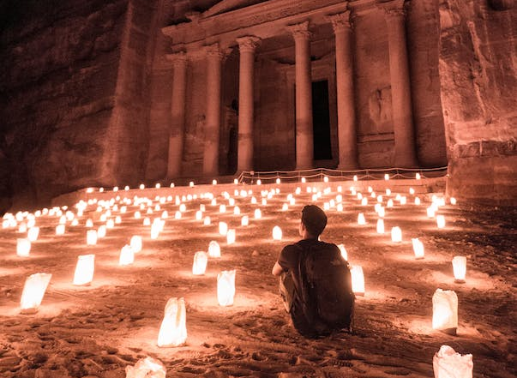
Novena to St Francis
For a world under threat
Day 9: We pray for Creation
“Most High, all-powerful, all-good Lord,
all praise is yours, all glory, honour and blessings.
To you alone, Most High, do they belong.” (St Francis of Assisi)
“Let us sing as we go. May our struggles and our concern for this planet never take away the joy of our hope.”
(Pope Francis, Laudato Si’)
Creator God we praise your world and look with awe on all that is.
May we commit to heal the earth and share your gifts in faith and trust.
Brother Francis, in purity of heart you gazed upon the world with love.
We ask you joyfully to intercede for us, As guardians of our common home.
St Francis, pray for us.
3rd October
A Mighty River
Amos 5: 24

Slide 35
4th October
Feast of St Francis of Assisi
Lord, make me an instrument of your peace:
where there is hatred, let me sow love; where there is injury, pardon; where there is doubt, faith; where there is despair, hope;
where there is darkness, light; where there is sadness, joy.
O divine Master, grant that I may not so much seek
to be consoled as to console, to be understood as to understand, to be loved as to love. For it is in giving that we receive,
it is in pardoning that we are pardoned,
A Mighty River
Amos 5: 24
and it is in dying that we are born to eternal life.

