Slide 1
Looking Forward
Monday 3rd July 2023
~ Looking Forward as Stewards ~
Monday 11th September 2023
Brentwood Diocese Education Service

Slide 2
Looking Forward as Stewards
Gracious and loving God,
we understand that you call us to be
the stewards of Your abundance,
the caretakers of all you have entrusted to us.
Help us always to use your gifts wisely
and teach us to share them generously.
May our faithful stewardship bear witness
to the love of Christ in our lives.
Season of Creation
BDES

Slide 3
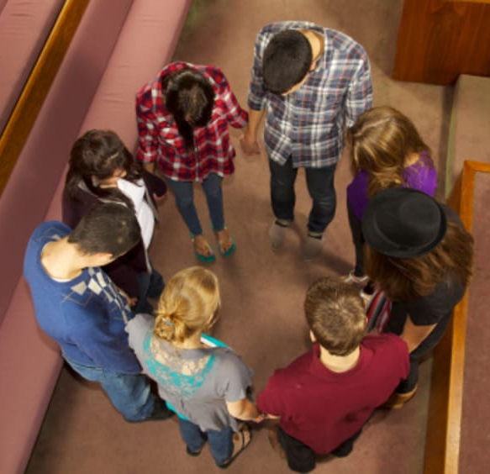
In Sunday’s Gospel Reading
10th September 2023
In the Gospel of Matthew, Jesus tells His friends :
“Where two or three are gathered together in my name, there am I in the midst of them.”
BDES

Slide 4
EDUCATION SUNDAY 10th SEPTEMBER
BDES

Slide 5
Preparing for World Youth Day 2027
“Jesus is the path, and we are going to walk with him.”
- Pope Francis,
World Youth Day, 2023
BDES

Slide 6
Do not be afraid
“Don’t be afraid. Be of good cheer. Jesus knows the heart of each one of our lives. He knows our hearts. Our hearts burn, knowing that we are loved.”
– Pope Francis, World Youth Day 2023
BDES

Slide 7
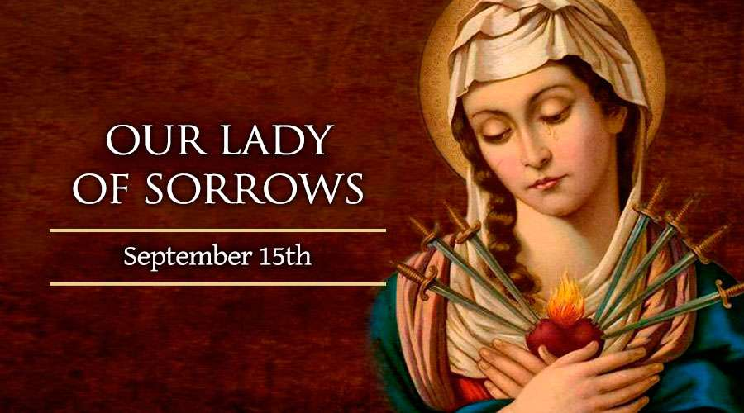
BDES

Slide 8
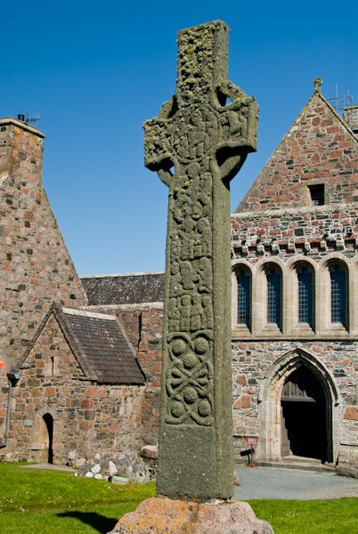
Places of Pilgrimage
IONA
is a holy isle and has been described as the birthplace of Christianity in Scotland. St Columba and 12 companions went there from Ireland in AD 563. The monastery they founded was one of the most important and influential in the British Isles. It sent missionaries to northern Britain to convert people to Christianity.
Pilgrims today still follow a route similar to that taken by pilgrims of old, ending at a 13th-century abbey which stands on the site of Columba’s church.
Iona’s spiritual life continues today, through xxxxxx the work of the Iona Community.
BDES

Slide 9
Looking Forward
Monday 3rd July 2023
~ Looking Forward as Stewards ~
Monday 11th September 2023
Brentwood Diocese Education Service

