Slide 1
Looking Forward
~ Looking Forward As Stewards ~
Monday 18th September 2023
Brentwood Diocese Education Service

Slide 2
Looking Forward As Stewards
Evangelii Gaudium Sunday
is celebrated each year on the Third Sunday in September.
We proclaim the unique message of the Gospel that brings joy to all people who receive it with an open heart.
Pope Francis invited the Catholic Church to be joyous
in proclaiming the faith –
seeking new ways of understanding the faith and reaching out to others.
The Church is finding ways to reach out to all people,
those of other faiths and none.
What are you doing to reach out?
BDES

Slide 3
In Sunday’s Gospel Reading …
Sunday 17th September 2023 :
The Gospel of Matthew :
“Forgive your brothers from your heart.”
BDES

Slide 4
Preparing for World Youth Day 2027
“Have the courage
to replace your doubts
with dreams.”
- Pope Francis,
World Youth Day, 2023
BDES

Slide 5
Reflection
DO NOT BE AFRAID
for your God goes with you;
he will never leave you.
(Deuteronomy 31 :6)
BDES

Slide 6
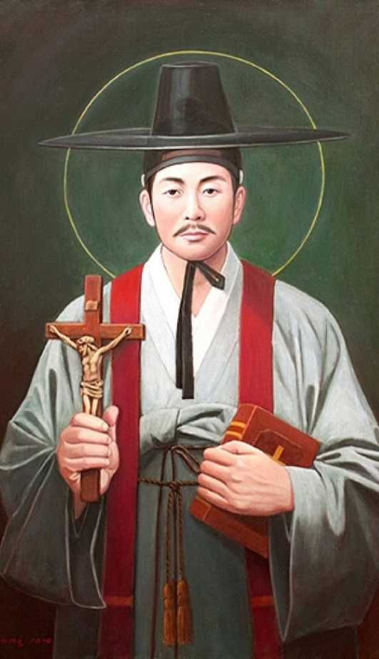
St Andrew Kim Taegon
St Andrew Kim Taegon was the first Korean-born Catholic priest and is the patron saint of Korean clergy.
He was baptised at the age 15 and joined the seminary in Macau. He then became a priest and returned to Korea.
Christianity was persecuted in his home country and at the age of 25 he was martyred near Seoul.
He was canonised in 1984 during a visit of Pope John Paul II to Korea and his feast day is celebrated on 20th September.
.
BDES

Slide 7
Places of Pilgrimage
HOLYWELL
is a site of pilgrimage in North Wales. The town takes its name from the well of St Winefride.
The shrine dates from the seventh century when Winefride, the daughter of a chieftain, who wished to become a nun was martyred for her beliefs.
An account of her life was produced by the abbey at Shrewsbury who held the bones of the saint.
The well is one of the best examples of a medieval holy well in Britain.
BDES

Slide 8
Looking Forward
~ Looking Forward As Stewards ~
Monday 18th September 2023
Brentwood Diocese Education Service

