Slide 1
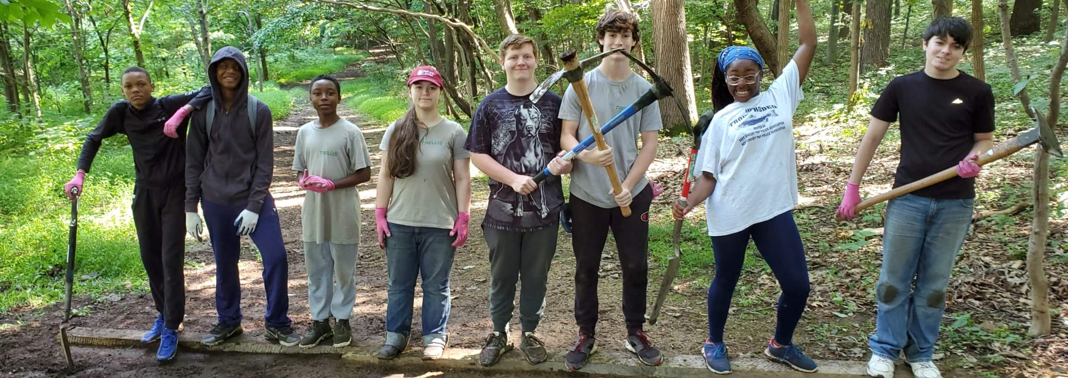
Looking Forward
Monday 3rd July 2023
~ Looking Forward as Stewards ~
Monday 25th September 2023
Brentwood Diocese Education Service

Slide 2
Looking Forward as Stewards
“In this season of Creation,
as followers of Christ on our shared journey,
let us live, work and pray
that our common home
will teem with life
once again.”
- Pope Francis
Season of Creation
BDES

Slide 3
In Sunday’s Gospel Reading
24th September 2023
In the Gospel of Matthew, Jesus tells His friends :
The last will be first, and the first will be last.
BDES

Slide 4
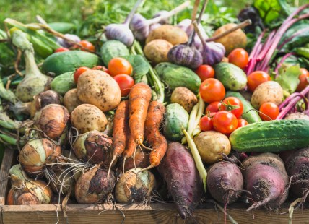
HARVEST SUNDAY 24th SEPTEMBER
Lord God,
who never fails to give us an abundance of heavenly gifts,
and the rich fruits of the earth;
we give thanks
to you in your glory
for the harvest,
and beg you again
to bless the harvest
which we have received
from your bounty,
to preserve it
and to shield it from harm.
BDES

Slide 5
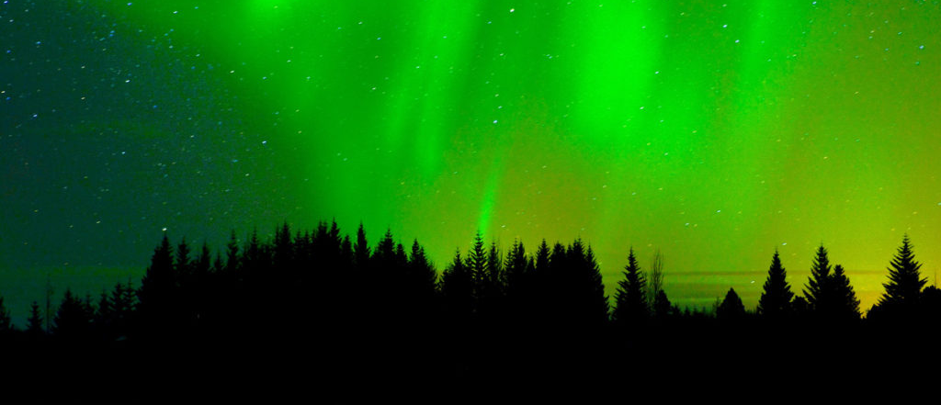
Reflection
DO NOT BE AFRAID,
I am the one who helps you.
(Isaiah 41 : 13)
BDES

Slide 6
Preparing for World Youth Day 2027
“In the Church there is room for everyone.”
- Pope Francis,
World Youth Day, 2023
BDES

Slide 7
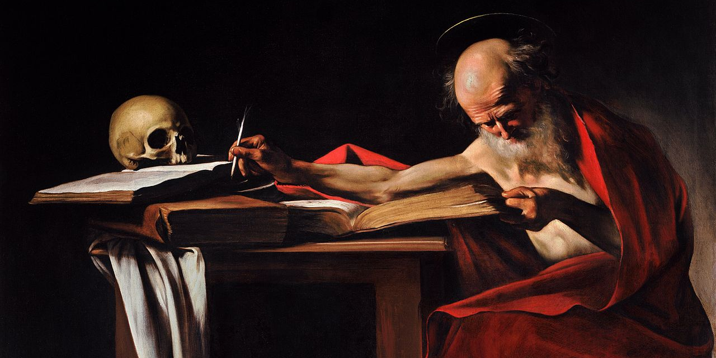
St Jerome translated the Bible from Hebrew and Greek into Latin.
____________________________________
Prayer of St. Jerome:
“O Lord,
you have given us
Your word as a light
to shine upon our path;
help us to meditate
on that word,
and follow its teaching,
that we may find in it
the light that shines
more and more
until the perfect day.”
Amen
St Jerome : 30th September
BDES

Slide 8
Places of Pilgrimage
HOLY ISLAND
is also known as Lindisfarne. It is situated off the Northumberland coast in the north east of England, just a few miles south of the border with Scotland. The island is linked to the mainland by a causeway which twice a day is covered by the tide.
Possibly the holiest site of Anglo-Saxon England, Lindisfarne was founded by St. Aidan, an Irish monk, who came from Iona, the centre of Christianity in Scotland. He converted Northumbria to Christianity and founded Lindisfarne Monastery on Holy Island in 635, becoming its first abbot and bishop.
BDES

Slide 9
Looking Forward
Monday 3rd July 2023
~ Looking Forward as Stewards ~
Monday 25th September 2023
Brentwood Diocese Education Service

