Slide 1
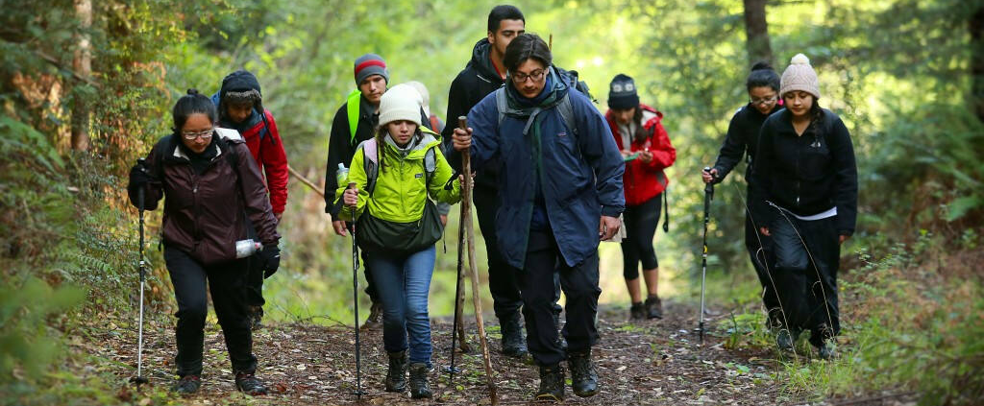
Looking Forward
Monday 3rd July 2023
~ Looking Forward as Stewards ~
Monday 2nd October 2023
Brentwood Diocese Education Service

Slide 2
Looking Forward as Stewards
WHAT IS A STEWARD?
A steward is as a disciple of Jesus who receives God's gifts gratefully,
cultivates them responsibly,
shares them lovingly in justice with others
and returns them with increase to the Lord.
WHAT IS STEWARDSHIP?
Stewardship is a way of life that comes from seeing everything as a gift from God, changing the way we see things. Time, talent, and treasure are all shared as a gift, in a planned, proportionate, thankful, and sacrificial manner.
Season of Creation
BDES

Slide 3
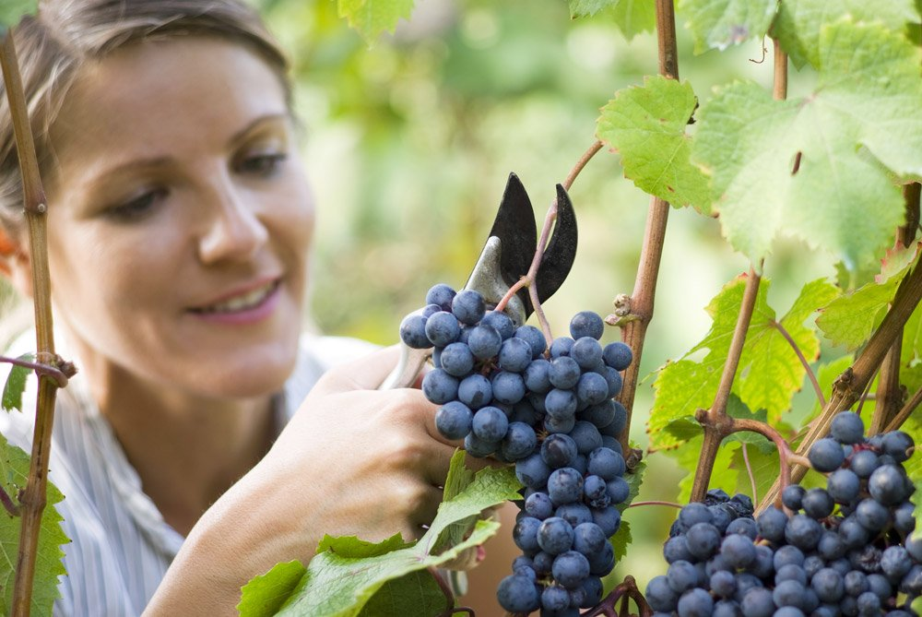
In Sunday’s Gospel Reading
1st October 2023
In the Gospel of Matthew, we are encouraged :
“Go out and work in the vineyard today.”
BDES

Slide 4
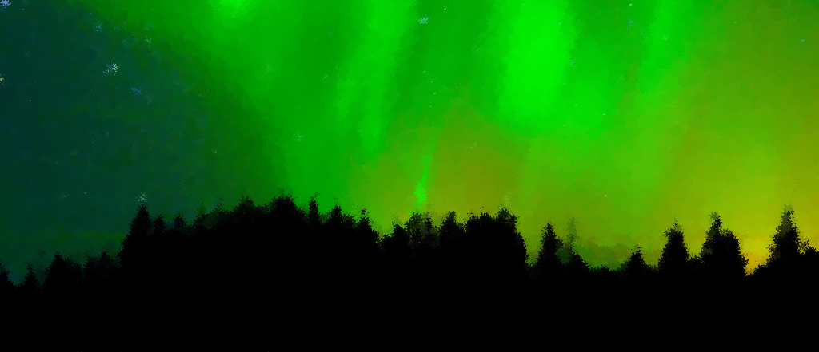
Reflection
DO NOT BE AFRAID,
I will provide for you.
(Genesis 50 : 21)
BDES

Slide 5
Preparing for World Youth Day 2027
“For God none of us is a number, but a face and a heart.”
- Pope Francis,
World Youth Day, 2023
BDES

Slide 6
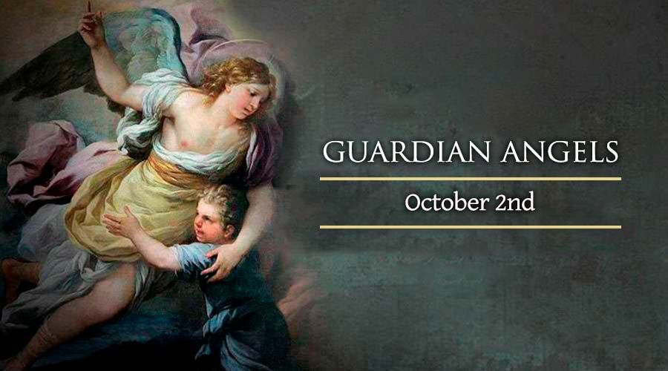
BDES
xxxxx

Slide 7
Places of Pilgrimage
KNOCK
The Sanctuary of Our Lady of Knock is a site of Roman Catholic pilgrimage and the Irish national shrine in the village of Knock in County Mayo. In 1879, some local people saw an apparition of the Our Lady, St Joseph, St John the Evangelist, and, upon a plain altar, the Lamb of God with a cross, accompanied by angels.
On 30th September 1979, Saint Pope John Paul II visited the shrine to commemorate apparition’s centenary. Pope Francis visited in 2018 as part of a visit to Ireland for the 9th World Meeting of Families, and on 14th April this year US President Joe Biden also made a private pilgrimage there.
BDES

Slide 8
Looking Forward
Monday 3rd July 2023
~ Looking Forward as Stewards ~
Monday 2nd October 2023
Brentwood Diocese Education Service

