Slide 1
World Youth Day 2023
Looking Back on a
Historic Encounter
Brentwood Diocese Education Service
“Supporting Catholic schools to provide excellent education where pupils flourish, and Christ is made known to all”

Slide 2
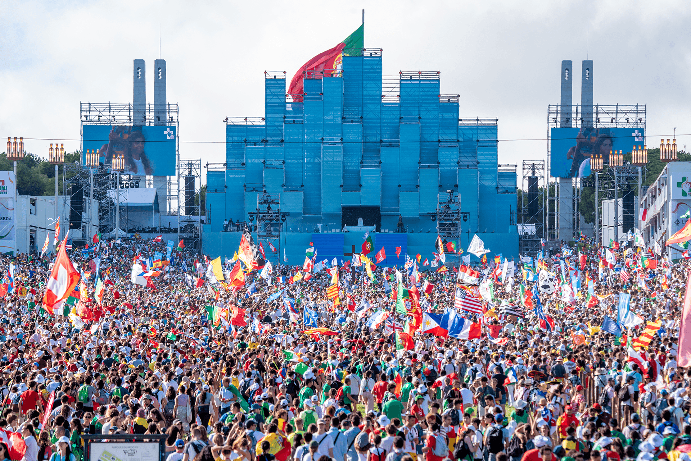
Tuesday 1st August
ON THE IMPORTANCE OF BEGINNING A JOURNEY
“Mary set out. She was young like all of you. All of you also set out. From near or far, you all set out. It is very important to set out.”
- Manuel Cardinal Clemente,
Patriarch of Lisbon
The Opening Mass
BDES

Slide 3
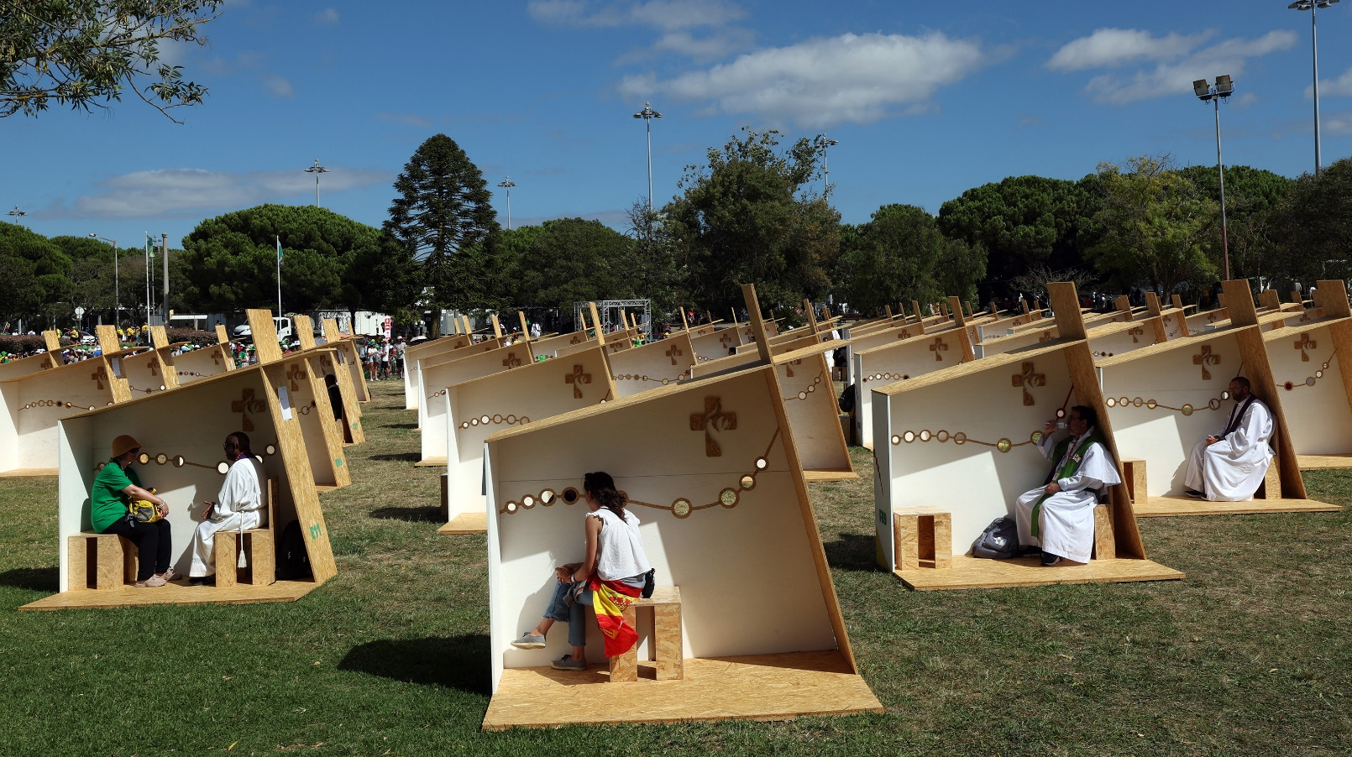
The City of Joy
The City of Joy was a space set up in the Lisbon park Jardim Vasco da Gama as a place of encounter with Jesus, a place where pilgrims found different experiences of Christian living and joy – at the Vocational Fair, in the silence of the Chapel, or and in the Sacrament of Reconciliation at the Reconciliation Park.
BDES

Slide 4
Wednesday 2nd August
Rise Up catechesis challenged young people to reflect on the big themes of Pope Francis’ pontificate: Ecology, Social Friendship and Mercy, the great message of God’s love.xxxxxxx
Rise Up Encounters
BDES

Slide 5
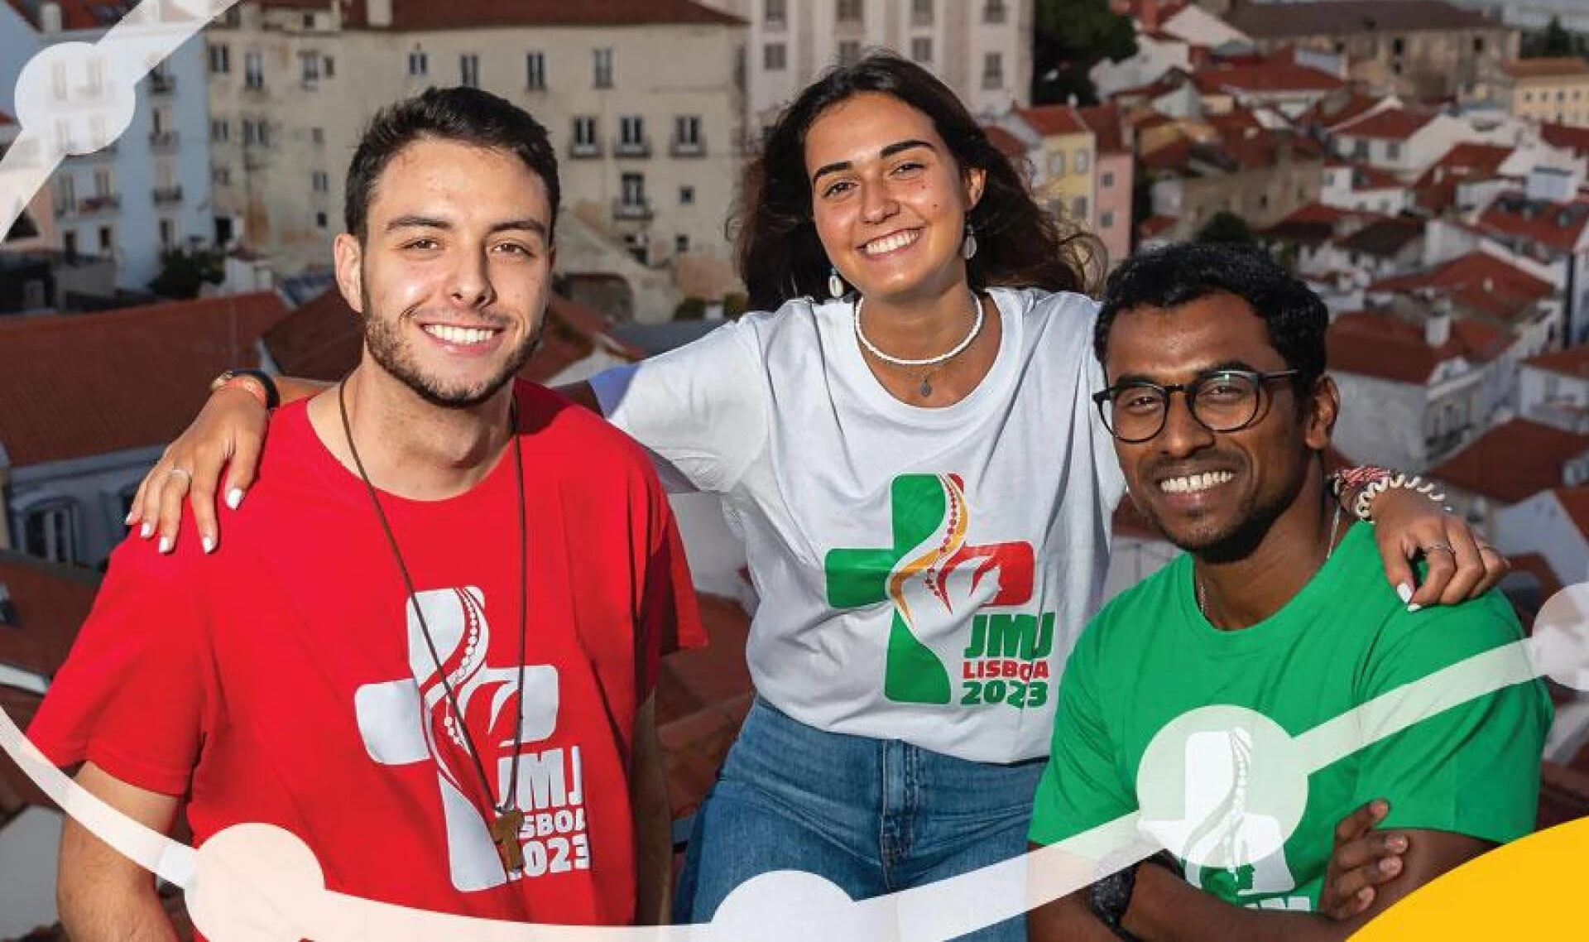
The Youth Festival
The Youth Festival was a set of cultural, religious, and sporting events, carried out by WYD pilgrims. Events involving music, cinema, exhibitions, theatre, dance, and conferences were mixed with religious events such as prayers, testimonies, adoration, and meetings conducted by all kinds of international groups.
BDES

Slide 6
Thursday 3rd August
ON FRIENDSHIP
“Let us learn from Mary to welcome every single person.”
- Manuel Cardinal Clemente,
Patriarch of Lisbon
Welcome Ceremony
BDES

Slide 7
The Youth Festival
The Youth Festival was a set of cultural, religious, and sporting events, carried out by WYD pilgrims. Events involving music, cinema, exhibitions, theatre, dance, and conferences were mixed with religious events such as prayers, testimonies, adoration, and meetings conducted by all kinds of international groups.
BDES

Slide 8
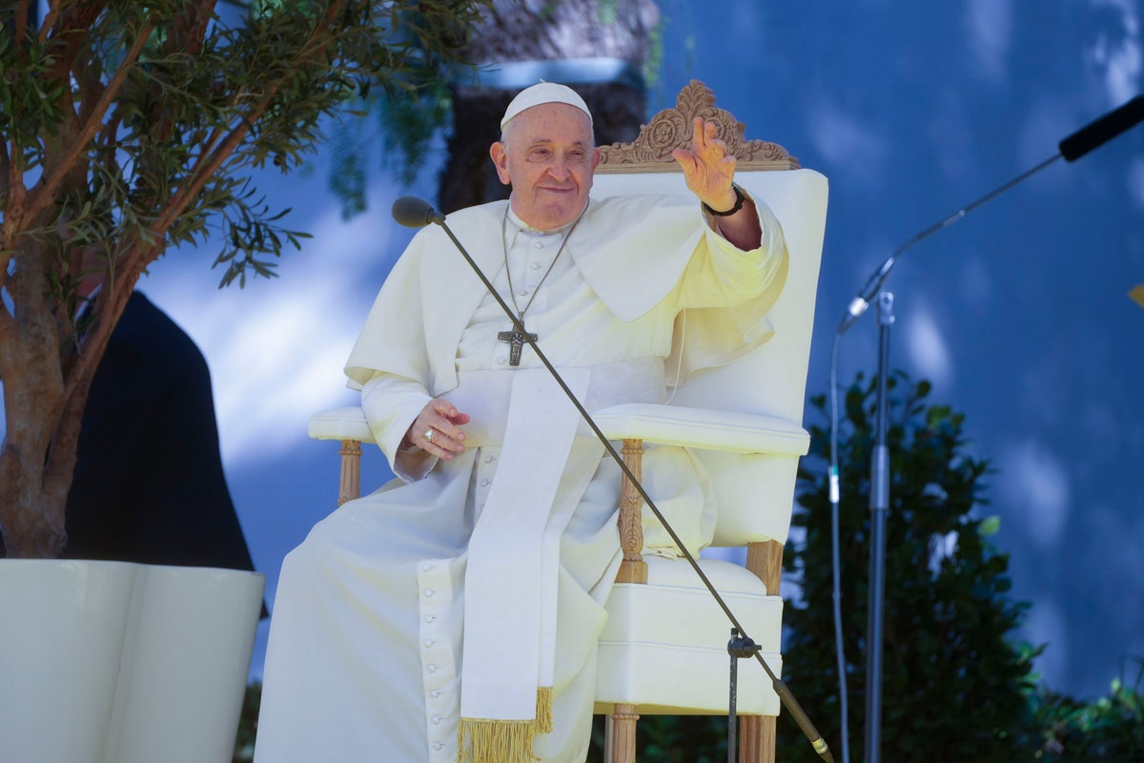
Friday 4th August
“When He was among us, Jesus walked, healing the sick, caring for the poor, doing justice… He walked among us, preaching and teaching us.”
- Pope Francis
Way of the Cross
BDES

Slide 9
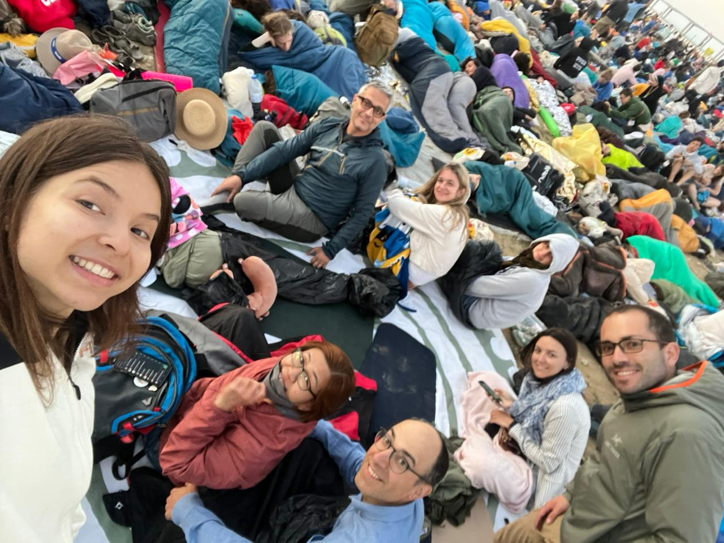
Saturday 5th August
“Don’t be afraid. Be of good cheer. Jesus knows the heart of each one of our lives. He knows our hearts. Our hearts burn, knowing that we are loved.”
- Pope Francis
Evening Vigil
BDES

Slide 10
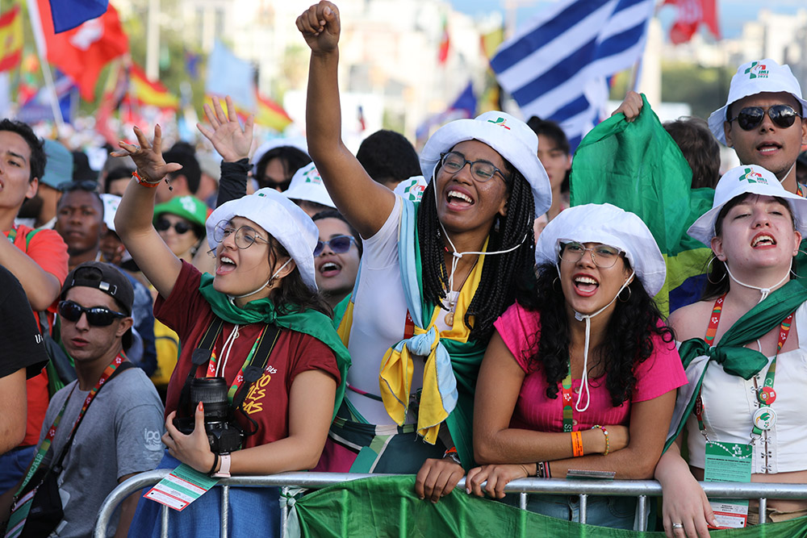
Sunday 6th August
For young people :xxxxxxxxxx that, listening to the Gospel and fascinated by the beauty of the Lord Jesus, may they dedicate themselves toxxxxxx building their own future, bringing hope and joy to the Church and to the world, xxx let us pray.
- Prayer of the Faithful
Missioning Mass
BDES

Slide 11
World Youth Day 2027

