Slide 1
Looking Forward
Monday 3rd July 2023
~ Looking Forward as Stewards ~
Monday 9th October 2023
Brentwood Diocese Education Service

Slide 2
Looking Forward as Stewards
“We thank you for all the blessings of this life, for those who love us, for occupations that fulfill us, and for leisure that restores us. Make us faithful stewards of your bounty and make us ever mindful of the needs of others, especially those who go to sleep hungry in our world.”
BDES

Slide 3
In Sunday’s Gospel Reading
8th October 2023
In the Gospel of Matthew, Jesus tells of God’s work :
“It is wonderful in our eyes.”
BDES

Slide 4
“I was in prison, and you came to me … as long as you did it to one of these my least brethren, you did it to me.” (Matthew 25 : 36-40)
WEEK OF PRAYER FOR PRISONERS AND THEIR DEPENDENTS 8th – 14th OCTOBER
BDES

Slide 5
Reflection
DO NOT BE AFRAID,
for I am with you; do not be dismayed, for I am your God; I will strengthen you, I will help you. (Isaiah 41 : 10)
BDES

Slide 6
Preparing for World Youth Day 2027
“We are loved the way we are, without makeup.”
- Pope Francis,
World Youth Day, 2023
BDES

Slide 7
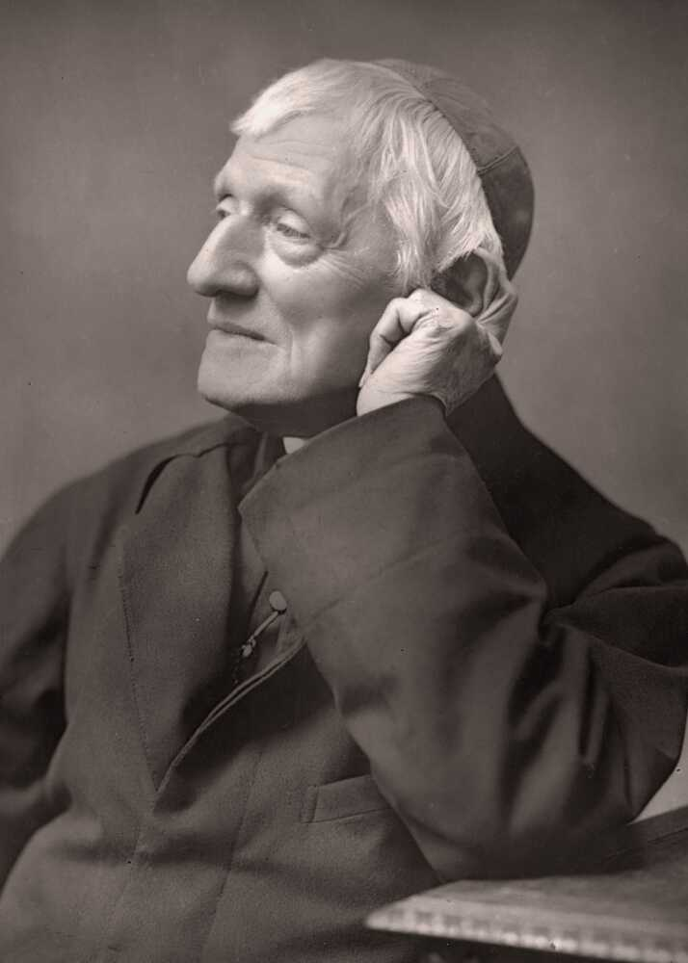
St John Henry Newman 9th October
St John Henry Newman chose “Heart speaks unto Heart” as the motto to go on his coat of arms when he became a Cardinal in 1879. Inspired by these words spoken by St. Francis de Sales, Newman calls us to hear God speaking to our hearts and to listen for our mission from God.
BDES

Slide 8
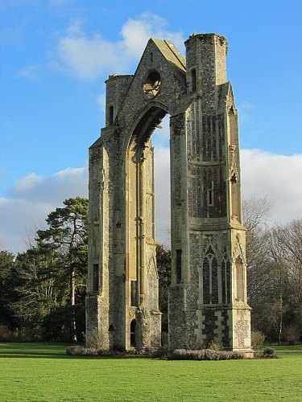
0
Places of Pilgrimage
WALSINGHAM
has had a famous shrine to Our Lady since 1061, when Lady Richeldis de Faverches built a replica of the Holy House of Nazareth, the scene of the Annunciation. It became one of the great places of pilgrimage in the Middle Ages.
In 1538, during the Reformation, the King’s Commissioners destroyed the Shrine and burned the statue of Our Lady. In 1897, the Sanctuary of Our Lady of Walsingham was restored and rebuilt, and pilgrimages began again.
BDES

Slide 9
Looking Forward
Monday 3rd July 2023
~ Looking Forward as Stewards ~
Monday 9th October 2023
Brentwood Diocese Education Service

