Slide 1
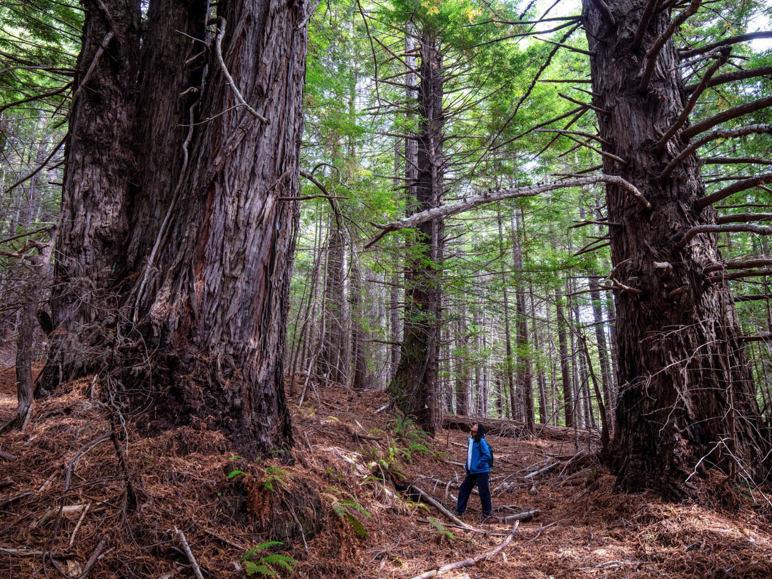
Looking Forward
~ Looking Forward As Stewards ~
Monday 16th October 2023
Brentwood Diocese Education Service

Slide 2
Looking Forward As Stewards
Pope Francis points out that “As stewards of God's creation, we are called to make the earth a beautiful garden for the human family. When we destroy our forests, ravage our soil and pollute our seas, we betray that noble calling.”
Sometimes it is difficult to see what we can do as individuals, but if we each do one small thing we can initiate greater change.
What can you do to look after our world?
BDES

Slide 3
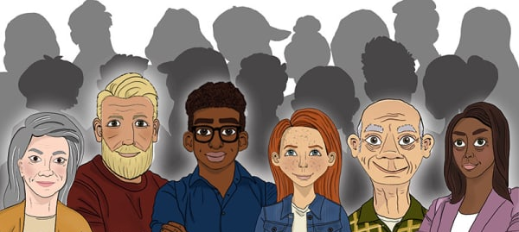
In Sunday’s Gospel Reading …
Sunday 15th October 2023
In the Gospel of Matthew, Jesus tells us that
“Many are invited.”
BDES

Slide 4
Reflection
“Do not be afraid, for I have redeemed you; I have called you by name, you are mine.” (Isaiah 43 : 1)
BDES

Slide 5
Preparing for World Youth Day 2027
“The only time that we are allowed to look down upon others is when we are offering to help them up.”
- Pope Francis,
World Youth Day, 2023
BDES

Slide 6
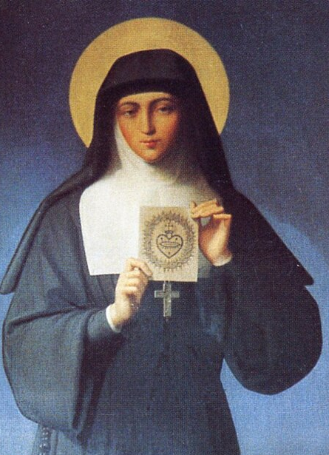
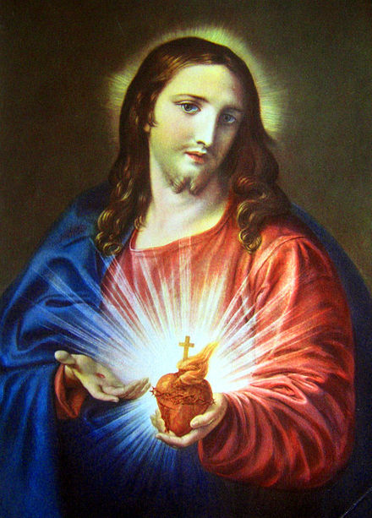
St Margaret Mary Alacoque
.
Margaret Mary Alacoque, VHM was born on 22nd July 1647 and died on 17th October 1690. She was a French nun in the Visitation order. She had been ill as a child and during this time offered to become a religious. As she grew older her family wanted her to marry but she was visited by a vision of Christ and became a nun at the age of 24.
In the convent she saw a number of visions of Christ and as a result she promoted devotion to the Sacred Heart of Jesus in its modern form.
BDES

Slide 7
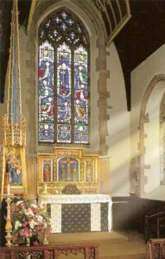
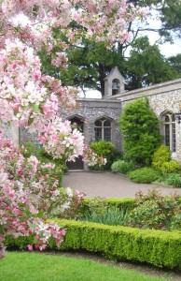
Walsingham: The Slipper Chapel
THE SLIPPER CHAPEL AT WALSINGHAM
Built in the mid-14th century, and dedicated to Saint Catherine of Alexandria, this chapel served pilgrims on their way to England’s Nazareth, the Holy House at Walsingham.
Saint Catherine was the patron saint of pilgrims to the Holy Land and her knights kept open the road to Nazareth during the Crusades. Her tomb lies in the Monastery on Mount Sinai, within the Basilica of the Annunciation.
Just as on Mount Sinai, Moses took off his shoes because he was on holy ground, so the pilgrims to England’s Holy Land used to remove their shoes and walk the Holy Mile into Walsingham.
BDES

Slide 8
Looking Forward
~ Looking Forward As Stewards ~
Monday 16th October 2023
Brentwood Diocese Education Service

