Slide 1
Looking Forward
Monday 3rd July 2023
~ Looking Forward as Carers ~
Monday 30th October 2023
Brentwood Diocese Education Service

Slide 2
Looking Forward as Carers
Lord, open my eyes. Let me see those around me who are in need of my compassion. Help me to listen to them, to hear their needs. Give me the heart to be interested in their troubles and show me the ways I can help. Help me to set a good example for those around me so that we can all work together to make the world a kinder, more caring place. We ask this through Christ our Lord. Amen.
BDES

Slide 3
In Sunday’s Gospel Reading
29th October 2023
In the Gospel of Matthew, Jesus teaches :
“You shall love the Lord, your God, with all your heart, with all your soul, and with all your mind.”
BDES

Slide 4
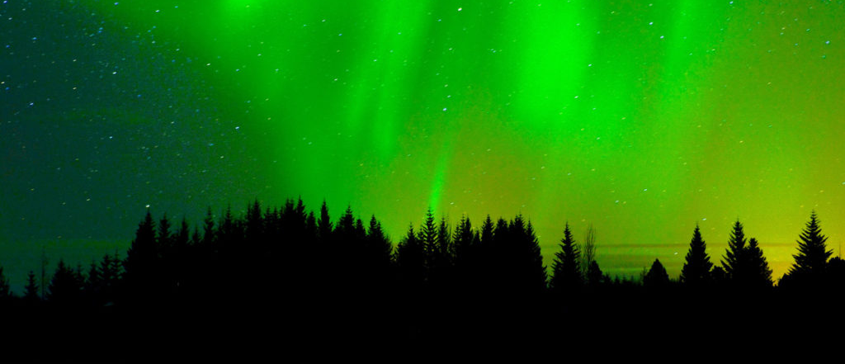
Reflection
DO NOT BE AFRAID,
for it is your Father's pleasure to give you the kingdom. (Luke 12 : 32)
BDES

Slide 5
Preparing for World Youth Day 2027
“Joy is not just for one person, it is for sharing with others.”
- Pope Francis,
World Youth Day, 2023
BDES

Slide 6
BDES

Slide 7
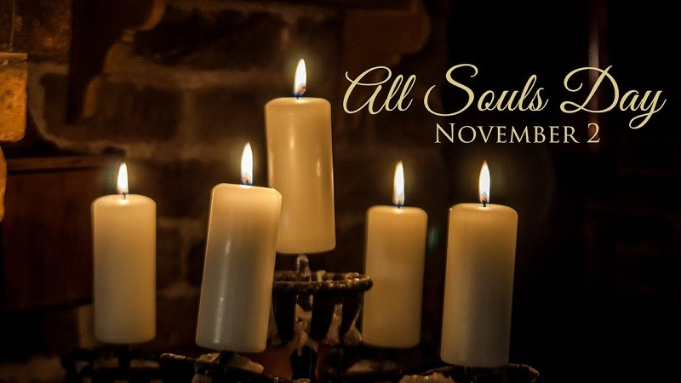
BDES

Slide 8
0
Places of Pilgrimage
ROME – ST PETER’S
The first St Peter’s church was built on the site of the necropolis (cemetery) next to the Circus of Nero on the Vatican Hill, where Jesus’ friend and disciple was martyred. Since its construction in the 16th century, the current St Peter’s Basilica remains one of the most colossal and significant structures in the world. It is home to the world’s largest dome, and houses artwork and sculpture to rival any gallery on the planet. Its greater significance is, of course, spiritual.
The centrepoint of Vatican City State, it is where hundreds of thousands of pilgrims travel every year to attend the public audiences with the Pope, held on the square xxxxxxx in front of the basilica.
BDES

Slide 9
Looking Forward
Monday 3rd July 2023
~ Looking Forward as Carers ~
Monday 30th October 2023
Brentwood Diocese Education Service

