Slide 1
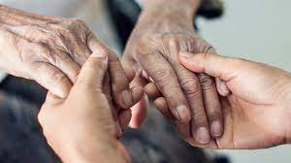
Looking Forward
Monday 3rd July 2023
~ Looking Forward as Carers ~
Monday 6th November 2023
Brentwood Diocese Education Service

Slide 2
Looking Forward As Carers
We pray for all those who look after others as carers, especially those who look after members of their families.
God of all mercies,
sustain those who care for others.
Grant them what they need for the moments ahead.
We ask this through the intercession of
Our Lady of Lourdes,
Amen.
BDES

Slide 3
In Sunday’s Gospel Reading …
Sunday 6th November 2023 :
In the Gospel of Matthew, Jesus teaches us :
“The greatest among you
must be your servant.”
BDES

Slide 4
Reflection
“Do not be afraid, I am the first and the last.” (Revelation 1 : 17)
BDES

Slide 5
Preparing for World Youth Day 2027
“Let us walk in hope, let us be mindful of our roots, and move forwards, without fear.”
- Pope Francis,
World Youth Day, 2023
BDES

Slide 6
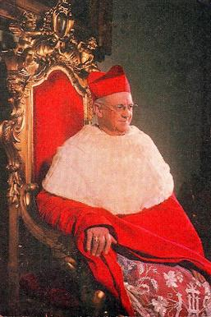
John Carmel Cardinal Heenan
ON 7th NOVEMBER WE REMEMBER THE ANNIVERSARY OF THE DEATH OF CARDINAL JOHN HEENAN, FORMERLY A PRIEST OF OUR DIOCESE OF BRENTWOOD.
John Heenan was born in Ilford, the youngest of four children of Irish parents John and Anne. He auditioned for Westminster Cathedral Choir School aged 9, but was rejected. He studied and was ordained to the priesthood on 6th July 1930.
Father Heenan did pastoral work in Brentwood until 1947, when he became Superior of the Catholic Missionary Society of England and Wales.
On 27th January 1951, Father Heenan was appointed Bishop of Leeds, and on 2nd May 1957 was named Archbishop of Liverpool. On 2nd September 1963 he was consecrated as the eighth Archbishop of Westminster, serving as the spiritual leader of the Catholic Church in England and Wales. He was made a Cardinal by Pope Paul VI in 1965.
Cardinal Heenan died in London, aged 70, and is buried in xxxxxxxx Westminster Cathedral.
BDES

Slide 7
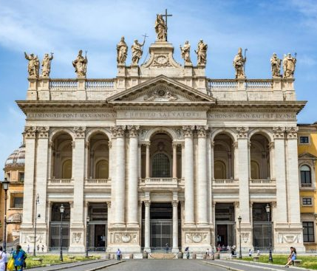
Rome : The Basilica of St John Lateran
“THE MOTHER OF ALL THE CHURCHES OF ROME AND OF THE WORLD”
Most people think that St Peter’s Basilica is the Cathedral of Rome. But …
… it is in fact the Papal Archbasilica of San Giovanni in Laterano, which is the official seat of the Bishop of Rome, in other words His Holiness the Pope.
The Basilica of St. John in Lateran is the oldest of the four main basilicas of the Eternal City. It was first built in the 4th century AD under Constantine, but has been renovated and rebuilt over the centuries by architects such as Domenico Fontana, Giacomo della Porta, Francesco Borromini and Alessandro Galilei. X
xxxxxxxxxxxxxxxxxx This impressive building is topped by a 7-metre statue of Christ, flanked by saints and doctors of the Church.
BDES

Slide 8
Looking Forward
Monday 3rd July 2023
~ Looking Forward as Carers ~
Monday 6th November 2023
Brentwood Diocese Education Service

