Slide 1
Looking Forward
Monday 3rd July 2023
~ Looking Forward as Carers ~
Monday 13th November 2023
Brentwood Diocese Education Service

Slide 2
Remembrance Sunday 12th November 2023
BDES

Slide 3
Looking Forward as Carers
O Lord, we thank you for the wonderful gift of love which allows us to build relationships and communities. We remain ever open to You, the Source of all love. Help us to continue to care for each other and accept each other as we get to know each other better. Make us generous in giving and humble in receiving. Let us forget selfishness and live for each other so that we may have truly one spirit.
BDES

Slide 4
In Sunday’s Gospel Reading
12th November 2023
In the Gospel of Matthew, we hear the cry :
“Lord, open the door for us!”
BDES

Slide 5
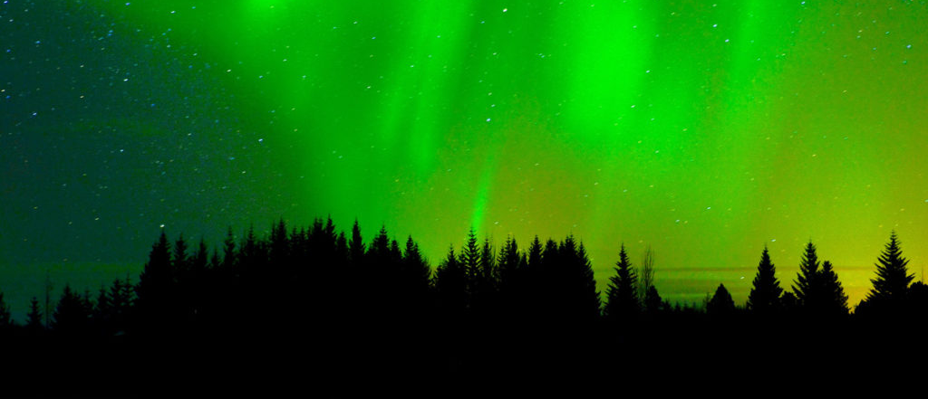
Reflection
DO NOT BE AFRAID,
do not be discouraged, for the Lord will be with you wherever you go. (Joshua 1 : 9)
BDES

Slide 6
Preparing for World Youth Day 2027
“We shine by welcoming Jesus into our hearts and learning to love as He does.”
- Pope Francis,
World Youth Day, 2023
BDES

Slide 7
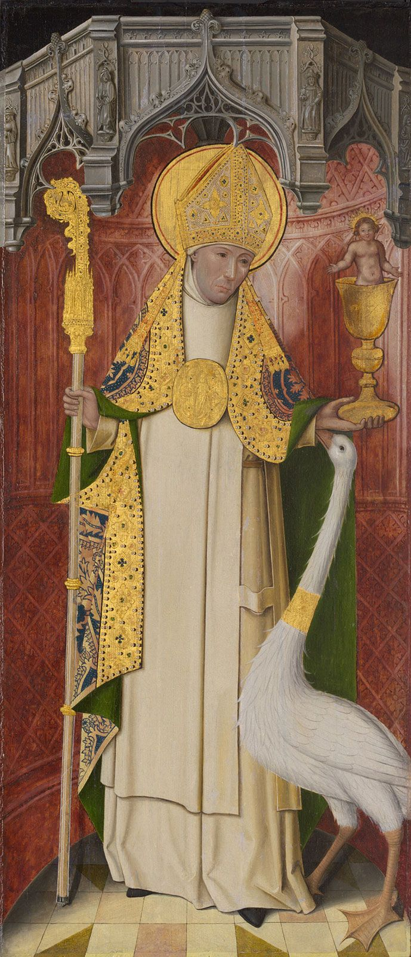
St Hugh of Lincoln 17th November
Like most of the great churchmen who came to England from abroad in the Middle Ages, Hugh of Avalon in Burgundy was a mighty builder. He rebuilt Lincoln cathedral, ruined by the great earthquake of 1185 and is responsible for the four bays of the choir, one of the finest examples of the Early English pointed style. He also began the great hall of the bishop’s palace. St. Hugh’s emblem is a white swan, in reference to the beautiful story of the swan of Stowe which contracted a deep and lasting friendship for the saint, even guarding him while he slept.
BDES

Slide 8
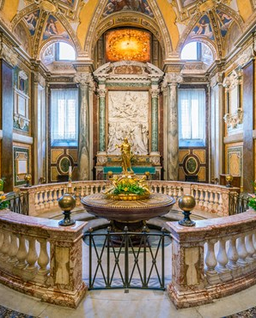
0
Places of Pilgrimage
ROME – ST MARY MAJOR
The Papal Basilica of Santa Maria Maggiore is the largest (‘Maggiore’) of the eighty churches in Rome dedicated to Our Lady. This church was built in 432 by order of Pope Sixtus III on the Esquiline Hill and is one of the seven pilgrim churches and four papal basilicas in Rome. It was built on the site where the Virgin Mary appeared in a dream to Pope Liberius. This is also where a blanket of snow appeared on the hill on 5th August 352 AD in the middle of summer. This day is commemorated every year with white flower petals that are dropped from the ceiling.
BDES

Slide 9
Looking Forward
Monday 3rd July 2023
~ Looking Forward as Carers ~
Monday 13th November 2023
Brentwood Diocese Education Service

