Slide 1
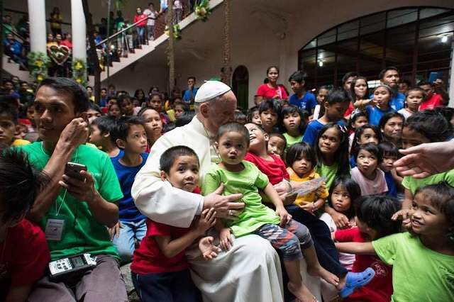
Looking Forward
Monday 3rd July 2023
~ Looking Forward as Carers ~
Monday 20th November 2023
Brentwood Diocese Education Service

Slide 2
Looking Forward As Carers
Generous God,
we lift up to your mercy that poverty
which is a moral and social wound
upon our country’s soul.
In your goodness,
help us to heal this wound
by working to alleviate
the suffering and pain of the poor.
Amen.
BDES

Slide 3
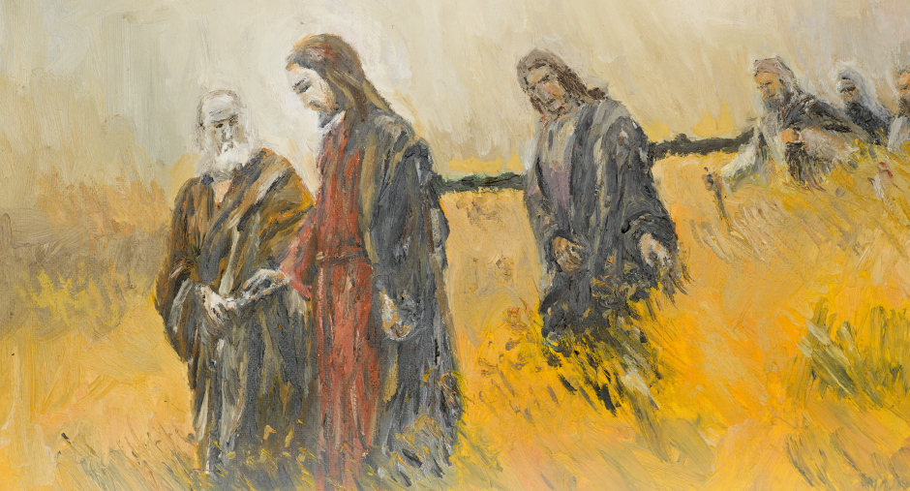
In Sunday’s Gospel Reading …
Sunday 19th November 2023
In the Gospel of Matthew, Jesus tells His friends :
“I will give you
great responsibilities.”
BDES

Slide 4
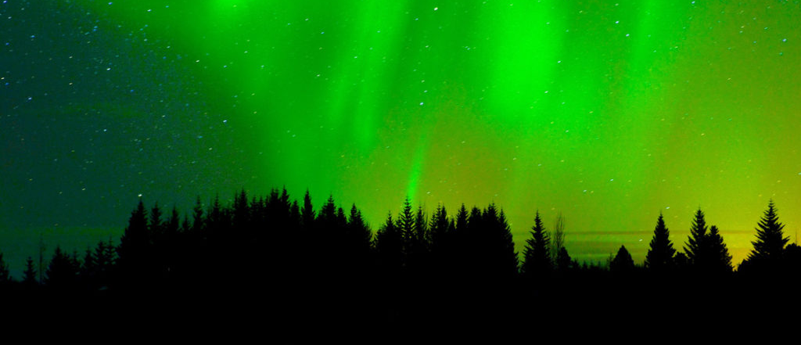
Reflection
“Do not let your hearts be troubled
and do not be afraid.”
(John 25 : 27)
BDES

Slide 5
Preparing for World Youth Day 2027
“Those who love do not stand idly by, but serve others.”
- Pope Francis,
World Youth Day
2023
BDES

Slide 6
The feast of the Presentation of the Blessed Virgin Mary is celebrated on November 21st.
It celebrates the dedication of herself which Mary made to God from her very childhood under the inspiration of the Holy Spirit who filled her with grace.
This magnificent Tintoretto in the church of the Madonna dell’Orto in Venice shows Mary being taken to the Temple in Jerusalem to be dedicated to God; the painting is high on a wall where the viewer is forced by perspective to look up the staircase to see the child xxx Mary ascending.
.
Presentation of the Blessed Virgin Mary
BDES

Slide 7
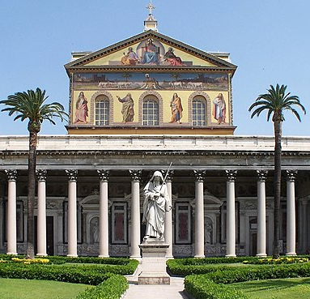
Rome : St Paul Outside the Walls
The Papal Basilica of St Paul Outside the Walls is one of Rome’s four major papal basilicas, along with the basilicas of Saint John in the Lateran, Saint Peter’s, and Saint Mary Major, and as one of the Seven Pilgrim Churches of Rome.
Tradition tells us that the basilica contains the tomb of St Paul and in 2006 it was confirmed that a white marble sarcophagus was present beneath the altar.
In 2009 the Pope confirmed that the bones dated from the 1st or 2nd Century, suggesting they could indeed be the bones of the Apostle.
BDES

Slide 8
Looking Forward
Monday 3rd July 2023
~ Looking Forward as Carers ~
Monday 20th November 2023
Brentwood Diocese Education Service

