Slide 1
Looking Forward
Monday 3rd July 2023
~ Looking Forward as Carers ~
Monday 27th November 2023
Brentwood Diocese Education Service

Slide 2
Looking Forward as Carers
PRAYER FOR A CARING HEART Merciful God, Give me a caring heart. Show me how to attend to the needs of others with gentleness and patience. Make me a healing and comforting presence in their lives. Help me to care for those whose needs are greater than my own - those who hunger and thirst, the imprisoned and the lonely, those without homes or hope. In the name of Your Son, Jesus Christ, model of caring and compassion, I pray.
BDES

Slide 3
Solemnity of Christ the King
26th November 2023
BDES

Slide 4
In Sunday’s Gospel Reading
26th November 2023
In the Gospel of Matthew, Jesus reminds us :
“What you did for one of these least ones, you did for me.”
BDES

Slide 5
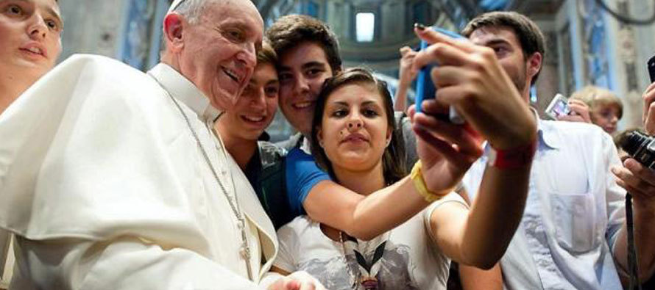
Youth Sunday 2023
BDES

Slide 6
Reflection
You came near when I called on you; you said,
DO NOT BE AFRAID,
(Lamentations 3 : 57)
BDES

Slide 7
Preparing for World Youth Day 2027
“Keep riding the waves of love, of charity. Be surfers of love!”
- Pope Francis,
World Youth Day, 2023
BDES

Slide 8
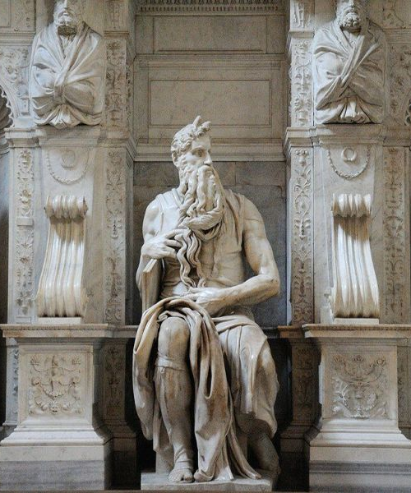
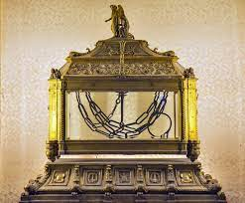
0
Places of Pilgrimage
ROME – ST PETER in CHAINS
San Pietro in Vincoli on Rome’s Oppian Hill is a minor basilica which houses chains believed to be those which held St Peter during his imprisonment in Rome; they are kept in a reliquary beneath the altar.
The church is perhaps best known for Michelangelo’s statue of Moses, part of the tomb of Pope Julius II. Moses is depicted with horns, signifying “the radiance of the Lord”, due to the similarity in the Hebrew words for xxxxxxxxxxx “rays of light” and “horns”.
BDES

Slide 9
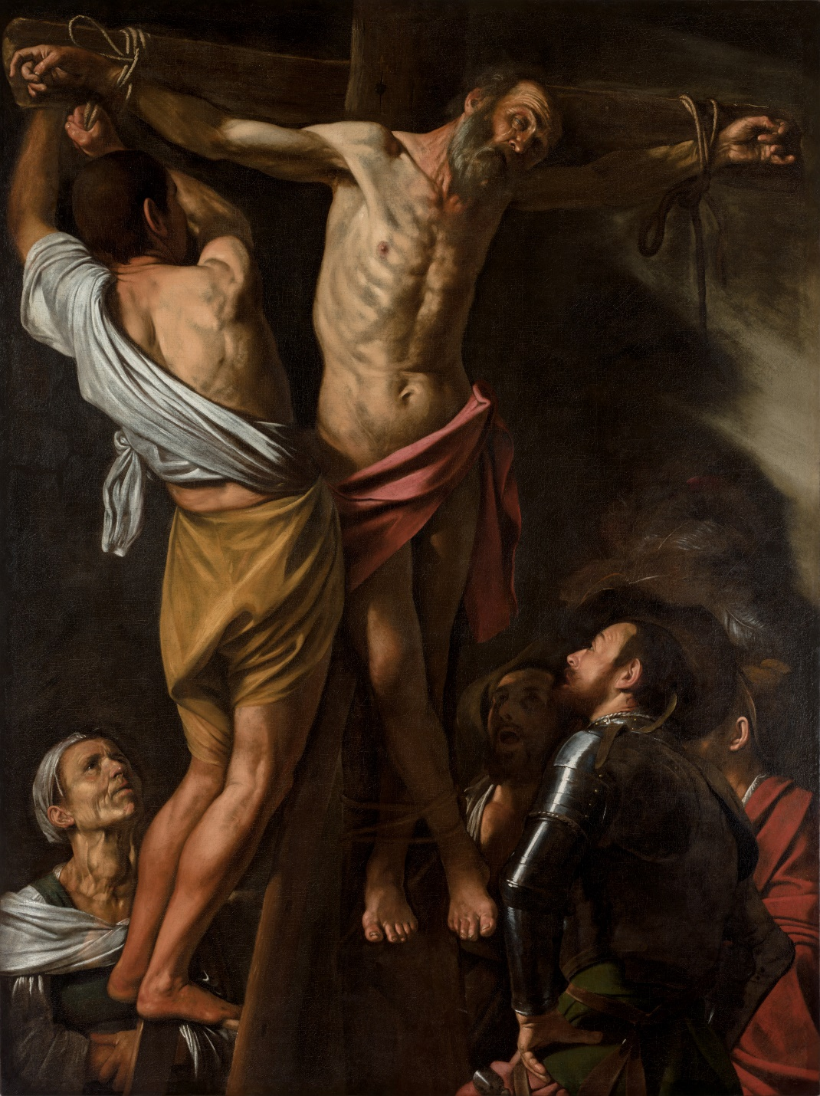
St Andrew’s Day, 30th November
A saint who had that “Get up and go” attitude. An ordinary fisherman, yet he was drawn to become a disciple of John the Baptist and then of Jesus. The Greek Church calls him Protokletos, the “First-Called”. Andrew became an apostle, a missionary and a martyr. He is the patron saint of Scotland and the instrument of his martyrdom, an X-shaped cross, is remembered in the Scottish saltire which is part of the Union Flag.
BDES
Detail of “The Crucifixion of St Andrew” by Caravaggio

Slide 10
Looking Forward
Monday 3rd July 2023
~ Looking Forward as Carers ~
Monday 27th November 2023
Brentwood Diocese Education Service

