Slide 1
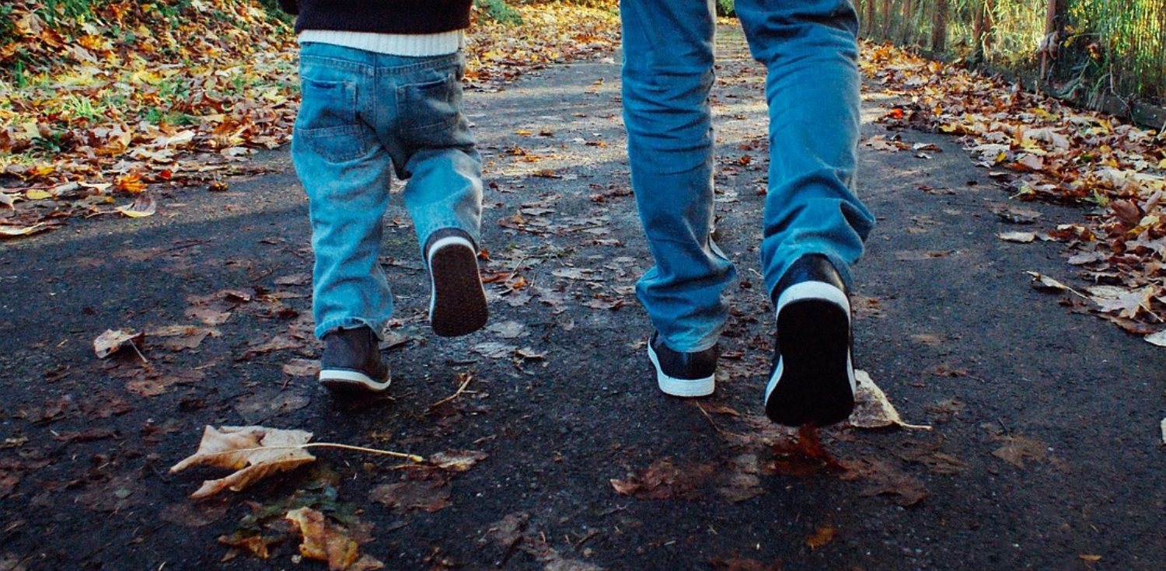
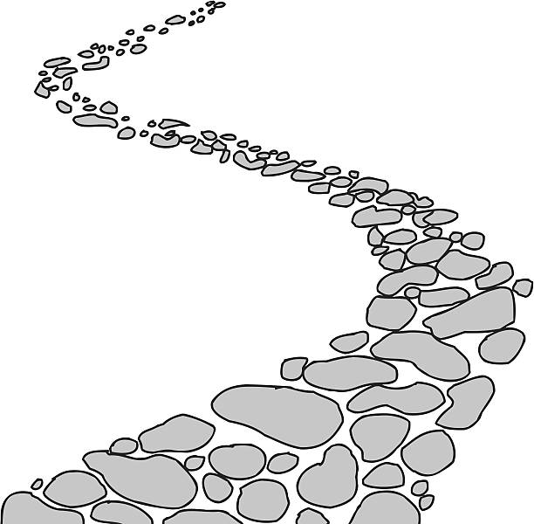
Walking the Path
Monday 3rd July 2023
~ Walking the Path of Generosity~
Monday 4th December 2023
Brentwood Diocese Education Service

Slide 2
Walking the path of generosity
Show me the right path, O Lord;
Point out the road for me to follow.
Lead me by your truth and teach me,
For you are the God who saves me.
All day long I put my hope in you.
Psalms 24: 4 - 5
BDES

Slide 3
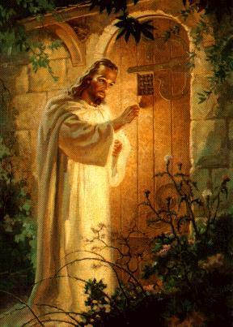
In Sunday’s Gospel Reading …
Sunday 3rd December 2023 :
The Gospel of Mark :
“Be on your guard stay awake.”
BDES

Slide 4
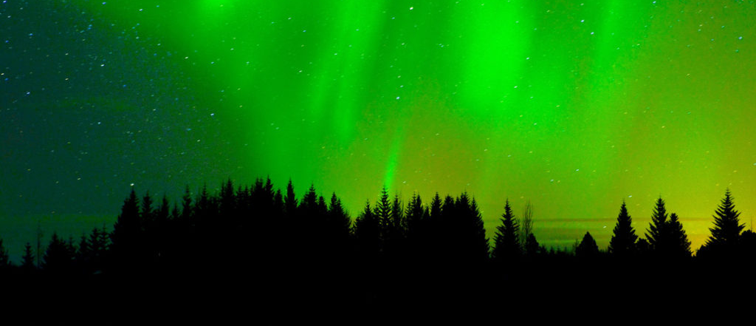
Reflection
“Do not be afraid, for your prayer has been heard.”
(Luke 1 : 12)
BDES

Slide 5
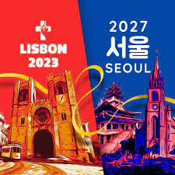
Preparing for World Youth Day 2027
“Jesus is the path
and we are going to walk with
Him.”
- Pope Francis,
World Youth Day, 2023
BDES

Slide 6
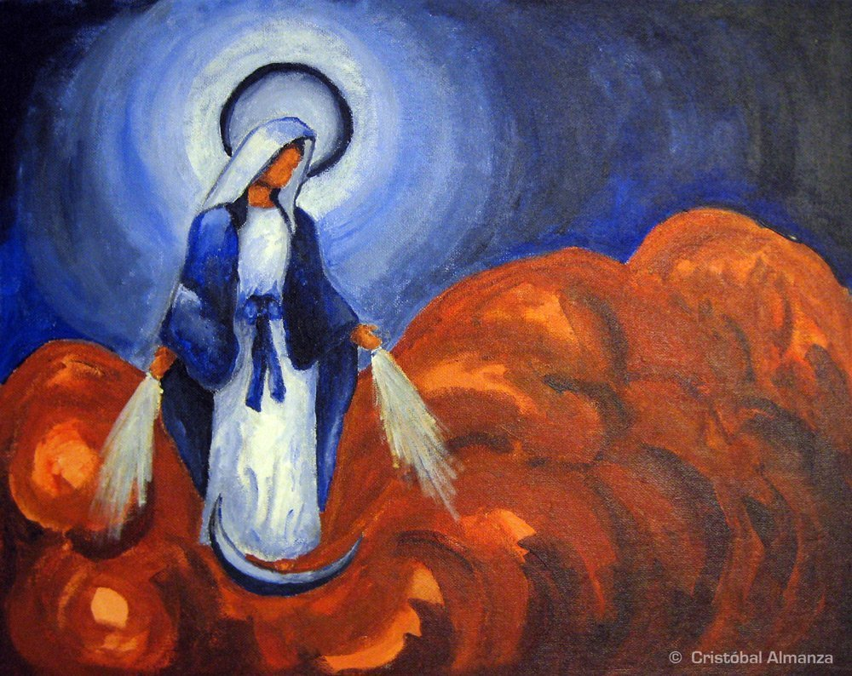
Feast of the Immaculate Conception of the Blessed Virgin Mary
This solemnity is celebrated on December 8th.
It celebrates the purity of the Virgin Mary who was free from original sin.
This grace enabled Mary to say Yes to God who requested, through the Angel Gabriel, that she become the Mother of God.
The liturgical colour for this day is white which is the colour of heaven and is used to celebrate great feasts.
BDES

Slide 7
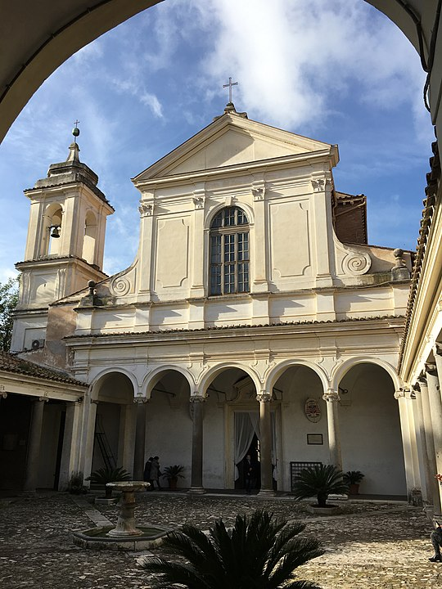
Rome : Basilica of St Clement
The Basilica of Saint Clement
In Italian the Basilica di San Clemente al Laterane.
This basilica began as a private home where Christians worshipped in secret.
It then became a basilica in the 4th Century when it was described as being dedicated to St Clement by St Jerome in 392.
The current basilica was rebuilt in the early 12th Century and today is one of the most richly decorated churches in Rome. It is owned and run by the Irish Dominicans who run a residence for priests studying and teaching in Rome.
BDES

Slide 8
Walking the Path
Monday 3rd July 2023
~ Walking the Path of Generosity~
Monday 4th December 2023
Brentwood Diocese Education Service

