Slide 1
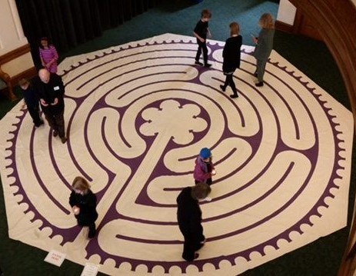
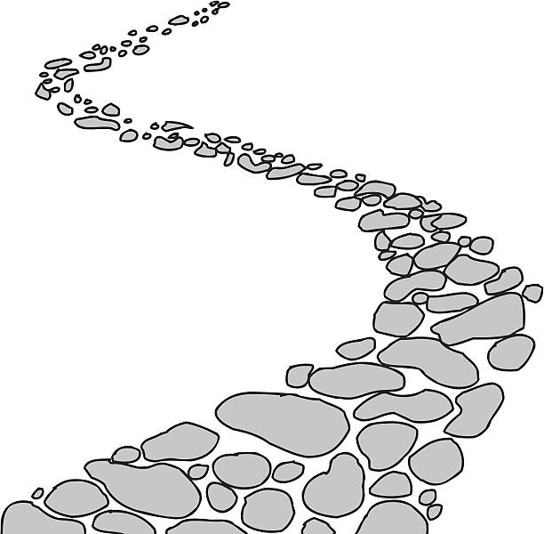

Walking the Path
~ Walking the Path of Generosity~
Monday 11th December 2023
Brentwood Diocese Education Service

Slide 2
Walking the path of generosity
Advent is a penitential season when we should repent of our sin.
Repentance means simply a change of direction, turning around and making a path straight.
We should pray, as prayer opens our hearts to the Holy Spirit.
We then can ask for mercy and forgiveness.
BDES

Slide 3
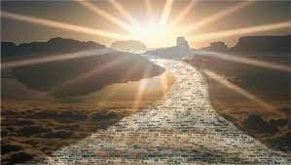
In Sunday’s Gospel Reading …
Sunday 10th December 2023 :
The Gospel of Mark :
“Prepare a way for the Lord.”
BDES

Slide 4
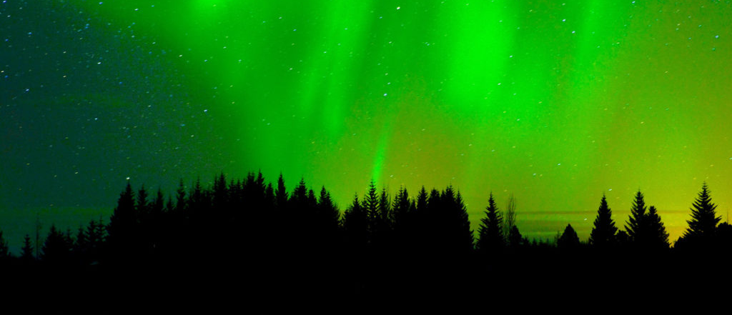
Reflection
“Do not be afraid, you have found favour with God”
(Luke 1 : 30)
BDES

Slide 5

Preparing for World Youth Day 2027
“When He was among us, Jesus walked, healing the sick, caring for the poor, doing justice…”
- Pope Francis,
World Youth Day, 2023
BDES

Slide 6
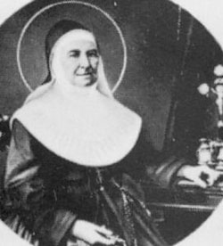
St Maria Rosello: 7th December
Maria Giuseppa Rossello
She was born in 1811 and died on 7 December 1880. She was an Italian religious sister who founded the Daughters of Our Lady of Mercy.
She followed a call to work with the poor and worked in education with the Institute of the Daughters of Our Lady of Mercy a congregation dedicated to bringing the mercy of God into the world.
She worked as the Superior General of the congregation for many years and died at the age of 69.
She was canonised in 1949 by Pope Pius XII
BDES

Slide 7
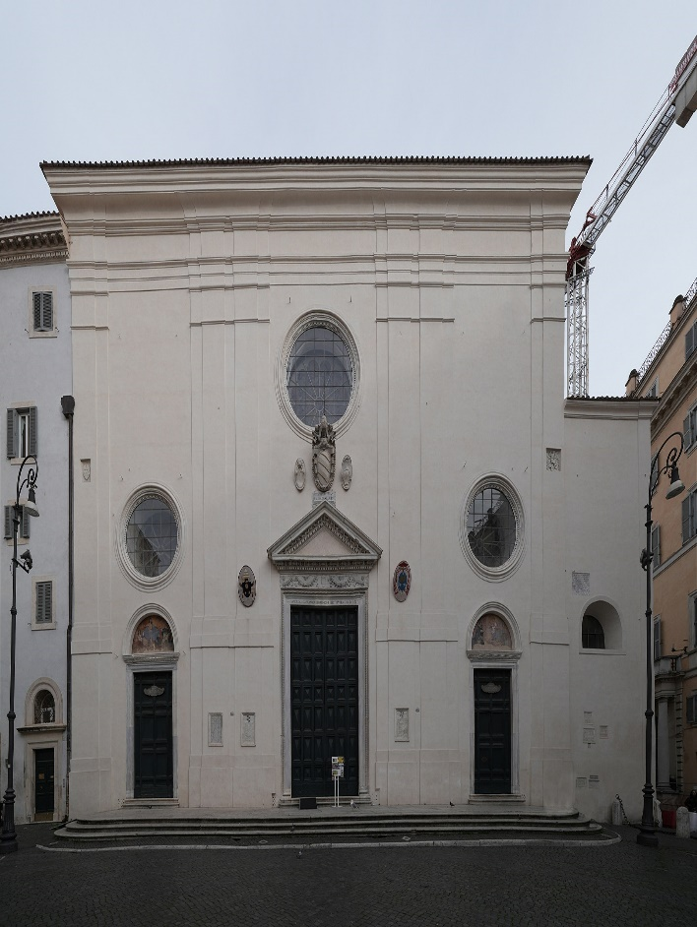
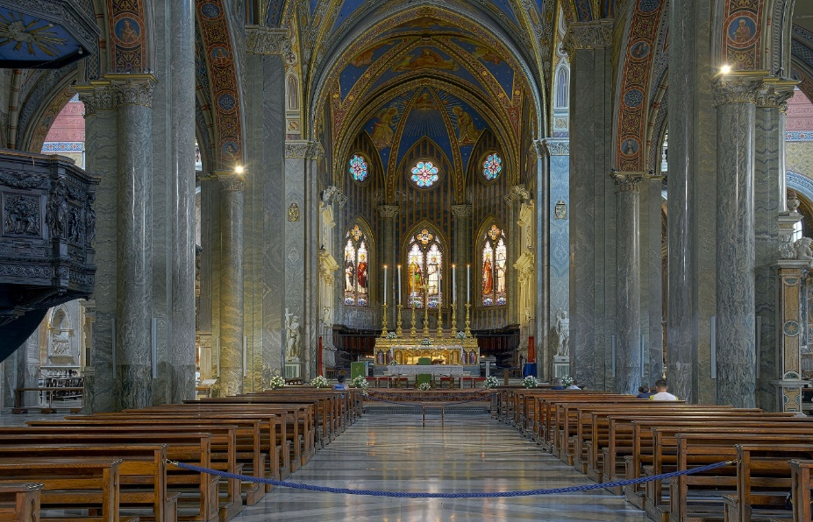
Rome : St Maria Sopra Minerva
St Maria Sopra Minerva
Santa Maria sopra Minerva is one of the major churches of the Order of Preachers (also known as the Dominicans) in Rome.
The church's name comes from the fact that the first Christian church structure on the site was built directly over (Italian: sopra) the ruins or foundations of a temple dedicated to the Egyptian goddess Isis, which had been wrongly thought to be the Greco-Roman goddess Minerva.
The church is located in Piazza della Minerva Rome within the ancient district known as the Campus Martius.
The Minerva is the only surviving example of original Gothic architecture church building in Rome. The interior has arched vaulting that was painted blue with gilded stars and trimmed with brilliant red ribbing in a 19th-century
Neo-Gothic restoration.
BDES

Slide 8
Walking the Path
~ Walking the Path of Generosity~
Monday 11th December 2023
Brentwood Diocese Education Service

