Slide 1
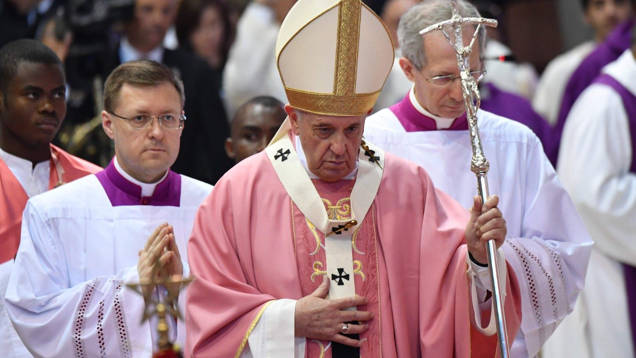
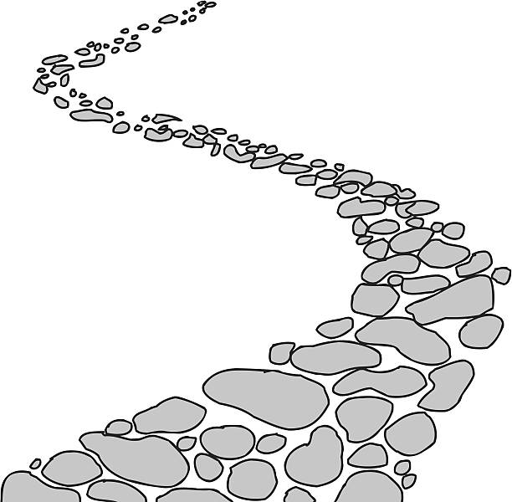
Walking the Path
~ Walking the Path of Generosity~
Monday 18th December 2023
Brentwood Diocese Education Service

Slide 2
Walking the path of generosity
Advent is a penitential season but it is also a season of great joy.
The third Sunday of Advent is Gaudete Sunday when the priest wears pink vestments and the pink candle is lit.
Pink is the colour of joy. In French it is called Rose which suggests the sense of beauty, creation nature and growing.
Joy is another gift of the Holy Spirit.
We should be joyful witnesses to the Gospel.
BDES

Slide 3
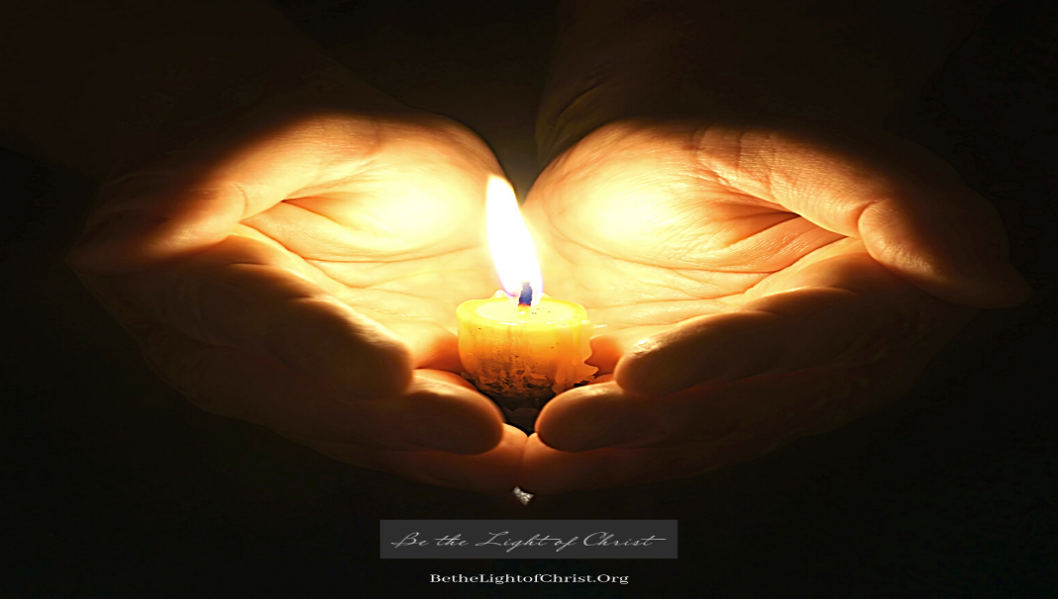
In Sunday’s Gospel Reading …
Sunday 17th December 2023 :
The Gospel of John :
“A witness to speak for the light.”
BDES

Slide 4
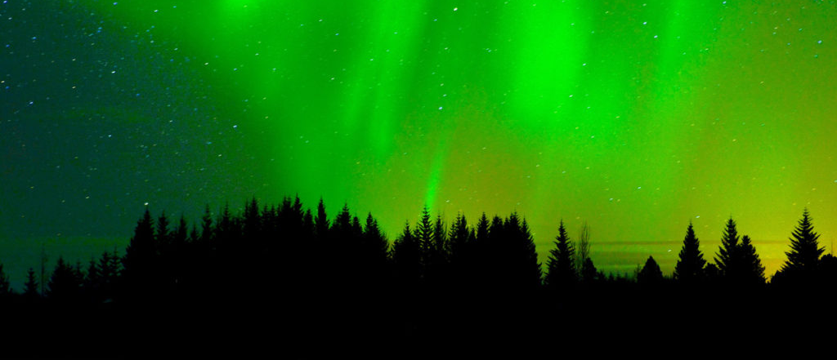
Reflection
“Do not be afraid, for I bring good news of great joy”
(Luke 2 : 10)
BDES

Slide 5
Preparing for World Youth Day 2027
“He walked among us,
preaching and teaching us”
- Pope Francis,
World Youth Day, 2023
BDES

Slide 6
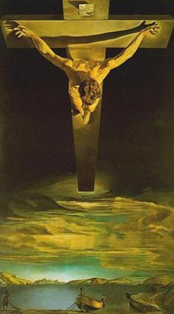
St John of the Cross: 14th December
John of the Cross was a great saint who was a reformer, a mystic and one of the great Spanish poets. He has inspired many other holy men and women to pursue God into the mysterious heights and depths of divine love.
John was born in Spain in 1542.
You might well have seen a print of the popular painting of Christ of St John of the Cross by Salvador Dalí, and wondered at the unusual perspective. St John (1542-1591) sketched a vision he received of Christ on the Cross as though from above, from a heavenly perspective.
BDES

Slide 7
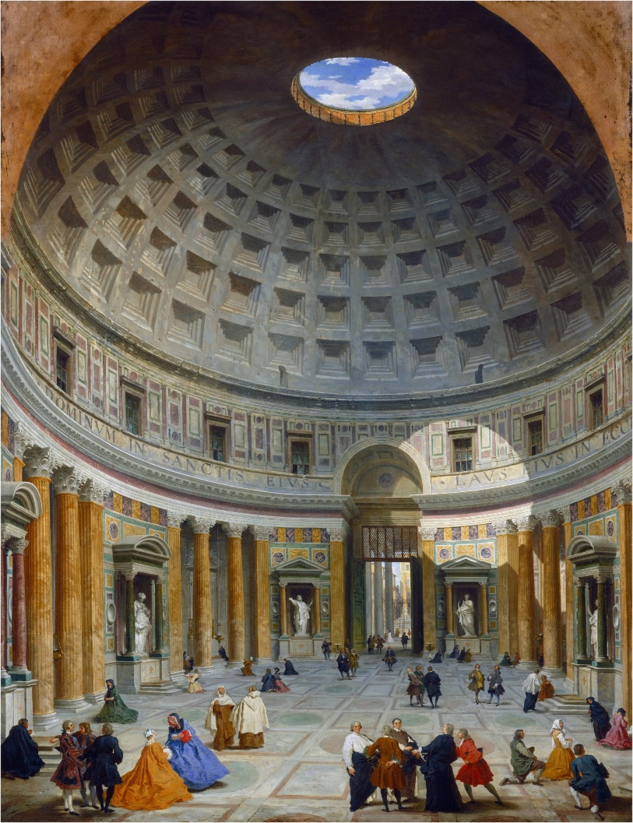
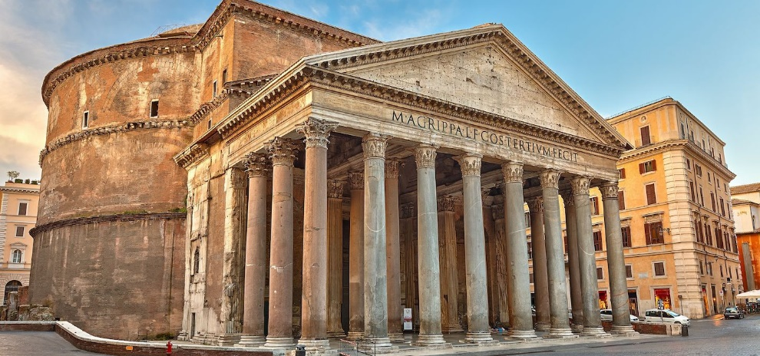
Rome : The Pantheon
Basilica of St Mary and the Martyrs
Basilica Santa Maria ad Martyers is a former Roman temple, hence it is called the Pantheon, which has been a Catholic church since 609AD.
It is one of the best preserved Roman buildings and is known informally as Santa Maria del Rotunda because of its round shape.
The front of the church is a portico with the round building behind it.
The dome is the largest unreinforced concrete dome in the world and has survived for over two thousand years.
BDES

Slide 8
Walking the Path
~ Walking the Path of Generosity~
Monday 18th December 2023
Brentwood Diocese Education Service

