Slide 1
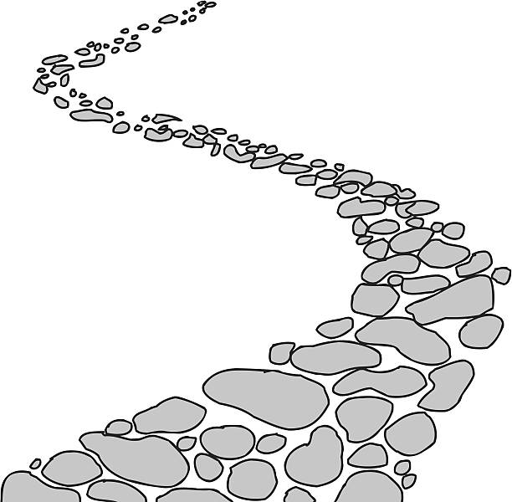
Walking the Path
~ Walking the Path of Gratitude~
Monday 8th January 2024
Brentwood Diocese Education Service

Slide 2
Walking the path of gratitude
Thank you, Lord, for the blessings
you have bestowed on my life.
You have provided me with more
than I could ever have imagined.
You have surrounded me with people
who always look out for me.
You have given me family and friends
who bless me every day
with kind words and actions.
BDES

Slide 3
Solemnity of the Epiphany
BDES
Image source : young-catholics.com

Slide 4
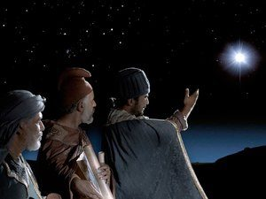
In Sunday’s Gospel Reading …
Sunday 7th January 2024 :
The Gospel of Matthew
tells us that
“They were gladdened
by a very great joy.”
BDES

Slide 5
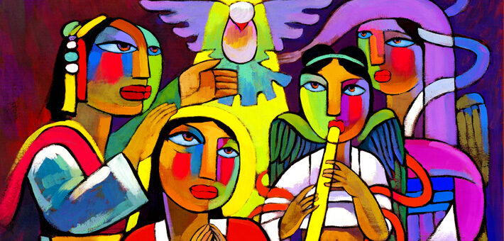
8th January : Feast of the Baptism of the Lord
BDES

Slide 6
Reflection
BDES

Slide 7
Preparing for World Youth Day 2027
“Jesus is the path, and we are going to walk with him.”
- Pope Francis,
World Youth Day 2023
BDES

Slide 8
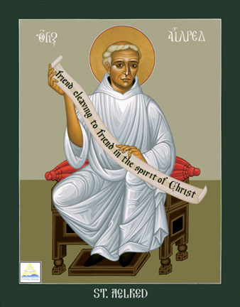
St. Aelred of Rievaulx
Feast day :
12th January
Aelred (1109 – 1167) was born in Hexham and eventually became abbot of the Cistercian abbey of Rievaulx, the imposing ruins of which can still be visited in North Yorkshire. He is the patron saint of friendship. In one of his many writings, the treatise On Spiritual Friendship, he wrote that “God is friendship … he who lives in friendship, lives in God, and God in him” - in this he consciously echoes John 4 : 16, where Jesus says “God is love. Whoever lives in love, lives in God, and God in them.” Aelred viewed Christ as the source of spiritual friendship. Be thankful for friendship!
BDES

Slide 9
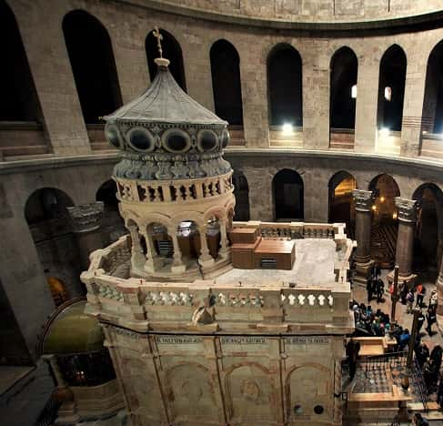
Jerusalem: Church of the Holy Sepulchre
The Aedicule
The Aedicule (from the Latin for “little house”) is a small structure within the Church of the Holy Sepulchre, enclosing the remains of a cave that has been venerated since at least the fourth century A.D. as the tomb of Jesus.
BDES

Slide 10
Walking the Path
~ Walking the Path of Gratitude~
Monday 8th January 2024
Brentwood Diocese Education Service

