Slide 1
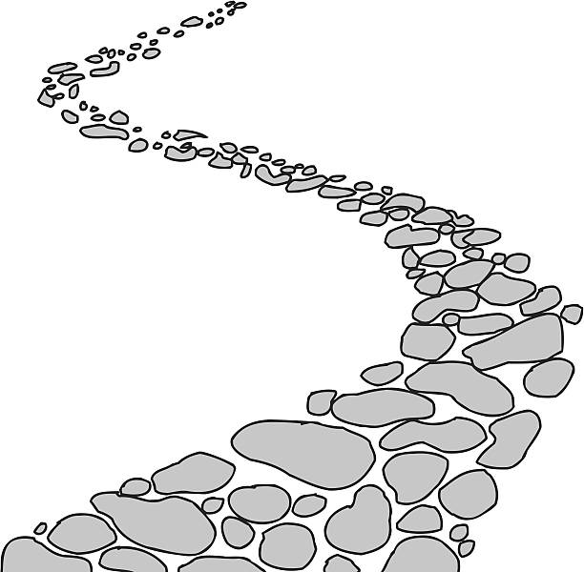
Walking the Path
~ Walking the Path of Gratitude~
Monday 15th January 2024
Brentwood Diocese Education Service

Slide 2
Walking the path of gratitude
For his theme for the World Day of Peace in 2024,
Pope Francis has chosen ‘Artificial Intelligence and Peace’.
This might seem a strangely technical theme, however we need to think about the consequences of the advances in AI for peace and justice.
We need to make sure that a ‘logic of violence and discrimination’ isn’t included in the development of AI at the expense of the most fragile and excluded; that the advancement of AI does not fuel injustice and inequality and conflict, and, of course, that AI is developed so that it serves humanity and the protection of our common home.
BDES

Slide 3
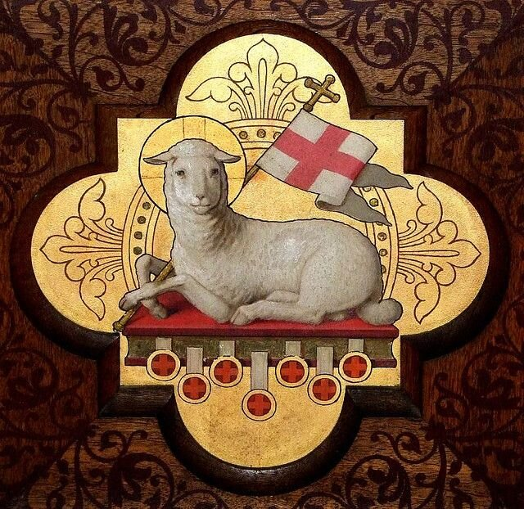
In Sunday’s Gospel Reading …
Sunday 14th January 2024 :
In the Gospel of John,
John the Baptist points to Christ :
“Behold the Lamb of God.”
BDES

Slide 4
Reflection
God our creator and sustainer,
We thank you for the gifts of creativity you have given us, for the ability to explore science and understand your creation.
We ask your forgiveness for the times we have used science for evil and not for good, for war and not for peace.
Make us vigilant as we develop technology,
that violence and discrimination may not take root,
that injustice and inequality will not be fuelled,
that the poor and vulnerable will not pay the cost.
May all that we create contribute to peace and justice.
Amen
BDES

Slide 5
Preparing for World Youth Day 2027
“Cultivate and bear witness to the hope, generosity, and solidarity that we all need”
- Pope Francis,
World Youth Day, 2023
BDES

Slide 6
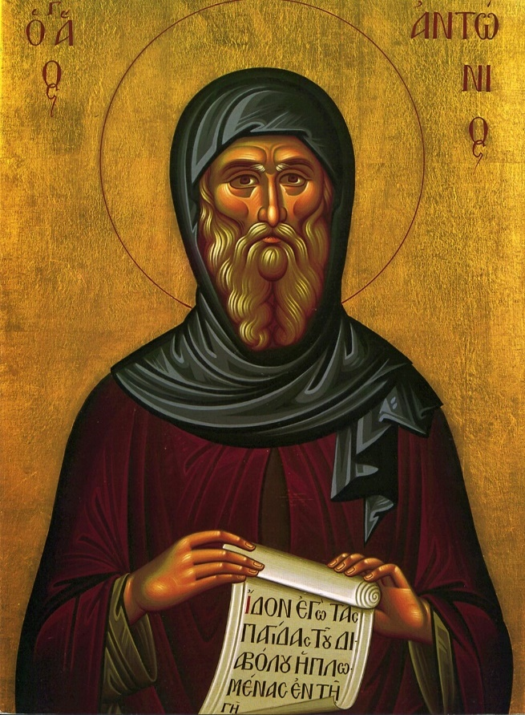
St Antony Abbot : 17th January
Antony was an Egyptian monk who lived a life of great asceticism, avoiding all types of indulgence, and only eating bread, salt and water once a day.
He is thought of as the first monk. He lived by himself for many years and then became the leader of a group of followers whom he organized and instructed. He devoted himself to this for 5 or 6 years before retiring again into solitude. This organisation inspired others and so he is called the father of monasticism.
He lived from 251 to 356 AD and died aged 105.
BDES

Slide 7
Jerusalem: Church of the Holy Sepulchre
Altar of the Crucifixion
The Church of the Holy Sepulchre is believed to include the site of the Crucifixion, the sacred site of Calvary.
The place of the cross is, according to tradition, sited at the eastern end of the nave with a black marble square on each side of the altar, remembering the two thieves crucified with Jesus. Pilgrims can kneel and place themselves under the central altar and reverence the spot where the Cross is said to have been fixed.
This site has been fixed since the time of the Roman Emperor Constantine in 335 AD when the church was first consecrated.
BDES

Slide 8
Walking the Path
~ Walking the Path of Gratitude~
Monday 15th January 2024
Brentwood Diocese Education Service

